Slide 1
Hydraulic calculations

Slide 2
Understanding Hydraulics
Most important aspect of hydraulics is pressure
Pressure in whole systems is the same

Slide 3
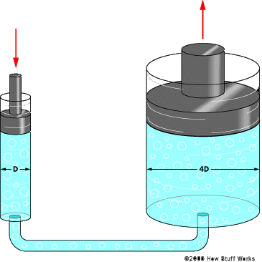
Pressure

Slide 4
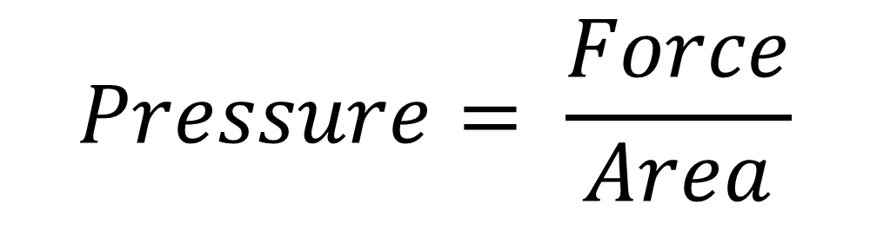
Formula
$$Pressure= \frac{Force}{Area}$$
WHERE…

Slide 5
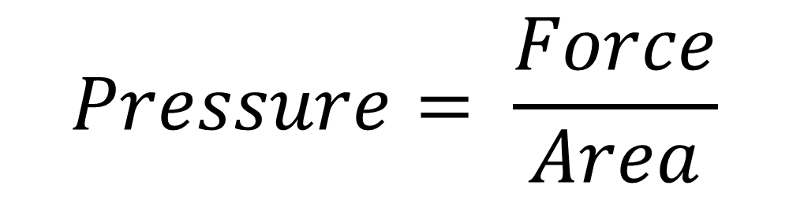
Formula units
Newton (N)
Pascal (Pa)
$$Pressure= \frac{Force}{Area}$$
Square Meters (m²)

Slide 6
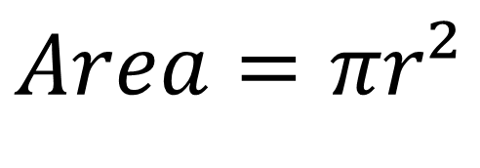
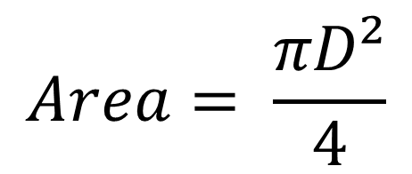
Calculating Area
$$Area= \frac{πD²}{4}$$
OR
$Area=$ $πr²$

Slide 7
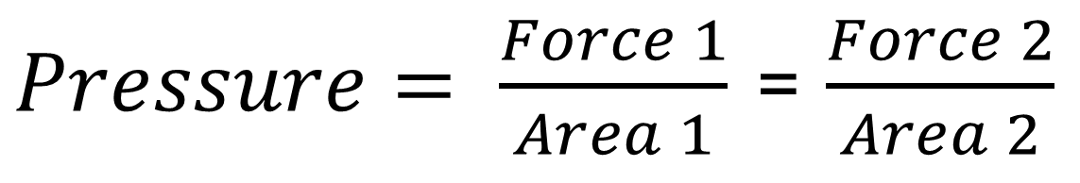
Pressure in hydraulics
$Pressure= \frac{Force 1}{Area 1}$ = $\frac{Force 2}{Area 2}$

Slide 8
Force 2
Force 1
Area 2
Area 1

Slide 9
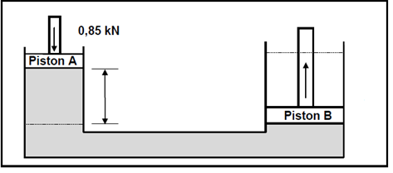
example
A diagrammatical representation of a hydraulic press is shown.
The applied force on piston A is 0,85 kN. The diameter of piston A is 36 mm and the diameter of piston B is 225 mm.

Slide 10
Calculate the pressure in the system.
Calculater the force Piston B can lift

Slide 11
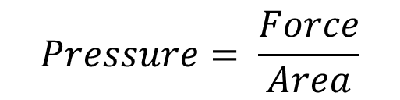
Solution
Apply formula
$$Pressure= \frac{Force}{Area}$$
Have only 1 variable…
First calculate area … ALWAYS CONVERT TO METERS!!!
So … 36mm = 0,036m

Slide 12
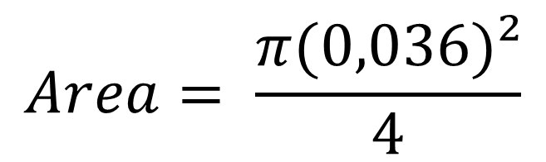
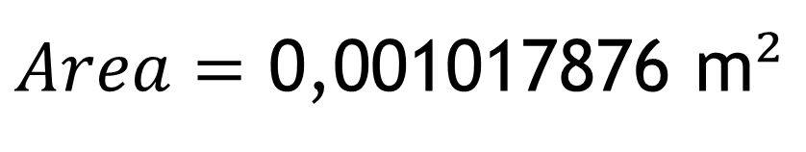
Calculating Area
$$Area= \frac{πD²}{4}$$
$$Area= \frac{π(0,036)²}{4}$$
$Area=$ 0,001017876 m$²$

Slide 13
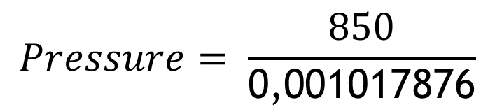
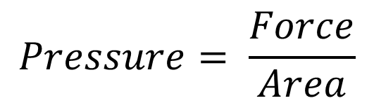
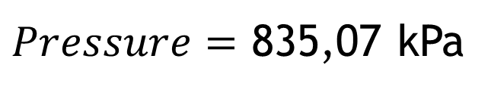
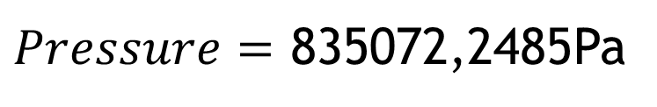
Calculating pressure
$$Pressure= \frac{Force}{Area}$$
$$Pressure= \frac{850}{\text{0,001017876}}$$
$Pressure=$ 835072,2485Pa
$Pressure=$ 835,07 kPa

Slide 14
Calculation force on piston b
Apply formula
$$Pressure= \frac{Force}{Area}$$
Have only 1 variable…
First calculate area … ALWAYS CONVERT TO METERS!!!
So … 225mm = 0,225m

Slide 15
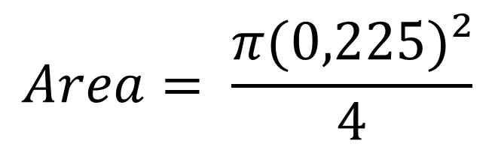
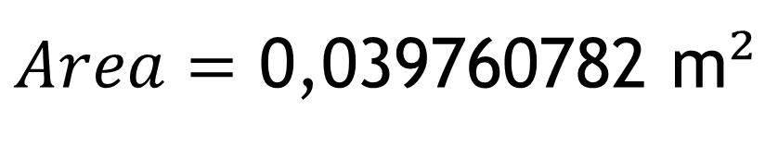
Calculating Area
$$Area= \frac{πD²}{4}$$
$$Area= \frac{π(0,225)²}{4}$$
$Area=$ 0,039760782 m$²$

Slide 16
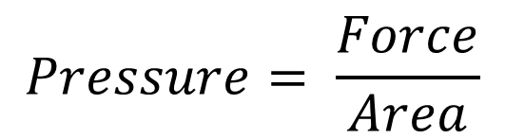
$$Pressure= \frac{Force}{Area}$$
Therefore:
Force = Pressure x Area
Force = 835072,2485 x 0,039760782
Force = 33209,00287 N
Force = 33,21 kN

Slide 17
?

