Slide 1

MATERIALS
Danie van der Westhuizen
SES: Mechanical Technology

Slide 2
Properties of materials
Hardness
Material’s ability to resist penetration, scratching, abrasion, indentation and wear
Brittleness
Material’s behaviour when fractures occur with little or no deformation
Strength
Material’s ability to withstand forces that are applied to it, without breaking, bending, shattering or deforming.

Slide 3
Heat Treatment
It is a word used to describe a process during which the mechanical and physical properties of a metal are changed by heating and cooling it down again.

Slide 4
Mechanical properties
Materials scientists learn about these mechanical properties by testing materials. Some of the important mechanical properties of the metals of the metals are Brittleness, Ductility, Elasticity, Fatigue, Hardness, Malleability, Plasticity, Resilience, Stiffness, Toughness, Yield strength

Slide 5
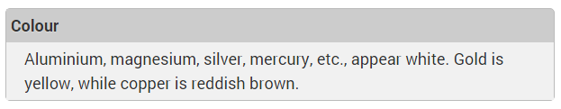
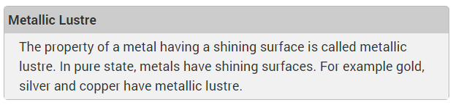
Physical Properties

Slide 6
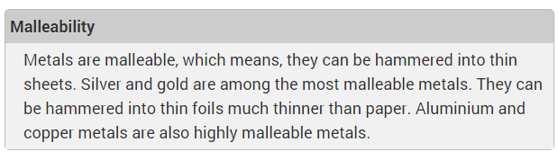
Physical Properties

Slide 7
Types of Heat Treatment
Hardening
Tempering
Annealing
Normalising

Slide 8
Quenching
Quenching in order of speed
Brine (water and salt)
Tap water
Fused or liquid salts
Molten lead
Soluble oil and water
Oil
Air

Slide 9
Critical Temperature
This is the temperature where a phase change, structural change or crystalline structure change takes place.
It greatly depends on the carbon or alloy content

Slide 10
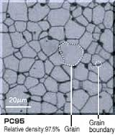
Steel structure
Ferrite
Ferrite is the micro structure of iron or steel which is mostly pure iron or steel and appears light grey or white when etched and viewed under a microscope

Slide 11
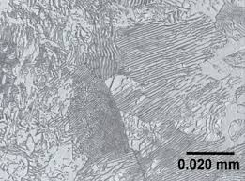
Cementite
When the carbon content rises above 0.83%, the carbon combines with Pearlite crystals to form a very hard combination of cementite crystals.

Slide 12
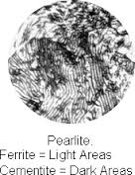
Pearlite
Pearlite is a combination of ferrite and cementite, occurring in alternating layers in the microstructure. It is the type of crystal formed before hardening when the steel contains 0.83% carbon.

Slide 13
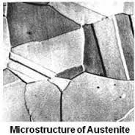
Austenite
This is a solid solution of iron and carbon carbide. The crystal formation is created when the carbon dissolves in the steel crystals to form smaller crystals between the higher and lower critical points

Slide 14
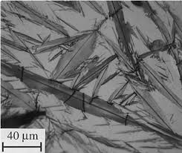
Martensite
This is the structure obtained when austenite is quenched suddenly.

Slide 15
Lower critical point (AC₁)
This is the lowest temperature that must be obtain in order for steel to be hardened.
It is always about 721 °C

Slide 16
Higher Critical point (AC₃)
This is the highest temperature steel can be heated in order to obtain maximum hardness.
Again – depends on the carbon content of steel

Slide 17
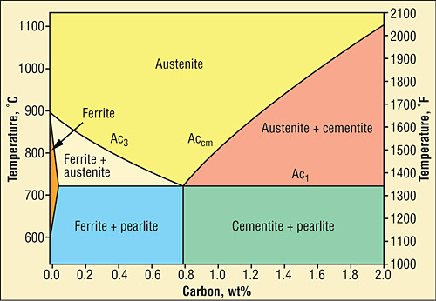
Carbon-Equilibrium Diagram
Pearlite

Slide 18
Changes during hardening
When carbon steels in the fully annealed state is heated, usually to a temperature between 680°C and 720°C, the alternate bands of layers of Ferrite and Cementite form many alternating layers side-by-side.
The Pearlite layers begin to merge into each other.
The temperature at which this occurs is known as the lower critical point (AC₁).
The merging process continues until the Pearlite is thoroughly dissolved, forming Austenite.

Slide 19
Changes during hardening
If the temperature of the steel continues to rise, Pearlite and any excess Ferrite or Cementite will also begin to dissolve into Austenite until only Austenite will be present.
The merging process continues until the Pearlite is completely dissolved to form Austenite.
If the temperature of the steel continues to rise and there is any remaining Ferrite or Cementite present, it will also dissolve until only Austenite is present.
The temperature at which the excess Ferrite or Cementite is completely dissolved into Austenite is called the upper critical point (AC₃).

Slide 20
QUESTIONS??

Slide 21
THANK YOU

