Slide 1

STRESS
Danie van der Westhuizen
SES: Mechanical Technology

Slide 2
Understanding DERIVED units
Unit | Abr. | 10? | 10 x ? | Example
Kilo | k | 10³ | 10x10x10 | 3651,4Pa = 3,65 x 10³ Pa = 3,65kPa
Mega | M | 10⁶ | 10x10x10x10x10x10 | 3651459,3Pa = 3,65 x 10⁶ Pa = 3,65MPa
Gega | G | 10⁹ | 10x10x10x10x10x10x10x10x10 | 3651459316,3Pa = 3,65 x 10⁹ Pa = 3,65GPa
Tera | T | 10¹² | 10x10x10x10x10x10x10x10x10x10x10x10 | 3651459316356,3Pa = 3,65 x 10¹² Pa = 3,65TPa

Slide 3
Calculating Young’s Modulus
Calculating Young’s Modulus consist of three different calculations:
Stress
Strain
And the Young’s Modulus

Slide 4
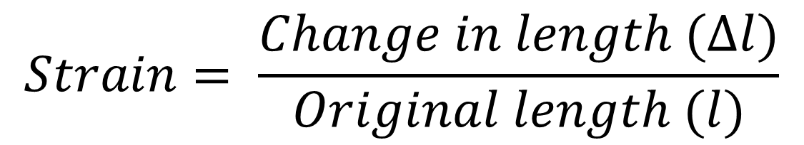
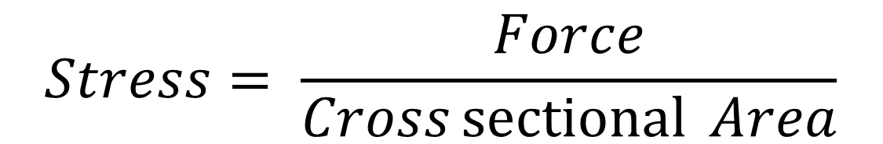
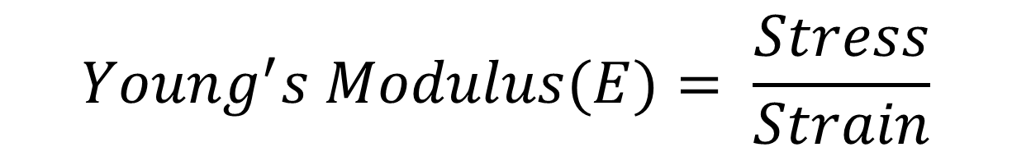
The Formulas…
$$Stress= \frac{Force}{Cross\operatorname{sectional}{Area}}$$
$$Strain= \frac{Change in length (∆l)}{Original length (l)}$$
$$Young^{′}s Modulus(E)= \frac{Stress}{Strain}$$

Slide 5
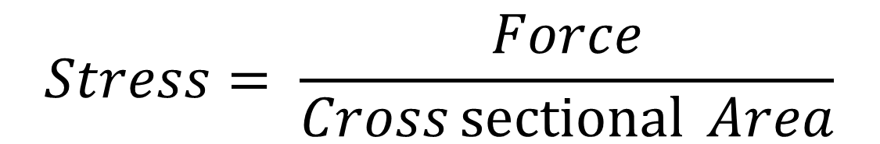
Understanding the Formula
$$Stress= \frac{Force}{Cross\operatorname{sectional}{Area}}$$

Slide 6
Units of the Formula
Pascal - Pa
Newton - N
$$Stress= \frac{Force}{Cross\operatorname{sectional}{Area}}$$
Square Meters – m²

Slide 7
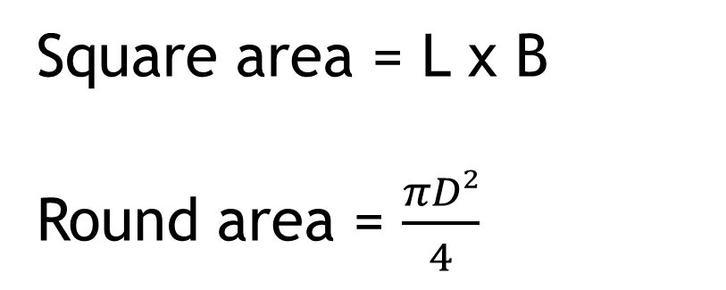
Understanding Area
Square area = L x B
Round area = $\frac{πD²}{4}$

Slide 8
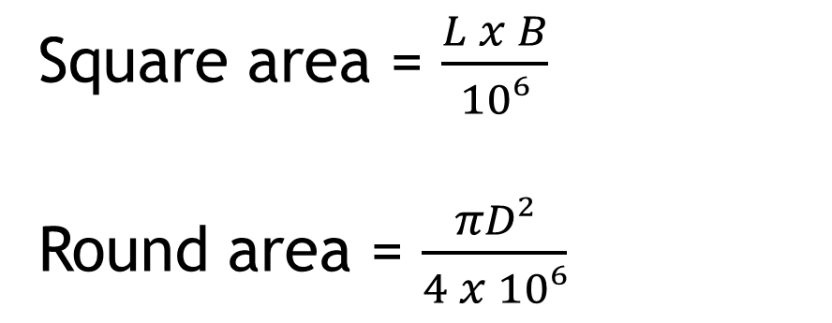
But ….
Area is measured in square meters and in engineering we measure in millimters, so to convert meter to millimeters we devide by 10⁶ , therefor…
Square area = $\frac{L x B}{10⁶}$
Round area = $\frac{πD²}{4 x 10⁶}$

Slide 9
But why 10⁶
1m
1 000mm
1m
1 000mm
1 000 x 1 000 = 1 000 000 or 10⁶

Slide 10
Example…
A 𝝓 32 mm round bar lengthens by 0.5mm in a tensile test under a load of 100kN.
Calculate Young’s modulus for the bar if its original length was 120 mm.

Slide 11
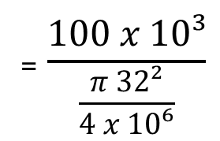
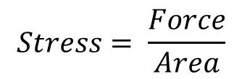
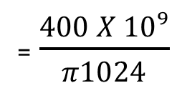
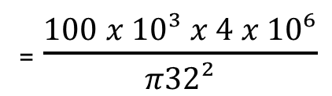
Calculating Stress…
$$Stress= \frac{Force}{Area}$$
PROBLEM – Fraction within a fraction – can not be
= $\frac{100 x 10³}{\frac{π 32²}{4 x 10⁶}}$
= $\frac{100 x 10³ x 4 x 10⁶}{π32²}$
= $\frac{400 X 10⁹}{π1024}$
= 124 339 799,3 Pa
= 124,34 MPa

Slide 12
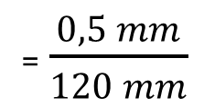
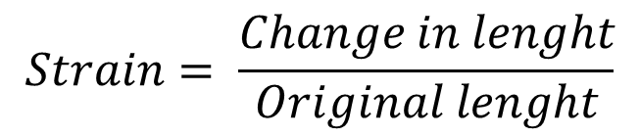
Calculating Strain…
$$Strain= \frac{Change in lenght}{Original lenght}$$
= $\frac{0,5 mm}{120 mm}$
= 0,00416

Slide 13
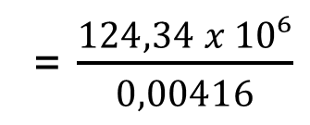
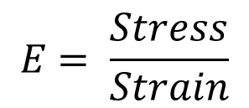
Calculating Young’s Modulus
$$E= \frac{Stress}{Strain}$$
= $\frac{124,34 x 10⁶}{0,00416}$
= 29 889 374 830 Pa
= 29,89 GPa

Slide 14
Calculating Stress in a Square bar
A square steel bar with 100 mm x 100 mm sides is subjected to a compressive force of 80 kN. Determine, by means of calculations, the Stress in the material:

Slide 15
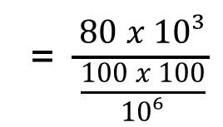
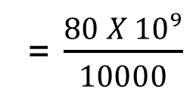
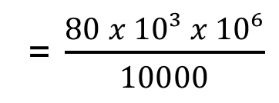
Calculating Stress…
$$Stress= \frac{Force}{Area}$$
PROBLEM – Fraction within a fraction – can not be
=$\frac{80 x 10³}{\frac{100 x 100}{10⁶}}$
= $\frac{80 x 10³ x 10⁶}{10000}$
= $\frac{80 X 10⁹}{10000}$
= 8 000 000 Pa
= 8 MPa

Slide 16
Questions ??

Slide 17
Thank You

