Slide 1
GAUTENG DEPARTMENT OF EDUCATION SEDIBENG EAST/WEST & GAUTENG EAST Subject Meeting Mechanical Technology Specialization Automotive; Fitting & Machining; Welding & Metalwork
23/24 January 2024– 14:30

Slide 2
AGENDA
Welcome and Register.
Statistics for GDE.
2023 NSC Examinations
Management Plan
Curriculum delivery and ATP completion
School visits and Support
Administration and Planning
Roadshows
Mark Sheets
Assignment and Baseline assessments.
Term 1 Formal Assessment.
Informal assessments.
PAT
Registers.
Training.
PLC
Website
Questions

Slide 3
Welcome and Register
Welcome to 2024
Register via QR code – Google Forms
Please complete BEFORE 16:00 – register lock after 16:00

Slide 4
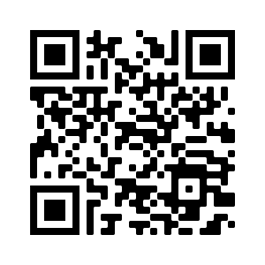
QR Code for register
https://forms.gle/qgBZYjy42v1P486N6

Slide 5
Statistics for GDE
17 January to 20 March
Curriculum coverage statistics for GDE
Update EVERY two weeks.
Link will be emailed and send via WhatsApp.
First update due 26th of January 2024
Google forms – Teacher profiles needs to be updated yearly.
Will send link by end of week.

Slide 6
2023 NSC Examinations – SEDIBENG EAST/WEST & GAUTENG EAST
Thank you for all your hard work and efforts in 2023!
Total of 8 distinctions across all three specialisations in the three districts + Hans Moore!
Gauteng total = 24 for all three specialisations, where:
> Automotive = 12
> Fitting & Machining = 24
> Welding & Metalwork = 3
Schools with large numbers obtained distinctions.

Slide 7
DISTRICT RESULTS - Average
Specialisation | SE | SW | GE | EN
Fitting & Machining | 37.8 | 53.1 | 52.8 | 52.9
Automotive | 42.2 | 33.1 | 58 | =
Welding & Metalwork | 36.1 | 33.4 | 42 | =

Slide 8
DISTRICT RESULTS – Pass Rates
Specialisation | SE | SW | GE | EN
Fitting & Machining | 87.5 | 98 | 100 | 100
Automotive | 96 | 81.2 | 100 | =
Welding & Metalwork | 92.8 | 81.5 | 85 | =

Slide 9
Automotive
3/5 Schools obtained 100% pass rate.
Total of 3 distinctions (GDE = 12)
HTS Springs – 2
HS Die Anker – 1
2/5 Schools obtained above 50% subject average.
CONGRATULATIONS!

Slide 10
RESULTS
District Name | Centre Name | % Achieved 30-100% | Distinctions | Subject Ave %
GAUTENG EAST | HOERSKOOL DIE ANKER | 100 | 1 | 64.92
GAUTENG EAST | SPRINGS TECHNICAL SCHOOL | 100 | 2 | 51.02
SEDIBENG EAST | GENERAL SMUTS HIGH SCHOOL | 100 | 0 | 42.30
SEDIBENG EAST | THUTO LORE SECONDARY SCHOOL | 92 | 0 | 42.05
SEDIBENG WEST DISTRICT | HOER TEGNIESE SKOOL CAREL DE WET | 81.25 | 0 | 33.10

Slide 11
Fitting & Machining
10/12 Schools obtained 100% pass rate.
Total of 5 distinctions (GDE = 24)
8/12 Achieved above 50% subject average.
GE – 4
SW – 1

Slide 12
Fitting & Machining
Springs Boys High School – 1
Springs Technical High School – 1
HS Transvalia – 1
HS John Vorster – 1
Laban Motlhabi Comp School – 1
CONGRATULATIONS!

Slide 13
RESULTS
District Name | Centre Name | % Achieved 30-100% | Distinctions | Subject Ave %
SEDIBENG WEST DISTRICT | HOERSKOOL TRANSVALIA | 100.00 | 1 | 62.00
SEDIBENG WEST DISTRICT | THUTO-TIRO COMP SCHOOL | 100.00 | 0 | 56.03
GAUTENG EAST | SPRINGS TECHNICAL SCHOOL | 100.00 | 1 | 55.83
GAUTENG EAST | SPRINGS BOYS HIGH SCHOOL | 100.00 | 1 | 53.79
GAUTENG EAST | HOERSKOOL DIE ANKER | 100.00 | 0 | 53.44
EKURHULENI NORTH | HOERSKOOL HANS MOORE | 100.00 | 0 | 51.59
GAUTENG EAST | HOERSKOOL JOHN VORSTER | 100.00 | 1 | 50.50
GAUTENG EAST | LABAN MOTLHABI COMP SCHOOL | 100.00 | 1 | 50.38
SEDIBENG WEST DISTRICT | SIZANANI THUSANANG COMP SCHOOL | 100.00 | 0 | 49.50
SEDIBENG WEST DISTRICT | HOER TEGNIESE SKOOL CAREL DE WET | 92.31 | 0 | 45.00
SEDIBENG EAST | GENERAL SMUTS HIGH SCHOOL | 100.00 | 0 | 42.92
SEDIBENG EAST | PHOENIX HIGH SCHOOL | 75.00 | 0 | 32.69

Slide 14
Welding & Metalwork
1/7 Schools obtained 100% pass rate.
Total of 0 distinctions (GDE = 3)
0/7 Schools obtained above 50% subject average.
CONCERNING!

Slide 15
RESULTS
District Name | Centre Name | % Achieved 30-100% | Distinctions | Subject Ave %
GAUTENG EAST | PROTEASKOOL / SCHOOL | 85.71 | 0 | 45.88
GAUTENG EAST | LABAN MOTLHABI COMP SCHOOL | 88.89 | 0 | 44.32
GAUTENG EAST | MAMELLONG COMPREHENSIVE | 92.31 | 0 | 41.38
SEDIBENG WEST DISTRICT | HOER TEGNIESE SKOOL CAREL DE WET | 100.00 | 0 | 36.60
GAUTENG EAST | SPRINGS TECHNICAL SCHOOL | 73.33 | 0 | 36.39
SEDIBENG EAST | THUTO LORE SECONDARY SCHOOL | 92.86 | 0 | 36.13
SEDIBENG WEST DISTRICT | THUTO-TIRO COMP SCHOOL | 62.96 | 0 | 30.26

Slide 16
IMPORTANT TO REMEMBER
Previous examination papers NB!!!!!
PLANNING!
Proper PAT tasks!
OWN Pat tasks!
Quality Assessments – March / June assessments
Informal assessments.
RESULT IN EXCELLENT PASS RATES!

Slide 17
To each and every educator who worked very hard.
By placing the interest of the learner first.
For your dedication to the subject

Slide 18
Management Plan
Management plan for school visits had been sent with email.
School visits to start 22 January 2024.
GDE / DBE responsibilities – will inform in due time if any changes will occur in management plan for school visits.
Next SUBJECT MEETING – 4 March 2024 – SE/SW
– 5 March 2023 – GE

Slide 19
Curriculum delivery and ATP completion
Educators do not teach all content – last year found whole topics missing!
Teach according to Revised ATP 2023/24vcontent for Grade 10 and 11.
Grade 12 – NO trimming of ATP!
ATP’s with % available on website for downloading.
SBA moderation in 2023 clearly showed educators did NOT USE the ATP’s with the allocated percentages.
H.O.D.’s to monitor ATP’s EVERY two weeks.
Curriculum behind – need to show strategies for catching UP!
Registers to be kept on ANY type of extra class.

Slide 20
SCHOOL VISITS AND SUPPORT
PLC support important – USE MS Teams or face-to-face.
If needed – I will arrange Teams meetings for educators and download registers.
Give support, but educators DO NOT implement support strategies and suggestions in order to make teaching and curriculum delivery more effective.
Email or WhatsApp if support is needed – concerning that only a few do this.
Upon visits – “I did not know” or “I did not understand” – Serious implication on quality teaching.
Support visits – monitor class teaching and teaching methods.

Slide 21
ADMINISTRATION and PLANNING
SBA and PAT files – separate
Teacher files – Table of content visible with content updated.
PAT files with mark sheets.
NO test/exam may leave the school premises.
NO PAT task to leave school premises.
Proper planning MUST be available for verification on school visit
Planning – WHAT / WHEN / HOW teaching is going to take place WITH ALL specified assessments included in planning
ATPs to be kept updated daily!

Slide 22
Moderation colour pens – Post moderation
School level – Green pen
District level – Orange pen
Provincial level – Pink pen

Slide 23
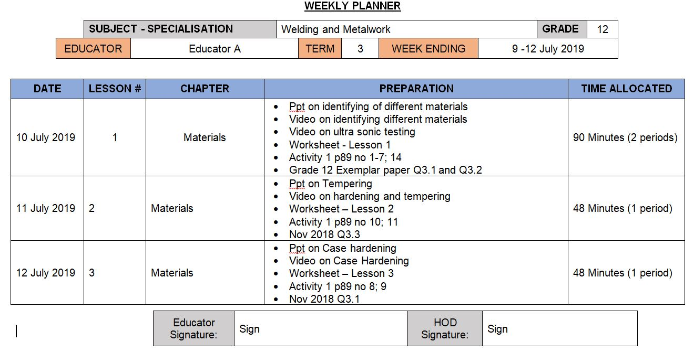
Complete Weekly Planner

Slide 24
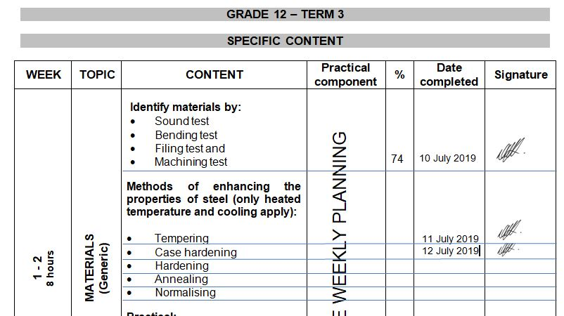
Complete ATP

Slide 25
Grade 12 Roadshows
Will be held on MS Teams from 12 – 14 February 2024
CONCERN – Absence from educators in 2023…..
PAT MEDIATION – ALL SPECIALISATIONS
ALL educators to attend.
Teams platform – TBC – will inform after 31 Jan on dates.
Time: 14:30 – 16:30
Grade 10 – 12 PAT to be discussed.
EACH Specialisation separate.
HOD to choose which to attend as all will be discussed same time due to time constraints.

Slide 26
Mark sheets
Composite Mark sheet:
Mark sheet is available on the website for download.
New weightings for Grade 10/11 on Pat in Term 2 and 3.
Use Phase 4 for Phase 2 and Phase 2 for Phase 4 on SASAMS.
PAT mark sheets in PAT documents.
Excel spread sheets are available on website for download (Grades 10 and 11).

Slide 27
Assignment and Baseline assessments
Grade 10/11 Assignment – formal assessment
Develop OWN assignment – same format as 2023, just own content.
H.O.D. To MODERATE!!
Term 1 SBA mark

Slide 28
Baseline assessments
Baseline assessment to be conducted for Grade 11 and 12 BEFORE EACH TOPIC!
Baseline assessment proof be available on school visits.
Requirement now from DBE Curriculum.
Determine content knowledge carried over from 2023.
Shortcomings in content knowledge to be addressed in teaching and lessons.

Slide 29
Term 1 Formal Assessments – Grade 12
Grade 12 – TEST – 60 minutes.
Grade 12 Guideline in pre-moderation tool.
NO 2 or 3 different tests and then add to make 50!
Set own tests.
H.O.D. To MODERATE!!
Term 1 SBA mark
ONLY work done in Term 1 to be assessed.
DO NOT accept average of below 50%!

Slide 30
Informal assessments
Informal assessment MUST be done.
Grade 10/11 can previous exam/test papers be used as extra assessments/homework
Grade 12 – NB!!! – Use last 5 NSC papers as top-up to informal assessments given to candidates.
Informal assessments to be done in learners books.
H.O.D. To monitor informal assessments
GDE will monitor informal assessments and must report back to DBE on amount and progress of informal assessments.
When learners are at home – assignments / research tasks to be given and must be monitored / checked by educators on return.
Poor 2023 SBA marks – shows CLEARLY lack of informal assessments!

Slide 31
PAT Tasks
PAT tasks on website for download.
Mediation on ALL PAT will be conducted on M’S Teams and dates to be announced..
Guidelines and requirements will be clearly indicated in mediation.
HOD’s to monitor PAT progress.
OWN Pat tasks COMPULSARY!

Slide 32
Registers
Daily class attendance registers MUST be kept! – It is policy!
Record must be kept of Grade 12 learners being absent.
H.O.D. and parents to be kept up to date with learners being absent if no valid reason has been provided to the school.
Catch-Up plan for leaners WHO was absent with valid reasons.
EXCEL Register available on website for use.
Stock registers MUST be updated – especially where new equipment, tool and material being delivered.
GDE to monitor asset registers.

Slide 33
TRAINING
Training service providers has not been appointed as yet.
Head Office meeting on 31 January.
27 January CANCELLED
17 February – Phase 1
24 February – Phase 2
2 March – Phase 3
16 March – Phase 4
Dates communicated in 2023 to all approved by unions – Focus on 2024 PAT tasks
Venues will be communicated after 31 January.
If any changes occur – educators will be informed in due time.

Slide 34
PLC
Imperative for professional development!
Need Agenda and register for Head Office.
All educators need to engage in PLC meetings – GDE requirement.
If needed – will arrange Teams meeting should educators want to.
Inform me in due time!

Slide 35
Website
www.mtechedusupport.co.za
For your support!

Slide 36
SOME THOUGHT

Slide 37
Questions
?
Please raise

