Slide 1

GAUTENG DEPARTMENT OF EDUCATION
SEDIBENG EAST/WEST
& GAUTENG EAST
Subject Meeting
Mechanical Technology Specialization
Automotive; Fitting & Machining; Welding & Metalwork
GE/EN – 30 January 2025 – 14:30
SE/SW – 6 February 2025 – 14:30

Slide 2
AGENDA
Welcome and Register.
Statistics for GDE.
2024 NSC Result Analysis
Management Plan
Curriculum delivery and ATP completion
School visits and Support
Administration and Planning
Roadshows
Mark Sheets
Assignment and Baseline assessments.
Term 1 Formal Assessment.
Informal assessments.
13) Progressed/High risk/Retained learners
PAT
Registers.
Training.
PLC
Website
Questions

Slide 3
Welcome and Register
Welcome to 2025
Register via QR code – Google Forms
Please complete BEFORE 16:00 – register lock after 16:00

Slide 4
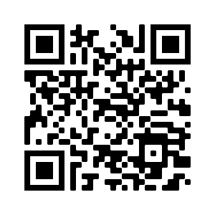
QR Code for register
https://forms.gle/qgBZYjy42v1P486N6

Slide 5
Statistics for GDE
15 January to 28 March
Curriculum coverage statistics for GDE
Update EVERY two weeks.
Link will be emailed and send via WhatsApp.
First update due 3 of February 2025
Google forms – Teacher profiles needs to be updated yearly.
Will send link by end of week.

Slide 6
2024 NSC Examinations – SEDIBENG EAST/WEST
& GAUTENG EAST
Thank you for all your hard work and efforts in 2024!
Total of 7 distinctions across all three specialisations in the three districts + Hans Moore! (2023 were 8)
Gauteng total = 49 for all three specialisations, where:
> Automotive = 12 (2023 – 12)
> Fitting & Machining = 32 (2023 – 22)
> Welding & Metalwork = 5 (2023 – 3)
Schools with large numbers obtained distinctions.

Slide 7
Analysis of Results - 2022 -2024
Subject Specialization | Pass Percentage % |  |  | Difference in % between 2023 & 2024 | Average % 2022 | Average% 2023 | Average% 2024 | Target 2025 %
 | 2022 | 2023 | 2024
Auto | 98 | 98.85 | 99.58 | +0,73% | 49 | 51 | 51.72 | 100
Fitting & Machining | 97.35 | 97.90 | 98.18 | +0.28% | 52 | 51 | 54.4 | 100
Welding & Metalwork | 95 | 88 | 96 | +8% | 45 | 42 | 48.49 | 100

Slide 8
Analysis of Results – National VS GP 2023 -2024
Subject | 2023 | 2023 | 2024 | 2024
Subject | GP | National | GP | National
Auto | 98 | 96 | 99.58 | 98.5
Fitting & Machining | 98 | 97 | 98.18 | 97.5
Welding & Metalwork | 88 | 92 | 96 | 97

Slide 9
GAUTENG DE
Grade 12 subject performance 2021- 2023-Automotive
YEAR | Total Entered | Total Wrote | Total Achieved 30-100% | Achieved 30-100% | Achieved 40-100% | Achieved 0 -29.9% Level 1 | Achieved 30-39.9% Level 2 | Achieved 40-49.9% Level 3 | Achieved 50-59.9% Level 4 | Achieved 60-69.9% Level 5 | Achieved 70-79.9% Level 6 | Achieved 80-100% Level 7 | Average Subject % | Distinctions
2022 | 617 | 596 | 581 | 98 | 79 | 15 | 122 | 211 | 141 | 79 | 24 | 4 | 49 | 4
2023 | 610 | 603 | 596 | 99 | 84 | 7 | 88 | 222 | 156 | 82 | 43 | 12 | 51 | 12
2024 | 732 | 721 | 718 | 99.58 | 87 | 3 | 88 | 254 | 209 | 111 | 44 | 12 | 52 | 12
Grade 12 subject performance 2019- 2022- Automotive
2021 NSC Roadshow Mechanical Technology
Notes:
A good sign is that there is an increase in the total learners that take the subject and a slight increase in the average compared to 2021.
The total for level 2,3 and 4 passes is concerning. It indicates that the learners know the bare minimum for a pass. 79,5% of the learners fall in this bracket,

Slide 10
GAUTENG DE
Grade 12 subject performance 2024 Automotive Top 10 schools
Centre Name | Total Wrote | Achieved 0-9.9% | Achieved 10-19.9% | Achieved 20-29.9% | Achieved 30-39.9% | Achieved 40-49.9% | Achieved 50-59.9% | Achieved 60-69.9% | Achieved 70-79.9% | Achieved 80-89.9% | Achieved 90-100% | Distinctions | Passed 30% | Average Subject %
FERNDALE HIGH SCHOOL | 7 | 0 | 0 | 0 | 0 | 1 | 2 | 2 | 0 | 2 | 0 | 2 | 100.00% | 66.07
TETELO SECONDARY SCHOOL | 8 | 0 | 0 | 0 | 0 | 0 | 3 | 3 | 1 | 1 | 0 | 1 | 100.00% | 65.19
MASISEBENZE COMPREHENSIVE SCHOOL | 5 | 0 | 0 | 0 | 0 | 0 | 2 | 1 | 2 | 0 | 0 | 0 | 100.00% | 64.50
WILLOWMOORE HIGH SCHOOL | 7 | 0 | 0 | 0 | 0 | 0 | 4 | 1 | 1 | 1 | 0 | 1 | 100.00% | 63.86
RHODESFIELD TECHNICAL HIGH SCHOOL | 47 | 0 | 0 | 0 | 0 | 10 | 10 | 16 | 10 | 1 | 0 | 1 | 100.00% | 60.79
TEBOGWANA SEC SCHOOL | 16 | 0 | 0 | 0 | 2 | 2 | 4 | 4 | 3 | 1 | 0 | 1 | 100.00% | 59.22
GENERAL SMUTS HIGH SCHOOL | 6 | 0 | 0 | 0 | 0 | 3 | 1 | 0 | 1 | 1 | 0 | 1 | 100.00% | 58.75
PRETORIA TECHNICAL HIGH SCHOOL | 22 | 0 | 0 | 0 | 0 | 5 | 7 | 8 | 1 | 1 | 0 | 1 | 100.00% | 58.39
HOER TEGNIESE SKOOL PRETORIA-TUINE | 13 | 0 | 0 | 0 | 0 | 2 | 7 | 3 | 1 | 0 | 0 | 0 | 100.00% | 56.81
UMQHELE SECONDARY SCHOOL | 10 | 0 | 0 | 0 | 0 | 2 | 4 | 4 | 0 | 0 | 0 | 0 | 100.00% | 56.50
Grade 12 subject performance 2022- Automotive UP schools
2021 NSC Roadshow Mechanical Technology
Notes:
A good sign is that there is an increase in the total learners that take the subject and a slight increase in the average compared to 2021.
The total for level 2,3 and 4 passes is concerning. It indicates that the learners know the bare minimum for a pass. 79,5% of the learners fall in this bracket,

Slide 11
GAUTENG DE
Grade 12 subject performance 2022- 2024 Fitting & Machining
Year | Total Entered | Total Wrote | Achieved 30-100% | Achieved 40-100% | 0-29% | 30-39% | 40-49% | 50-59% | 60-69% | 70-79% | 80-100% | Avg pass %
2022 | 635 | 622 | 97.35 | 84 | 21 | 107 | 176 | 154 | 101 | 45 | 18 | 50
2023 | 666 | 652 | 98 | 85 | 13 | 119 | 195 | 169 | 100 | 45 | 22 | 52
2024 | 666 | 661 | 98.18 | 85.17 | 12 | 86 | 169 | 169 | 117 | 76 | 32 | 54.4
Grade 12 subject performance 2019- 2022- Fitting & Machining
2021 NSC Roadshow Mechanical Technology
Notes:
A good sign is that there is an increase in the total learners that take the subject and a slight increase in the average compared to 2021.
The total for level 2,3 and 4 passes is concerning. It indicates that the learners know the bare minimum for a pass. 79,5% of the learners fall in this bracket,

Slide 12
GAUTENG DE
Grade 12 subject performance 2023- Fitting & Machining Top 10 schools
Centre Name | Total Wrote | Achieved 0-9.9% | Achieved 10-19.9% | Achieved 20-29.9% | Achieved 30-39.9% | Achieved 40-49.9% | Achieved 50-59.9% | Achieved 60-69.9% | Achieved 70-79.9% | Achieved 80-89.9% | Achieved 90-100% | Distinctions | Passed 30% | Average Subject %
HOERSKOOL ZWARTKOP | 18 | 0 | 0 | 0 | 0 | 0 | 1 | 3 | 5 | 6 | 3 | 9 | 100 | 79.47
JABULANI TECHNICAL SECONDARY SCHOOL | 7 | 0 | 0 | 0 | 0 | 0 | 1 | 3 | 3 | 0 | 0 | 0 | 100 | 67.36
HOERSKOOL MARAIS VILJOEN | 9 | 0 | 0 | 0 | 0 | 0 | 1 | 6 | 1 | 1 | 0 | 1 | 100 | 67.33
UMQHELE SECONDARY SCHOOL | 23 | 0 | 0 | 0 | 0 | 0 | 7 | 7 | 7 | 1 | 1 | 2 | 100 | 66.72
HOERSKOOL OVERKRUIN | 1 | 0 | 0 | 0 | 0 | 0 | 0 | 1 | 0 | 0 | 0 | 0 | 100 | 64.50
WEDELA TECHNICAL HIGH SCHOOL | 9 | 0 | 0 | 0 | 0 | 3 | 0 | 2 | 3 | 1 | 0 | 1 | 100 | 64.00
KATLEHONG TECHNICAL SENIOR SEC | 36 | 0 | 0 | 0 | 1 | 2 | 12 | 8 | 12 | 1 | 0 | 1 | 100 | 63.26
FOCHVILLE HIGH SCHOOL | 8 | 0 | 0 | 0 | 0 | 1 | 2 | 2 | 3 | 0 | 0 | 0 | 100 | 63.25
HOERSKOOL TRANSVALIA | 7 | 0 | 0 | 0 | 0 | 0 | 4 | 1 | 2 | 0 | 0 | 0 | 100 | 61.64
CURTIS NKONDO SEC SCHOOL | 12 | 0 | 0 | 0 | 1 | 0 | 5 | 3 | 2 | 1 | 0 | 1 | 100 | 61.63
Grade 12 subject performance 2022- Fitting & Machining UP schools
2021 NSC Roadshow Mechanical Technology
Notes:
A good sign is that there is an increase in the total learners that take the subject and a slight increase in the average compared to 2021.
The total for level 2,3 and 4 passes is concerning. It indicates that the learners know the bare minimum for a pass. 79,5% of the learners fall in this bracket,

Slide 13
GAUTENG DE
Grade 12 subject performance 2022- 2024- Welding and Metalwork
YEAR | Total Entered | Total Wrote | Achieved 30% | Achieved 40% | Achieved 0 -29.9% Level 1 | Achieved 30-39.9% Level 2 | Achieved 40-49.9% Level 3 | Achieved 50-59.9% Level 4 | Achieved 60-69.9% Level 5 | Achieved 70-79.9% Level 6 | Achieved 80-100% Level 7 | Average Subject % | Distinctions
2022 | 452 | 443 | 95 | 74 | 27 | 139 | 137 | 87 | 37 | 14 | 2 | 45 | 2
2023 | 444 | 444 | 88 | 72 | 52 | 147 | 139 | 64 | 29 | 10 | 3 | 42 | 3
2024 | 501 | 493 | 96 | 75.25 | 20 | 103 | 156 | 112 | 72 | 26 | 5 | 48.9 | 5
Grade 12 subject performance 2019- 2022- Welding and Metalwork
2021 NSC Roadshow Mechanical Technology

Slide 14
GAUTENG DE
Grade 12 subject performance 2024 - Welding & Metalwork Top 10 schools
Centre Name | Total Wrote | Achieved 0-9.9% | Achieved 10-19.9% | Achieved 20-29.9% | Achieved 30-39.9% | Achieved 40-49.9% | Achieved 50-59.9% | Achieved 60-69.9% | Achieved 70-79.9% | Achieved 80-89.9% | Achieved 90-100% | Distinctions | Passed 30% | Average Subject %
HOER TEGNIESE SKOOL PRETORIA-TUINE | 5 | 0 | 0 | 0 | 0 | 1 | 0 | 2 | 1 | 1 | 0 | 1 | 100 | 67.60
PROTEASKOOL / SCHOOL | 5 | 0 | 0 | 0 | 0 | 1 | 1 | 2 | 0 | 1 | 0 | 1 | 100 | 63.60
NICK MPSHE SEC SCHOOL | 15 | 0 | 0 | 0 | 1 | 2 | 3 | 5 | 3 | 1 | 0 | 1 | 100 | 61.53
HOERSKOOL ERASMUS | 5 | 0 | 0 | 0 | 0 | 0 | 3 | 1 | 1 | 0 | 0 | 0 | 100 | 60.50
ITIRELE-ZENZELE COMPREHENSIVE SCHOOL | 6 | 0 | 0 | 0 | 0 | 2 | 2 | 0 | 1 | 1 | 0 | 1 | 100 | 60.42
RHODESFIELD TECHNICAL HIGH SCHOOL | 41 | 0 | 0 | 1 | 0 | 7 | 17 | 7 | 8 | 1 | 0 | 1 | 97.56 | 58.29
EKANGALA SECONDARY SCHOOL | 6 | 0 | 0 | 0 | 0 | 2 | 2 | 2 | 0 | 0 | 0 | 0 | 100 | 54.50
PRETORIA TECHNICAL HIGH SCHOOL | 12 | 0 | 0 | 0 | 1 | 0 | 9 | 2 | 0 | 0 | 0 | 0 | 100 | 54.50
MAMELLONG COMPREHENSIVE | 14 | 0 | 0 | 0 | 2 | 4 | 3 | 4 | 1 | 0 | 0 | 0 | 100 | 53.07
LABAN MOTLHABI COMPREHENSIVE SCHOOL | 14 | 0 | 0 | 0 | 1 | 5 | 3 | 5 | 0 | 0 | 0 | 0 | 100 | 53.07
Grade 12 subject performance 2022- Welding and Metalwork- UP Schools
2021 NSC Roadshow Mechanical Technology

Slide 15
DISTRICT RESULTS – Pass Rates
Specialisation | SE | SW | GE | EN
Fitting & Machining | 94,4 | 95,1 | 100 | 100
Automotive | 100 | 100 | 100 | =
Welding & Metalwork | 96,3 | 87,5 | 98,6 | =

Slide 16
DISTRICT RESULTS - Average
Specialisation | SE | SW | GE | EN
Fitting & Machining | 43,9 | 52,2 | 52 | 54,7
Automotive | 48,4 | 48,8 | 55,5 | =
Welding & Metalwork | 41,6 | 42,9 | 52 | =

Slide 17
Automotive
6/6 Schools obtained 100% pass rate.
Total of 1 distinction (GDE = 12)
Gen Smuts HS – 1
3/6 Schools obtained above 50% subject average.
CONGRATULATIONS!

Slide 18
RESULTS
District Name | Centre Name | Distinctions | Average % | Pass %
SEDIBENG EAST | GENERAL SMUTS HIGH SCHOOL | 1 | 58,75 | 100,00
GAUTENG EAST | HOERSKOOL DIE ANKER | 0 | 56,08 | 100,00
GAUTENG EAST | SPRINGS TECHNICAL SCHOOL | 0 | 54,88 | 100,00
SEDIBENG WEST DISTRICT | HOER TEGNIESE SKOOL CAREL DE WET | 0 | 47,83 | 100,00
SEDIBENG EAST | PHOENIX HIGH SCHOOL | 0 | 43,79 | 100,00
SEDIBENG EAST | THUTO LORE SECONDARY SCHOOL | 0 | 42,44 | 100,00

Slide 19
Fitting & Machining
8/11 Schools obtained 100% pass rate.
Total of 5 distinctions (GDE = 32)
7/11 Achieved above 50% subject average.
GE – 4
SW – 1
HS Hans Moore – 1

Slide 20
Fitting & Machining
Springs Boys High School – 2
HS Hans Moore – 1
Thuto-Tiro SOS – 1
Laban Motlhabi Comp School – 1
CONGRATULATIONS!

Slide 21
RESULTS
District Name | Centre Name | Distinctions | Average % | Pass %
SEDIBENG WEST DISTRICT | HOERSKOOL TRANSVALIA | 0 | 61,64 | 100,00
GAUTENG EAST | LABAN MOTLHABI COMPREHENSIVE SCHOOL | 1 | 59,57 | 100,00
GAUTENG EAST | SPRINGS BOYS HIGH SCHOOL | 2 | 59,29 | 100,00
GAUTENG EAST | SPRINGS TECHNICAL SCHOOL | 0 | 58,73 | 100,00
EKURHULENI NORTH | HOERSKOOL HANS MOORE | 1 | 54,67 | 100,00
GAUTENG EAST | HOERSKOOL DIE ANKER | 0 | 51,64 | 100,00
SEDIBENG WEST DISTRICT | SIZANANI THUSANANG COMPREHENSIVE SCHOOL | 0 | 50,21 | 100,00
GAUTENG EAST | HOERSKOOL JOHN VORSTER | 0 | 49,50 | 100,00
SEDIBENG EAST | PHOENIX HIGH SCHOOL | 0 | 43,94 | 94,44
SEDIBENG WEST DISTRICT | THUTO-TIRO COMPREHENSIVE | 1 | 53,65 | 94,12
SEDIBENG WEST DISTRICT | HOER TEGNIESE SKOOL CAREL DE WET | 0 | 43,25 | 87,50

Slide 22
Welding & Metalwork
7/10 Schools obtained 100% pass rate.
Total of 1 distinction (GDE = 5)
4/10 Schools obtained above 50% subject average.
CONCERNING!

Slide 23
RESULTS
District Name | Centre Name | Distinctions | Average % | PASS %
GAUTENG EAST | PROTEASKOOL / SCHOOL | 1 | 63,60 | 100,00
GAUTENG EAST | MAMELLONG COMPREHENSIVE | 0 | 53,07 | 100,00
GAUTENG EAST | LABAN MOTLHABI COMPREHENSIVE SCHOOL | 0 | 53,07 | 100,00
SEDIBENG WEST DISTRICT | THUTO-TIRO COMPREHENSIVE | 0 | 51,42 | 100,00
GAUTENG EAST | SPRINGS TECHNICAL SCHOOL | 0 | 46,50 | 100,00
SEDIBENG EAST | PHOENIX HIGH SCHOOL | 0 | 42,50 | 100,00
SEDIBENG WEST DISTRICT | HOER TEGNIESE SKOOL CAREL DE WET | 0 | 39,50 | 100,00
SEDIBENG EAST | THUTO LORE SECONDARY SCHOOL | 0 | 40,69 | 95,24
GAUTENG EAST | ESIBONELWESIHLE SECONDARY | 0 | 43,83 | 93,33
SEDIBENG WEST DISTRICT | SIZANANI THUSANANG COMPREHENSIVE SCHOOL | 0 | 37,83 | 66,67

Slide 24
IMPORTANT TO REMEMBER
Previous examination papers NB!!!!!
PLANNING!
Proper PAT tasks!
OWN PAT tasks!
Quality Assessments – March / June assessments
Informal assessments.
Support programs and content for highflyers to enhance number of distinctions
RESULT IN EXCELLENT PASS RATES!

Slide 25

To each and every educator who worked very hard.
By placing the interest of the learner first.
For your dedication to the subject

Slide 26
Management Plan
Management plan for school visits had been sent with email.
School visits to start 20 January 2025.
GDE / DBE responsibilities – will inform in due time if any changes will occur in management plan for school visits.
Next SUBJECT MEETING – 3 March 2024 – SE/SW
– 4 March 2023 – GE

Slide 27
Curriculum delivery and ATP completion
Educators do not teach all content – last year found whole topics missing!
Teach according to Revised ATP 2023/24/25 content for Grade 10 and 11.
Grade 12 – NO trimming of ATP!
ATP’s with % available on website for downloading.
SBA moderation in 2024 clearly showed educators did NOT USE the ATP’s with the allocated percentages.
D.H.’s to monitor ATP’s EVERY two weeks.
Curriculum behind – need to show strategies for catching UP!
Registers to be kept on ANY type of extra class.
Subject Improvement Plan to be submitted to DSA – 14 February 2025

Slide 28
SCHOOL VISITS AND SUPPORT
PLC support important – USE MS Teams or face-to-face.
If needed – I will arrange Teams meetings for educators and download registers.
Give support, but educators DO NOT implement support strategies and suggestions in order to make teaching and curriculum delivery more effective.
Email or WhatsApp if support is needed – concerning that only a few do this.
Upon visits – “I did not know” or “I did not understand” – Serious implication on quality teaching.
Support visits – monitor class teaching and teaching methods.

Slide 29
ADMINISTRATION and PLANNING
SBA and PAT files – separate
Teacher files – Table of content visible with content updated.
PAT files WITH mark sheets.
NO test/exam may leave the school premises.
NO PAT task or part of it to leave school premises.
Proper planning MUST be available for verification on school visit
Planning – WHAT / WHEN / HOW teaching is going to take place WITH ALL specified assessments included in planning
ATPs to be kept updated daily!
Please complete Educator Profiles on Google Forms – Link will be send via WA

Slide 30
Moderation colour pens – Post moderation
School level – Green pen
District level – Orange pen
Provincial level – Pink pen

Slide 31
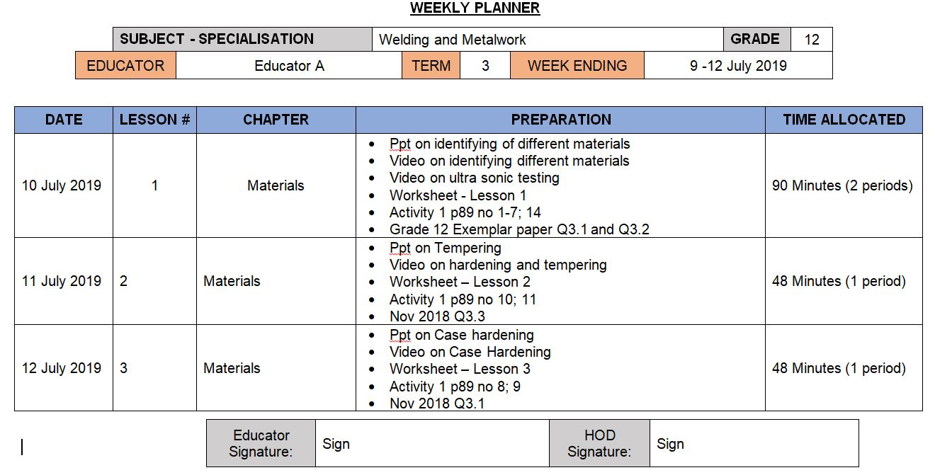
Complete Weekly Planner

Slide 32
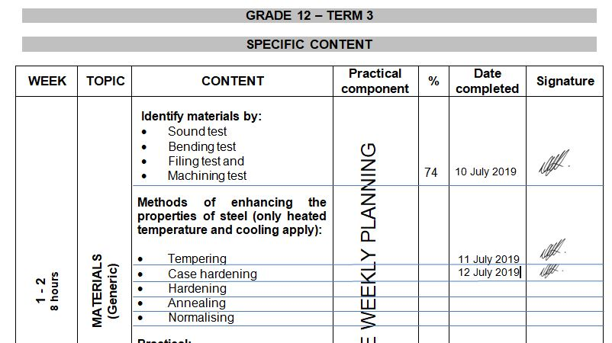
Complete ATP

Slide 33
Grade 12 Roadshows
Will be held on MS Teams from 3 – 5 February 2025
CONCERN – Absence from educators in 2024 …..
PAT MEDIATION – ALL SPECIALISATIONS
ALL educators to WITH DH MUST attend.
Teams platform
Time: 14:30 – 16:30
Grade 10 – 12 PAT to be discussed.
EACH Specialisation separate.
Automotive – 10 February
Fitting and Machining – 12 February
Welding and Metalwork – 13 February

Slide 34
Mark sheets
Composite Mark sheet:
Mark sheet is available on the website for download.
New weightings for Grade 10/11 on PAT in Term 2 and 3.
Use Phase 4 for Phase 2 and Phase 2 for Phase 4 on SASAMS.
PAT mark sheets in PAT documents.
Excel spread sheets not yet available on website for download (Grades 10 - 12). Will inform when available.

Slide 35
Baseline assessments
Develop OWN Baseline assessments
GDE to monitor
D.H. to MONITOR!!
SEPARATE book/file to monitor baseline assessments.
Separate mark sheet for informal recording

Slide 36
Baseline assessments
Baseline assessment to be conducted for Grade 11 and 12 BEFORE EACH TOPIC!
Baseline assessment proof be available on school visits.
Requirement now from DBE Curriculum.
Determine content knowledge carried over from 2024.
Shortcomings in content knowledge to be addressed in teaching and lessons.

Slide 37
Term 1 Formal Assessments – GradeS 10 – 12
Grades 10 – 12: TEST – 60 minutes.
Grades 10 – 12 Guideline in pre-moderation tool. USE IT.
NO 2 or 3 different tests and then add to make 50!
Set own tests.
D.H. To pre- and post MODERATE!!
Term 1 SBA mark
ONLY work done in Term 1 to be assessed.
DO NOT accept average of below 50%!
MUST be SEND to DSA for APPROVAL!!
PLC welcomed!

Slide 38
Informal assessments
Informal assessment MUST be done.
Grade 10/11 can previous exam/test papers be used as extra assessments/homework
Grade 12 – NB!!! – Use last 5 NSC papers as top-up to informal assessments given to candidates.
Informal assessments to be done in learners books.
D.H. to monitor informal assessments
GDE will monitor informal assessments and must report back to DBE on amount and progress of informal assessments.
When learners are at home – assignments / research tasks to be given and must be monitored / checked by educators on return.
Schools with poor 2024 SBA marks – shows CLEARLY lack of informal assessments!

Slide 39
Progress / High Risk / Retained learners
SEPARATE name list for progressed learners – Grades 10 – 12
MUST be evident in Educator file AND D.H file.
Progressed learners' names to be submitted to DSA by 7 February 2025
Weekly extra classes for Progress / High Risk / Retained learners. – NON NEGIOTIABLE (S.I.P.)
Registers evident where learners sign for attendance each week.
Remedial work – NO HOMEWORK – Learners work in class
Separate book – Cover Page – Subject Intervention and Learner name.
Record communication to parents of absence.

Slide 40
PAT Tasks
PAT tasks on website for download.
Mediation on ALL PAT will be conducted on MS Teams and dates to be announced.
Guidelines and requirements will be clearly indicated in mediation.
DH’s to monitor PAT progress.
Phase 1 to be completed by end of Term 1.
Do not wait to continue – Grade 12 WM can quickly finish Phase 1 and already start preparations for Phase 4.
Available on website for download
Grade 10 available on Monday 3 Feb for download
Grade 11 minor change in Phase 4 – will re-upload.

Slide 41
IMPORTANT MATTERS RE PAT
OWN Pat tasks COMPULSARY!
READ instructions in the documents.
WHOLE document must be in EACH learner PAT file
Follow instructions for assessment in PAT document
Learners to conduct self assessment FIRST BEFORE educator assess!
USE rubrics and do not thumb-suck marks!
Auto – Procedures – NO learner complete it – Educator do
SIGNATURES!!!! Learners AND Educators NB!!!!

Slide 42
Registers
Daily class attendance registers MUST be kept! – It is policy!
Record must be kept of Grade 12 learners being absent.
D.H. and parents to be kept up to date with learners being absent if no valid reason has been provided to the school.
Catch-Up plan for leaners WHO was absent with valid reasons.
EXCEL Register available on website for use.
Stock registers MUST be updated – especially where new equipment, tool and material being delivered.
GDE to monitor asset registers.

Slide 43
TRAINING
EPTD SETA Training service providers has been appointed.
Head Office had a meeting on 29 January.
Communication will go to individuals identified by HO – only limited spaces available.
Takes preference over GDE training
31 days during 2025
Certification after completion
GDE Training Dates will communicated
Content under development
April cancelled - Mostly over Saturdays
Proposed dates – 22 Feb and 8 March – Verify on 7 Feb
July is confirmed
If any changes occur – educators will be informed in due time.

Slide 44
PLC
Imperative for professional development!
Need Agenda and register for Head Office.
All educators need to engage in PLC meetings – GDE requirement.
If needed – will arrange Teams meeting should educators want to.
Inform me in due time!

Slide 45
Website
www.mtechedusupport.co.za
For your support!

Slide 46


SOME THOUGHT

Slide 47
Questions
?

