Slide 1

GAUTENG DEPARTMENT OF EDUCATION
SEDIBENG EAST/WEST
& GAUTENG EAST
Subject Meeting
Mechanical Technology Specialization
Automotive; Fitting & Machining; Welding & Metalwork
GE/EN – 10 March 2025 – 14:30
SE/SW – 11 March 2025 – 14:30

Slide 2
AGENDA
Welcome and Register.
Statistics for GDE.
Management Plan
School visits and Support
Curriculum delivery and ATP completion
Subject Improvement Plans
Administration and Planning
Mark sheets
Assignment and Baseline assessments.
Term 1 Formal Assessment.
SBA Moderation Phase 1
Informal assessments.
Progressed/High risk/Retained learners
PAT

Slide 3
DBE PAT Mediation
PAT Moderation Phase 1
Registers.
Training.
NSC Marking 2025.
Subject combination verification
SASAMS Marks verification
SSIP planning and Information
PLC
Important to remember
Website
Questions

Slide 4
Welcome and Register
Welcome to second subject meeting for 2025
Register via QR code – Google Forms
Please complete BEFORE 16:00 – register lock after 16:00

Slide 5
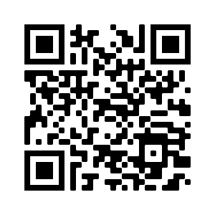
QR Code for register
https://forms.gle/qgBZYjy42v1P486N6

Slide 6
Statistics for GDE
15 January to 28 March
Curriculum coverage statistics for GDE
Update EVERY two weeks.
Link will be emailed and send via WhatsApp.
First update due Thursday 3 March 2025
Google forms – Teacher profiles needs to be updated yearly.
Will send link by end of week.

Slide 7

To each and every educator who worked very hard.
By placing the interest of the learner first.
For your dedication to the subject

Slide 8
Management Plan
Management plan for school visits had been sent with email.
Term 2 will be sent in first week of Term 2.
GDE / DBE responsibilities – will inform in due time if any changes will occur in management plan for school visits.
Only available 8-10 April and then 22 April onwards due to DBE responsibilities.
Next SUBJECT MEETING – 22 April 2025 – SE/SW
– 23 April 2025 – GE

Slide 9
SCHOOL VISITS AND SUPPORT
PLC support important – USE MS Teams or face-to-face.
If needed – I will arrange Teams meetings for educators and download registers.
Give support, but educators DO NOT implement support strategies and suggestions in order to make teaching and curriculum delivery more effective.
Email or WhatsApp if support is needed – concerning that only a few do this.
Upon visits – “I did not know” or “I did not understand” – Serious implication on quality teaching.
Support visits – monitor class teaching and teaching methods.

Slide 10
Not ready for school visits …..
Focus on support and monitoring.
Support – Theory and PAT
Monitoring – Have the following ready:
Teacher files
Signed ATPs
Learner's books – Grades 10 – 12
DH file
List of progressed learners / High risk learners
Class registers

Slide 11
Curriculum delivery and ATP completion
Educators do not teach all content – Found whole topics missing!
Teach according to Revised ATP 2023/24/25 content for Grade 10 and 11.
Grade 12 – NO trimming of ATP!
ATP’s with % available on website for downloading.
Discussed in Grades 10/11 Roadshow how to utilise revised ATPs with %ATP
D.H.’s to monitor ATP’s EVERY two weeks.
Curriculum behind – need to show strategies for catching UP!
Registers to be kept on ANY type of extra class.

Slide 12
Subject Improvement Plan
Thank you for submissions of SIP.
Will have a short MS Teams workshop on SIP and what content is needed
Some SIP very vague
Template provided.
Template available on website for download
SIP MUST be submitted EVERY Term after result analysis.
Document name:
Subject Improvement Plan (School + Subject) – Template
Example: Subject Improvement Plan (Phoenix HS – Fitting)

Slide 13
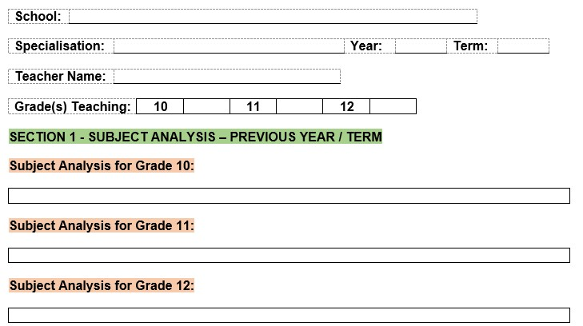
Inserting result analysis

Slide 14
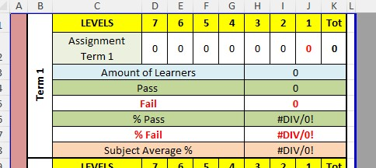

Slide 15
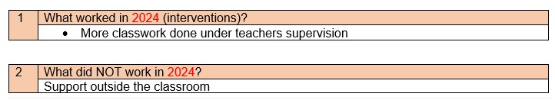
Example of poor submission

Slide 16
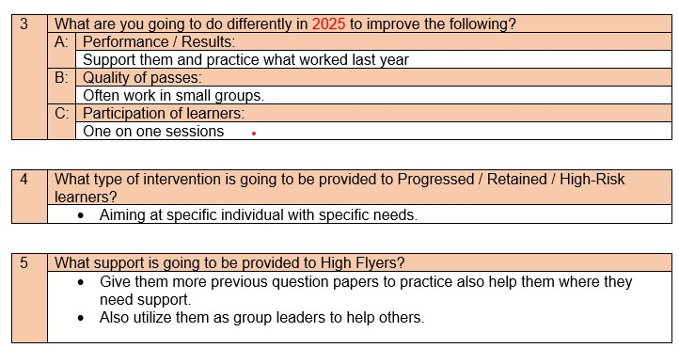

Slide 17
ADMINISTRATION and PLANNING
SBA and PAT files – separate
Teacher files – Table of content visible with content updated.
PAT files WITH mark sheets.
NO test/exam may leave the school premises.
NO PAT task or part of it to leave school premises.
Proper planning MUST be available for verification on school visit
Planning – WHAT / WHEN / HOW teaching is going to take place WITH ALL specified assessments included in planning
Going to revise WEEKLY planner to include what info is needed.
ATPs to be kept updated daily!
Please complete Educator Profiles on Google Forms – Link will be send via WA

Slide 18
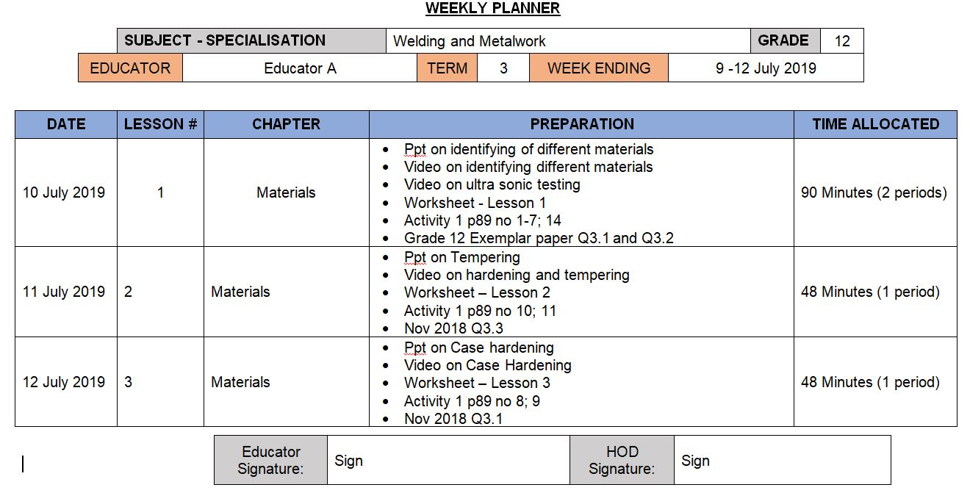
Complete Weekly Planner

Slide 19
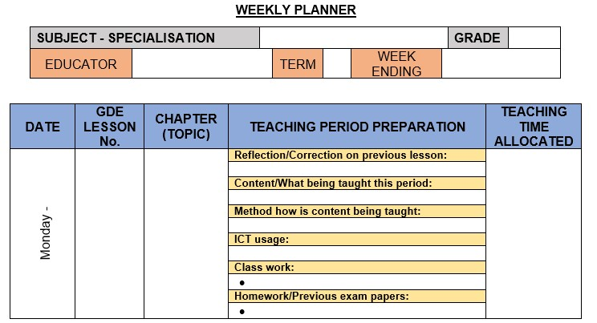
NEW WEEKLY PLANNER

Slide 20
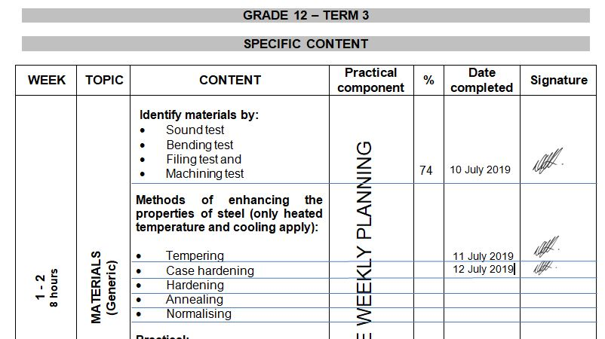
Complete ATP

Slide 21
Mark sheets
Composite Mark sheet:
Composite Mark sheet is available on the website for download.
Ensure weightings for Grade 10/11 on PAT in Term 2 and 3 is correct.
PAT mark sheets in PAT documents.
USE mark sheets in PAT documents for each learner – transfer to Composite and then SASAMS

Slide 22
Weightings
Grade 12
Grade 10 and 11
Term 1 | Term 2 | Prelim | Final Exam
50 marks – 5 % | 200 marks – 10% | 200 marks – 10% | 200 marks – 50%
25% |  |  | 50%
PAT |  |  | 250 marks – 25%
Term 1 | Term 2 | Term 3 | Final Exam
50 marks – 10 % | 150 marks – 20% | 50 marks – 10% | 200 marks – 40%
40% |  |  | 40%
PAT |  |  | 250 marks – 20%

Slide 23
Baseline assessments
Develop OWN Baseline assessments
GDE to monitor
D.H. to MONITOR!!
SEPARATE book/file to monitor baseline assessments.
Separate mark sheet for informal recording

Slide 24
Baseline assessments
Baseline assessment to be conducted for Grade 11 and 12 BEFORE EACH TOPIC!
Baseline assessment proof be available on school visits.
Requirement now from DBE Curriculum.
Determine content knowledge carried over from 2024.
Shortcomings in content knowledge to be addressed in teaching and lessons.

Slide 25
Term 1 Formal Assessments – GradeS 10 – 12
Grades 10 – 12: TEST – 60 minutes.
Grades 10 – 12 Guideline in pre-moderation tool. USE IT.
NO 2 or 3 different tests and then add to make 50!
Set own tests.
D.H. To pre- and post MODERATE!!
Term 1 SBA mark
ONLY work done in Term 1 to be assessed.
DO NOT accept average of below 50%!
MUST be SEND to DSA for APPROVAL!!
PLC welcome!

Slide 26
Moderation colour pens – Post moderation
School level – Green pen
District level – Orange pen
Provincial level – Pink pen

Slide 27
SBA MODERATION
Phase 1 moderation – e-marking will be conducted.
Same method as done past 3 years.
Detailed Memo with required documents needed for upload will be send when schools re-open in Term 2.
MUST be submitted by 15th of April 2025! – NO LATE SUBMISSIONS.
Each school already have a PW and Login details for uploads – NO FILES to be send to district office unless otherwise instructed.
D.H.’s and Principals will be accountable persons for uploads.
TM’s will download and e-mark and re-upload District Moderation is completed.
Schools will be informed when to download completed moderated SBA.

Slide 28
Informal assessments
Informal assessment MUST be done.
Grade 10/11 can previous exam/test papers be used as extra assessments/homework – USE Relab books! (on website)
Questions + answers in learners books.
Grade 12 – NB!!! – Use last 5 NSC papers as top-up to informal assessments given to candidates.
Informal assessments to be done in learners books.
D.H. to monitor informal assessments
GDE will monitor informal assessments and must report back to DBE on amount and progress of informal assessments.
When learners are at home – assignments / research tasks to be given and must be monitored / checked by educators on return.
Recent school visits showed CLEARLY lack of informal assessments!

Slide 29
Progress / High Risk / Retained learners
SEPARATE name list for progressed learners – Grades 10 – 12
MUST be evident in Educator file AND D.H file.
Weekly extra classes for Progress / High Risk / Retained learners. – NON NEGIOTIABLE (S.I.P.)
Registers evident where learners sign for attendance each week.
Remedial work – NO HOMEWORK – Learners work in class
Separate book – Cover Page – Subject Intervention and Learner name.
Record communication to parents of absence.
MUST be available for verification during school visits.

Slide 30
PAT Tasks
PAT tasks on website for download.
In GDE, Mediation on ALL PAT were conducted on MS Teams.
Guidelines and requirements were clearly indicated in mediation.
DH’s to monitor PAT progress.
Phase 1 to be completed by end of Term 1.
Do not wait to continue – Grade 12 WM can quickly finish Phase 1 and already start preparations for Phase 4.
Available on website for download

Slide 31
IMPORTANT MATTERS RE PAT
OWN PAT tasks COMPULSARY! – Must be evident for verification
READ instructions in the documents.
WHOLE document must be in EACH learner PAT file
Follow instructions for assessment in PAT document
Learners to conduct self assessment FIRST BEFORE educator assess!
USE rubrics and do not thumb-suck marks!
Auto – Procedures – NO learner complete it – Educator do
SIGNATURES!!!! Learners AND Educators NB!!!!

Slide 32
DBE PAT Mediation
Compulsory for all!
Automotive – 12 March at 14:10 via MS Teams.
Fitting & Machining/Welding & Metalwork – 13 March at 14:10 via MS Teams.
Links will be shared by DBE to provinces and then to all.

Slide 33
Pat MODERATION – PHASE 1
School to be selected for Phase 1 moderation from GDE Chief Moderator for Mechanical Technology.
School will be informed in time.
Subject Advisors are Provincial Moderators and will conduct Pat moderation for Phase 1 on selected schools.
Internal Moderation MUST be conducted on ALL PAT tasks as per policy.
Reports available when PM conduct visit.
Mark sheet MUST be signed by ALL stakeholders – Teacher / D.H / Principal.
Unsigned mark sheet will NOT be accepted.
Moderation will take place from 22nd of APRIL - 14th of May 2025
PAT tasks to READY for moderation!!

Slide 34
Registers
Daily class attendance registers MUST be kept! – It is policy!
Record must be kept of Grade 12 learners being absent.
D.H. and parents to be kept up to date with learners being absent if no valid reason has been provided to the school.
Catch-Up plan for leaners WHO was absent with valid reasons.
EXCEL Register available on website for use.
Stock registers MUST be updated – especially where new equipment, tool and material being delivered.
GDE to monitor asset registers.

Slide 35
TRAINING
EPTD SETA Training service providers has been appointed.
Head Office had a meeting on 7 March.
Communication will go to individuals identified by HO – only limited spaces were available.
Takes preference over GDE training
31 days during 2025
Contract will be signed during induction session by HO
Certification after completion
July is confirmed – 30 June – 4 July
If any changes occur – educators will be informed in due time.

Slide 36
2025 NSC Marking
Applications open
Apply on PAYMARKER
Must register for account on PAYMARKER
MUST have CERTIFIED documents
ALL documents required must be scanned in Pdf and attached.
MUST have taught Grade 12 in past 2 years.
Pass % Must be above 80%.

Slide 37
Subject combination verification
DH and Principal accountable for subject combinations.
DSA must conduct verification at schools to ensure correct subject combinations.
DH / Teachers to keep track of learners during the year if they change subjects – DSA MUST BE INFORMED OF SUCH!
See policy regarding subject changes
Only allowed to changed with Technical stream band

Slide 38
SASAMS Mark verification
DH to verify marks from working mark sheets to SASAMS
Sign and school stamp both sheets
Scan composite and SASAMS
Send via email to DSA for final verification
MUST be done EVERY term and final exam.

Slide 39
Grade 12 SSIP planning
SSIP camps for all three Technologies
300 boys and 300 girls between Mechanical, Electrical and Civil.
Identify poor learner performance in 2024(grade 11) and Term 1 2025
Boys and girls list separate.
Excel sheet and all relevant information will be shared via email during the week.
Complete and submit BEFORE 28 March 2025.

Slide 40
PLC
Imperative for professional development!
Need Agenda and register for Head Office.
All educators need to engage in PLC meetings – GDE requirement.
If needed – will arrange Teams meeting should educators want to.
Inform me in due time!

Slide 41
IMPORTANT TO REMEMBER
Previous examination papers NB!!!!!
Relab books for Grades 10/11
PLANNING!
Proper PAT tasks!
OWN PAT tasks!
Quality Assessments – March / June assessments
Informal assessments.
Support programs and content for highflyers to enhance number of distinctions
RESULT IN EXCELLENT PASS RATES!

Slide 42
Website
www.mtechedusupport.co.za
For your support!

Slide 43


SOME THOUGHT

Slide 44
Questions
?

