Slide 1

GAUTENG DEPARTMENT OF EDUCATION
SEDIBENG EAST/WEST
& GAUTENG EAST
Subject Meeting
Mechanical Technology Specialization
Automotive; Fitting & Machining; Welding & Metalwork
22-23 April 2025 – 14:30

Slide 2
AGENDA
Welcome and Register.
Statistics for GDE.
Management Plan
Curriculum delivery and ATP completion
School visits and Support
Mark sheets and Pat mark sheets.
Baseline assessments.
Term 2 Formal Assessment.
Informal assessments.
PAT
SBA District Moderation
PAT Phase 1 Moderation
Registers.
Training.
SSIP
PLC
Website
Questions

Slide 3
Welcome and Register
Welcome to the Term 2 of 2025
Register via QR code – Google Forms
Please complete BEFORE 16:00 – register lock after 16:00

Slide 4
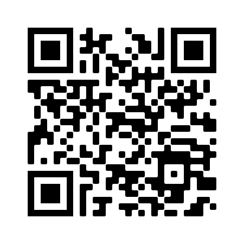
QR Code for register
https://forms.gle/qgBZYjy42v1P486N6

Slide 5
Statistics for GDE
8 April to 27 June (51 Days)
Curriculum coverage statistics for GDE
Update EVERY two weeks.
Link will be emailed and send via WhatsApp.
Next update due 24th of April 2025
Will resend link.
Result submission a CHALLENGE!!!!!
Link has been sent via WhatsApp.

Slide 6
Management Plan
Management plan for Term 2 school visits had been sent with email.
School visits – educators not ready or do not inform when not available!
Term 2 has been emailed on 10 April 2025 to all – FILE and note on calendar the dates!
GDE / DBE responsibilities – will inform in due time if any changes will occur in management plan for school visits.
TERM 2 SUBJECT MEETINGS – 26 May 2025 – SE/SW
– 27 May 2025 – GE

Slide 7
Term Planning NB!
NOTE: 8 April to 27 June (51 Days) Now ….. June exams start 30 May.
Minus 19 Exam days ….
32 Effective Teaching Days for Term 2!!
As of today – 23 days left!
PLAN AHEAD!!

Slide 8
Curriculum delivery and ATP completion
Educators to teach all content in ATP / R-ATPs
Grade 12 – NO trimming of ATP!
ATP’s with % available on website for downloading.
D.H.’s to monitor ATP’s EVERY two weeks – NOT HAPPENING!
On visits in Term 1 DH neglected this! Term 2 Moderation also shows not happening.
School visits indicated some educators are behind with curriculum – need to show strategies for catching UP! DH TO MANAGE!
MUST be emailed by DH in writing strategies to catch up curriculum behind.
Registers to be kept on ANY type of extra class.

Slide 9
SCHOOL VISITS AND SUPPORT
Give support, but educators DO NOT implement support strategies and suggestions in order to make teaching and curriculum delivery more effective.
Email or WhatsApp if support is needed – concerning that only a few do this.
Learners' books and ATPs to be ready for monitoring – excuses learners are not at school today – please collect in advance! Need to verify ATP and curriculum completion.
Upon visits – “I did not know” or “I did not understand” – Serious implication on quality teaching.

Slide 10
Mark sheets
Composite Mark sheet:
Note the weightings for Grade 10/11 – ENSURE correctness on SASAMS
PAT Phase 1 = 50
PAT Phase 2 = 50
Exam Term 2 = 150 ….. NOT 200
PAT Phase 4 = 100
PAT mark sheets in PAT documents.
Composite Excel spread sheet is available on website for download – even with extended lines.

Slide 11
PAT Mark Sheets
Educators must adhere to GDE and DBE guidelines!
EACH learner MUST have a portfolio of evidence (PAT file) for each grade and specialisation.
Automotive Grade 10, Fitting Grade 10 – 12 and Welding Grade 10 – 12:
New strategy of assessment – Has been discussed in the previous subject meetings AND PAT mediation!
PAT moderation – Need the learners files where recording of assessment has been done.
INTERNAL MODERATION!!!!

Slide 12
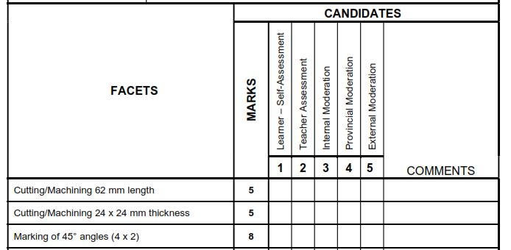
Grade 12 Fitting and Welding

Slide 13
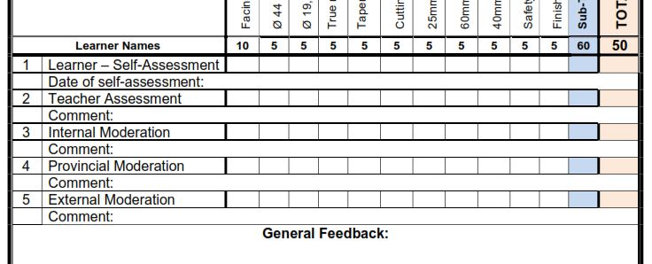
Gr10 Automotive, Gr10-12 Fitting and Welding

Slide 14
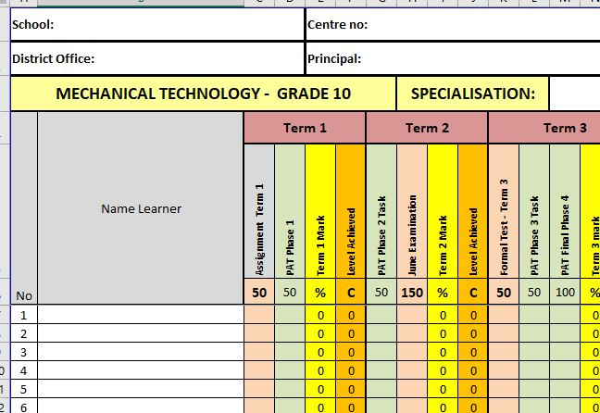
Composite Mark Sheet
Complete composite mark sheet

Slide 15
Baseline assessments
Baseline assessment to be conducted for Grade 11 and 12 BEFORE EACH TOPIC!
Baseline assessment proof be available on school visits.
Educator still do not conduct baseline assessments!
Requirement now from DBE Curriculum.
Determine content knowledge carried over from 2023.
Shortcomings in content knowledge to be addressed in teaching and lessons.

Slide 16
Term 2 Formal Assessments – Grade 12
Grade 12 – EXAMINATION – 3 hours (180 minutes.)
COMMON paper from GDE – 18 JUNE 2025, morning session.
Topics same as in pre-moderation tool.
NB!! To be on par with curriculum delivery!
DO NOT RUSH!!!!!!!
D.H. To MODERATE!!
ONLY work done in Term 1 and 2 to be assessed.

Slide 17
Term 2 Formal Assessments – Grade 10 – 11
ONLY Weightings in pre-moderation tool to be used.
150 marks – 2½ hours (150 minutes).
USE PRE-Moderation tool weighting!! NOTHING ELSE…..
Set own examinations. (PLC welcome – MUST inform DSA of PLC)
D.H. To PRE-MODERATE!!
PLC leaders to send me email on schools participating.
ONLY work done in Term 1 and 2 to be assessed.
MUST be approved by district as per policy!!
FINAL submission date: 5 MAY 2025.
MUST be submitted WITH pre-moderation report AND Blooms!

Slide 18
Informal assessments
Informal assessment MUST be done! School visits shows lack of informal assessments in learners' books!
Grade 10/11 can previous exam/test papers be used as extra assessments/homework
Grade 12 – NB!!! – Use last 5 NSC papers as top-up to informal assessments given to candidates – currently not happening!
Informal assessments to be done in learners' books.
D.H. To monitor informal assessments
GDE will monitor informal assessments and must report back to DBE on amount and progress of informal assessments.
Poor 2024 SBA marks – shows CLEARLY lack of informal assessments!

Slide 19
PAT Tasks
PAT tasks on website for download.
Mediation on ALL PAT was conducted on 10/12-13 February 2025 by GDE and on 12/13 March by DBE.
Guidelines and requirements was clearly indicated in the mediation.
DH’s to monitor PAT progress – not happening…..
Lack of proper planning still a challenge!
No planning – educator + DH + principal mediation session to resolve challenge….
PAT mediation videos available on website.

Slide 20
SBA MODERATION
Phase 1 moderation – e-marking to be conducted.
Same method as done in 2021 - 2024.
Detailed Memo with required documents was sent on the 9th of April.
FINAL submissions by 15th of April 2025! – STILL LATE SUBMISSIONS EXPERIENCED!.
D.H.’s and Principals will be accountable persons for uploads.
TM’s will download and e-mark and re-upload District Moderation is completed.
Schools will be informed when to download completed moderated SBA.
Renaming of Pdf still challenging – School/Subject

Slide 21
SBA MODERATION – PHASE 2
Phase 2 moderation / Phase 1 Provincial moderation – e-marking to be conducted.
Same method as done in Term 1.
Detailed Memo with required documents was sent on the 9th of April.
MECH TECH – Provincial paper – 18 JUNE 2025, morning session.
MUST be submitted by 25th of JUNE 2025! – BE ON TIME!!!!.
D.H.’s and Principals will be accountable persons for uploads.
Schools will be informed when to download completed moderated SBA.

Slide 22
Pat MODERATION – PHASE 1
Schools was informed for Phase 1 moderation from GDE Chief Moderator for Mechanical Technology.
School was informed in management plan sent to all.
Subject Advisors are Provincial Moderators and will conduct Pat moderation for Phase 1 on selected schools.
Internal Moderation MUST be conducted on ALL PAT tasks as per policy.
Reports available when PM conduct visit.
LEARNERS files to be present with completed marks and self-assessment evident.
Mark sheet MUST be signed by ALL stakeholders – Teacher /D.H. / Principal.
Unsigned mark sheet will NOT be accepted.
Moderation will take place from 8th of APRIL - 25th of APRIL as per GDE Assessment Guideline 06 for 2025.
PAT tasks to READY for moderation!!

Slide 23
Registers
Daily class attendance registers MUST be kept! – It is LAW.
Record must be kept of Grade 12 learners being absent.
D.H. and parents to be kept up to date with learners being absent if no valid reason has been provided to the school.
Catch-Up plan for leaners WHO was absent with valid reasons.
EXCEL Register available on website for use.
Stock registers MUST be updated – especially where new equipment, tool and material being delivered.
GDE to monitor asset registers.

Slide 24
TRAINING
Training was conducted on selected Saturdays in Term 1.
Focus on PAT tasks.
POOR attendance by educators.
THANK YOU to those who attended.
NEXT TRAINING – 30 JUNE – 4 JULY 2025.
If any changes occur – educators will be informed in due time.
Venues:
Pretoria THS
Phoenix HS
John Orr THS

Slide 25
SSIP
SSIP has been arranged again for Technical Subjects for June/October holidays.
Girl learners focus on June camp
Focus on Level 1-2.
Limited space – if exhausted – level 1
Email sent with template
MUST have ALL Specialisation info.
ASAP please.

Slide 26
PLC
Received very little PLC information…..
PLC leaders??????
STRATEGY – Need a plan for Term with dates from PLC leaders.
Need Agenda and register for Head Office.
All educators need to engage in PLC meetings – DBE requirement.
If needed – will arrange Teams meeting should educators want to.
Inform me in due time!

Slide 27
Website
www.mtechedusupport.co.za
For your support!

Slide 28


SOME THOUGHT

Slide 29

Questions

