Slide 1

GAUTENG DEPARTMENT OF EDUCATION
SEDIBENG EAST/WEST
& GAUTENG EAST
Subject Meeting
Mechanical Technology Specialization
Automotive; Fitting & Machining; Welding & Metalwork
27 May 2025 – 14:30

Slide 2



Virtual House rules
Please MUTE your microphone.
Raise hand for question at END presentation.
Switch off your camera – it saves data.

Slide 3
AGENDA
Welcome and Register.
Statistics for GDE.
Management Plan
Curriculum delivery and ATP completion
School visits and Support
Baseline assessments.
Term 2 Formal Assessment.
Mark sheets and Pat mark sheets.
Informal assessments.
PAT

Slide 4
AGENDA
SBA District Phase 1 Moderation
PAT Phase 1 Moderation
PAT Phase 2 Moderation
Registers.
Training.
SSIP
PLC
Website
Questions

Slide 5
Welcome and Register
Last meeting for Term 2 of 2025
Please complete BEFORE 16:00 – register lock after 16:00
Link post in Chat
Please complete
https://forms.gle/qgBZYjy42v1P486N6

Slide 6
Statistics for GDE
8 April to 27 June (51 Days)
Curriculum coverage statistics for GDE
Update EVERY two weeks.
Link will be emailed and send via WhatsApp.
Next update due 29th May 2025
Did post link on Monday.
Result submission a CHALLENGE VERY time!!!!!
ALL results to be completed before end of term on google form. Link will be pinned on chat.

Slide 7
Management Plan
Management plan for Term 3 school visits will be send via email before school close.
Will start of with PAT Phase 2 moderation.
School visits – educators not ready or do not inform when not available!
FILE and note on calendar the dates!
GDE / DBE responsibilities – will inform in due time if any changes will occur in management plan for school visits.
TERM 3 SUBJECT MEETINGS – 4 August 2025 – SE/SW
– 5 August 2025 – GE
– 8 September 2025 – SE/SW
– 9 September 2025 – GE

Slide 8
Term Planning NB!
NOTE: Term 3 – 22 July to 3 October (54 Days) Now ….. Prelim exams start 1 September (ESTIMATE!).
Minus 24 Exam days ….
30 (25) Effective Teaching Days for Term 3 for Grade 12!!
Curriculum delivery MUST be completed by at least 23 Aug as to have time for revision.
PLAN AHEAD!!

Slide 9
Curriculum delivery and ATP completion
Educators to teach all content in ATP / R-ATPs
NEW ATP’s with % available on website for downloading.
Emailed yesterday R-ATPs with added % for every week as to make reporting and managing curriculum easier.
D.H.’s to monitor ATP’s EVERY two weeks.
On visits in Term 1/2 DH neglected this!
School visits indicated some educators are behind with curriculum – need to show strategies for catching UP!
MUST be emailed by DH in writing strategies to catch up curriculum behind.
Registers to be kept on ANY type of extra class.

Slide 10
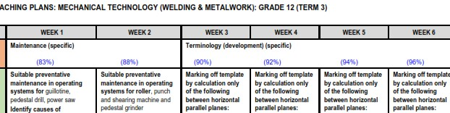
Expected completion in BLUE – by end of week number

Slide 11
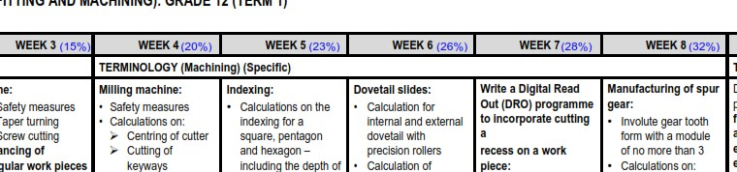
Expected completion in BLUE – by end of week number

Slide 12
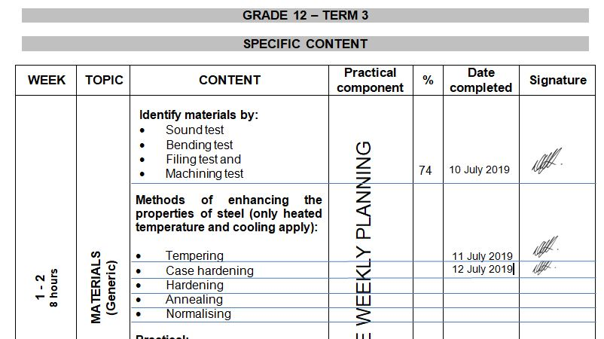
Complete ATP – Date and sign
Do not sign globally – sign of after EACH lesson/content completed as per ATP.

Slide 13
SCHOOL VISITS AND SUPPORT
Give support, but there are still educators that DO NOT implement support strategies and suggestions in order to make teaching and curriculum delivery more effective.
Email or WhatsApp if support is needed – concerning that only a few do this.
Learners' books and ATPs to be ready for monitoring – excuses learners are not at school today – please collect in advance! Need to verify ATP and curriculum completion.
DH is to ensure readiness for school visits / moderation.

Slide 14
Mark sheets
Composite Mark sheet:
Note the weightings for Grade 10/11.
PAT mark sheets in PAT documents.
Excel spread sheets are available on website for download.

Slide 15
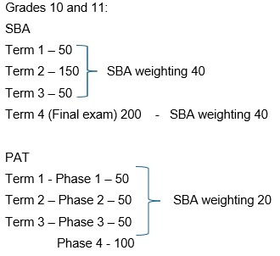
Weightings on SASAMS

Slide 16
PAT Mark Sheets
Educators must adhere to GDE and DBE guidelines!
EACH learner MUST have a portfolio of evidence (PAT file) for each grade and specialisation.
Automotive Grade 10, Fitting Grade 10 – 12 and Welding Grade 10 – 12:
NO EXCELL SHEETS – Has been discussed in the previous subject meetings AND PAT mediation!
USE PAT mark sheets in PAT documents – transfer to composite/working mark sheet – verify correctness – transfer to SASAMS
PAT moderation – Need the learners files where recording of assessment has been done.
INTERNAL MODERATION!!!!

Slide 17
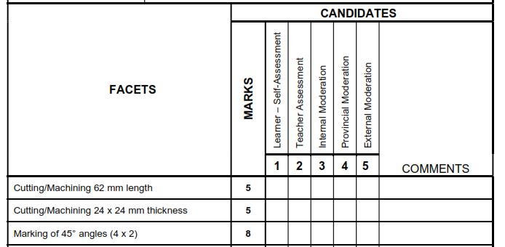
Grade 12 Fitting and Welding

Slide 18
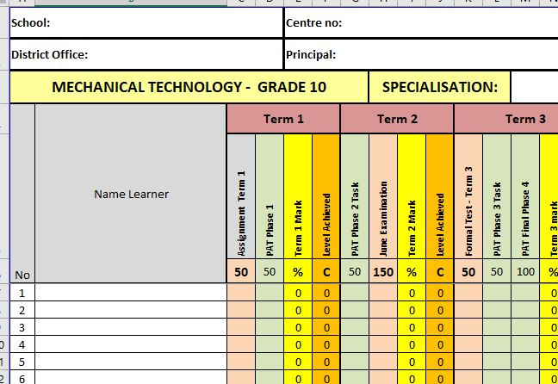
Composite Mark Sheet
Complete composite mark sheet

Slide 19
Baseline assessments
Baseline assessment to be conducted for Grade 11 and 12 BEFORE EACH TOPIC!
Baseline assessment proof be available on school visits.
Educator still do not conduct baseline assessments!
Requirement now from DBE Curriculum.
Determine content knowledge carried over from 2024.
Shortcomings in content knowledge to be addressed in teaching and lessons.

Slide 20
Term 2 Formal Assessments – Grade 12
Grade 12 – EXAMINATION – 3 hours (180 minutes.)
Provincial paper from GDE – 18 JUNE 2025, morning session.
MARKING GUIDELINE Discussion starting PROMPTLY at 14:00. ALL educators to attend
Topics same as in pre-moderation tool.
NB!! To be on par with curriculum delivery!
D.H. To post MODERATE!!
ONLY work done in Term 1 and 2 will be assessed in examination for June 2025.

Slide 21
Term 2 Formal Assessments – Grade 10 – 11
ONLY Weightings in pre-moderation tool to be used.
150 marks – 2½ hours (150 minutes).
Set own examinations. (PLC welcome – MUST inform DSA of PLC)
D.H. To PRE-MODERATE!!
Term 2 SBA mark
ONLY work done in Term 1 and 2 to be assessed.
Will conduct visits in June to verify schools who do not participate in PLC papers and Exam paper has not been approved by District Official.

Slide 22
Informal assessments
Informal assessment MUST be done! School visits shows lack of informal assessments in learners' books!
Grade 10/11 can previous exam/test papers be used as extra assessments/homework –RELAB BOOKLETS! Download from website.
Grade 12 – NB!!! – Use last 5 NSC papers as top-up to informal assessments given to candidates – currently not happening!
Informal assessments to be done in learners' books.
D.H. To monitor informal assessments
GDE will monitor informal assessments and must report back to DBE on amount and progress of informal assessments.
Poor 2024 SBA marks – shows CLEARLY lack of informal assessments!

Slide 23
PAT Tasks
PAT tasks must be on par for Term 2 – time very limited in Term 3 to complete.
GRADE 12 – MUST BE COMPLETE BY END OF AUGUST AS PER DBE MANAGEMENT PLAN IN PAT.
Mediation on ALL PAT that was conducted in February 2025 by GDE is available on the website for revisit of videos.
Guidelines and requirements was clearly indicated in the mediation.
DH’s to monitor PAT progress – not happening…..
Lack of proper planning still a challenge!
No planning – educator + DH + principal mediation session to resolve challenge….
THANK YOU to those who are on par!

Slide 24
SBA MODERATION – Phase 1
Phase 1 moderation completed – e-marking was conducted.
MUST be downloaded BEFORE 5 June 2025.
Must be printed and hard copies saved in files for future references.
Reports available in Teacher file AND DH Subject file.
Adhere to recommendations in report.
DH responsible to see recommendations are adhered to.

Slide 25
SBA MODERATION – Phase 1 - CHALLENGES
Late uploading of documents.
Some schools did not quality check scans!
Shadow marking from DH.
Not adhering to Section 4 in CAPS Policy – Mark vs Time and topics.
Formula pages – not full formula pages scanned with question paper.

Slide 26
SBA (Phase 2) AND PROVINCIAL (Phase 1) MODERATION
SBA Phase 2 and PROVINCIAL Phase 1 moderation – e-marking will be conducted.
Upload ONLY once for both moderation processes.
Detailed Memo with required documents will be sent on 18th of June.
MUST be submitted by 27th of JUNE 2025! – NO LATE SUBMISSIONS.
ENOUGH TIME TO POST MODERATE!
Each school already have a PW and Login details for uploads – NO FILES to be send to district office unless otherwise instructed.
D.H.’s and Principals will be accountable persons for uploads.
TM’s will download and e-mark and re-upload District Moderation is completed.
Schools will be informed when to download completed moderated SBA.

Slide 27
Pat MODERATION – PHASE 1
7 from 9 School ready for moderation – THANK you!
No serious challenges experienced.
PAT can be completed in time for final moderation.

Slide 28
Pat MODERATION – PHASE 2
Schools was informed for Phase 2 moderation from GDE Chief Moderator for Mechanical Technology.
School was informed in management plan sent to all.
Subject Advisors are Provincial Moderators and will conduct Pat moderation for Phase 2 on selected schools.
Internal Moderation MUST be conducted on ALL PAT tasks as per policy.
Reports available when PM conduct visit.
LEARNERS files to be present with completed marks and self-assessment evident.
Automotive learners MUST be present for moderation.

Slide 29
Pat MODERATION – PHASE 2
Mark sheet MUST be signed by ALL stakeholders – Teacher /D.H. / Principal.
Unsigned mark sheet will NOT be accepted.
Moderation will take place from 24th / 25th of July and continue from 4 – 12 August.
PAT tasks to READY for moderation!!
In Advance – PREPARE FOR FINAL MODERATION STARTING END OF AUGUST! PLAN AHEAD!!
IF PAT is completed for Grade 12 – Please inform me in advance – will save time during moderation process.

Slide 30
Registers
Daily class attendance registers MUST be kept! – It is LAW.
Record must be kept of Grade 12 learners being absent.
D.H. and parents to be kept up to date with learners being absent if no valid reason has been provided to the school.
Catch-Up plan for leaners WHO was absent with valid reasons.
EXCEL Register available on website for use.
Stock registers MUST be updated – especially where new equipment, tool and material being delivered.
GDE to monitor asset registers.

Slide 31
TRAINING
NEXT TRAINING – 30 JUNE – 4 JULY 2025.
If any changes occur – educators will be informed in due time.
Venue:
John Orr THS
EPD-Seta candidates are excused from other training – takes preference.

Slide 32
SSIP
SSIP has been arranged again for Technical Subjects for June/October holidays.
Email will be sent on 1 June on which learners has been selected.
Waiting further information from Head Office on arrangements.
Will communicate via email and WA.

Slide 33
PLC
Still waiting to received PLC information…..
PLC leaders – Please send asap.
STRATEGY – Need a plan for Term 3 with dates from PLC leaders.
Need Agenda and register for Head Office.
All educators need to engage in PLC meetings – DBE requirement.
If needed – will arrange Teams meeting should educators want to.
Inform me in due time!

Slide 34
Website
www.mtechedusupport.co.za
For your support!

Slide 35


SOME THOUGHT

Slide 36

Questions

