Slide 1

GAUTENG DEPARTMENT OF EDUCATION
SEDIBENG EAST/WEST
& GAUTENG EAST
Subject Meeting
Mechanical Technology Specialization
Automotive; Fitting & Machining; Welding & Metalwork
SE/SW – 16 February 2026 – 14:30
GE/EN – 17 February 2026 – 14:30

Slide 2
AGENDA
Welcome and Register.
Statistics for GDE.
2025 NSC / Grade 10 and 11 - Result Analysis
Management Plan
Curriculum delivery and ATP completion
School visits and Support
Administration and Planning
Roadshows
Mark Sheets
Assignment and Baseline assessments.
Term 1 Formal Assessment.

Slide 3
AGENDA
Informal assessments.
Progressed/High risk/Retained learners
PAT
Registers.
Training.
PLC
Website
Questions

Slide 4
Welcome and Register
Welcome to 2026
Register via QR code – Google Forms
Please complete BEFORE 16:00 – register lock after 16:00

Slide 5
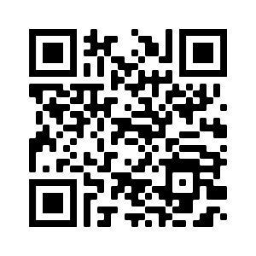
QR Code for register
https://forms.gle/qgBZYjy42v1P486N6

Slide 6
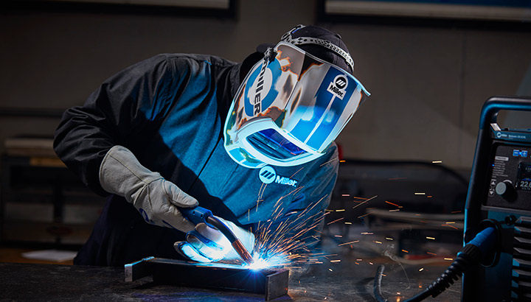
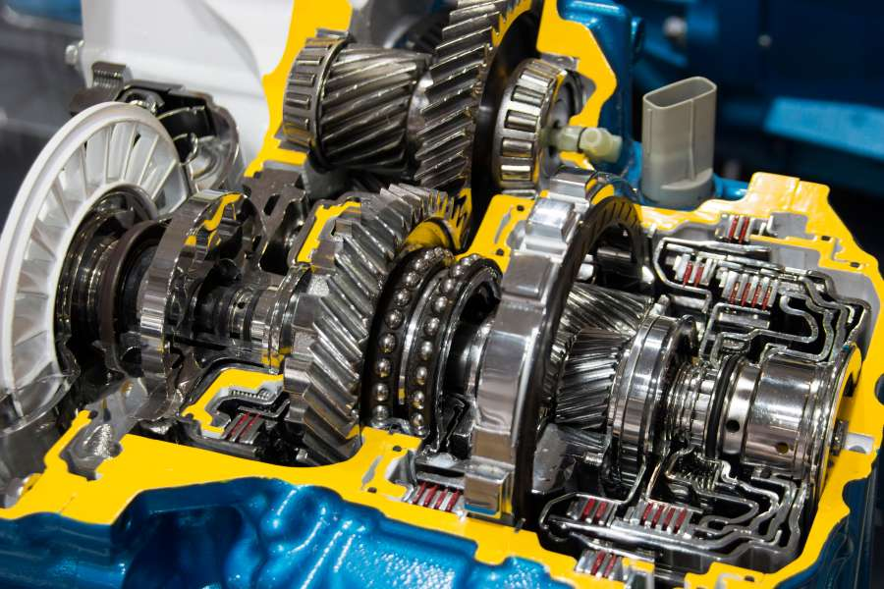
GDE AIM for 2026
50%
100%
5%

Slide 7

MECHANICAL TECHNOLOGY HASHTAG
# 100/55/5/90
BACHELORS
PASS RATE
55%
100%
PROGRESSED LEARNERS
PASS RATE
DISTINCTIONS
90%
5%

Slide 8
Statistics for GDE
14 January to 27 March
Curriculum coverage statistics for GDE
Update EVERY Week.
Link was emailed and send via WhatsApp (Pinned).
First update was due 13 of February 2026
ONCE a month – comprehensive update – link will be send via email and WhatsApp
Google forms – Teacher profiles needs to be updated yearly.
Will send link was sent via WA.

Slide 9
2025 NSC Examinations – SEDIBENG EAST/WEST
& GAUTENG EAST
Total of 9 (improved by 2) distinctions across all three specialisations in the three districts + Hans Moore!
> Automotive = 0
> Fitting & Machining = 9
> Welding & Metalwork = 0
Schools with large numbers obtained distinctions.
Number of Level 6 obtained:
> Automotive = 12 (2025 = 4)
> Fitting & Machining = 17 (2025 = 19)
> Welding & Metalwork = 3 (2025 = 1)

Slide 10
2025 NSC Examinations – SEDIBENG EAST/WEST
& GAUTENG EAST
Total of 9 (improved by 2) distinctions across all three specialisations in the three districts + Hans Moore!
> Automotive = 0
> Fitting & Machining = 9
> Welding & Metalwork = 0
Schools with large numbers obtained distinctions.
Number of Level 6 obtained:
> Automotive = 12 (2025 = 4)
> Fitting & Machining = 17 (2025 = 19)
> Welding & Metalwork = 3 (2025 = 1)

Slide 11
GR 12 DISTRICT RESULTS - Average
Specialisation | SE | SW | GE | EN
Automotive | 48,33 | 47,83 | 55,48 | =
Fitting & Machining | 43,94 | 49,04 | 55,75 | 54,67
Welding & Metalwork | 41,60 | 42,92 | 52,01 | =
2024
Specialisation | SE | SW | GE | EN
Automotive | 46,46 | 52,5 | 56,48 | =
Fitting & Machining | 62,05 | 55,0 | 53,70 | 55,2
Welding & Metalwork | 39,47 | 45,28 | 46,82 | =
2025

Slide 12
GR 12 DISTRICT RESULTS – Pass Rates
Specialisation | SE | SW | GE | EN
Automotive | 100 | 100 | 100 | =
Fitting & Machining | 94 | 92 | 100 | 100
Welding & Metalwork | 95 | 93 | 100 | =
2024
Specialisation | SE | SW | GE | EN
Automotive | 96  | 100  | 100  | =
Fitting & Machining | 100  | 98,5  | 100  | 100 
Welding & Metalwork | 96  | 100  | 88  | =
2025

Slide 13
Automotive
5/6 Schools obtained 100% pass rate.
Total of 0 distinctions
4/6 Schools obtained above 50% subject average.

Slide 14
RESULTS
District Name | Centre Name | Distinctions | %Average | Pass %
GAUTENG EAST | SPRINGS TECHNICAL SCHOOL | 0 | 59,12 | 100
GAUTENG EAST | HOERSKOOL DIE ANKER | 0 | 53,83 | 100
SEDIBENG WEST DISTRICT | HOER TEGNIESE SKOOL CAREL DE WET | 0 | 52,5 | 100
SEDIBENG EAST | PHOENIX HIGH SCHOOL | 0 | 51,5 | 100
SEDIBENG EAST | THUTO LORE SECONDARY SCHOOL | 0 | 45,61 | 100
SEDIBENG EAST | GENERAL SMUTS HIGH SCHOOL | 0 | 42,28 | 89

Slide 15
Fitting & Machining
10/11 Schools obtained 100% pass rate.
Total of 9 distinctions (5 in 2025)
7/11 Achieved above 50% subject average.
2/11 Achieved above 60 % subject average
1/11 Achieved above 70% subject average
GE – 5
EN - 2
SE – 1
SW – 1

Slide 16
Fitting & Machining
HS Hans Moore – 2
Springs Boys High School – 3
Springs THS – 2
Phoenix High School – 1
HTS Carel de Wet THS – 1

Slide 17
RESULTS
District Name | Centre Name | Distinctions | %Average | Pass %
SEDIBENG WEST DISTRICT | HOERSKOOL TRANSVALIA | 0 | 74,5 | 100,0
GAUTENG EAST | SPRINGS BOYS HIGH SCHOOL | 3 | 63,43 | 100,0
SEDIBENG EAST | PHOENIX HIGH SCHOOL | 1 | 62,05 | 100,0
GAUTENG EAST | SPRINGS TECHNICAL SCHOOL | 2 | 58,89 | 100,0
EKURHULENI NORTH | HOERSKOOL HANS MOORE | 2 | 55,2 | 100,0
SEDIBENG WEST DISTRICT | THUTO-TIRO COMPREHENSIVE | 0 | 53,88 | 100,0
GAUTENG EAST | HOERSKOOL DIE ANKER | 0 | 51,64 | 100,0
GAUTENG EAST | HOERSKOOL JOHN VORSTER | 0 | 48,94 | 100,0
SEDIBENG WEST DISTRICT | HOER TEGNIESE SKOOL CAREL DE WET | 1 | 48,29 | 100,0
GAUTENG EAST | LABAN MOTLHABI COMPREHENSIVE SCHOOL | 0 | 45,61 | 100,0
SEDIBENG WEST DISTRICT | SIZANANI THUSANANG COMPREHENSIVE SCHOOL | 0 | 43,32 | 94,1

Slide 18
Welding & Metalwork
6/10 Schools obtained 100% pass rate.
Total of 0 distinctions
2/10 Schools obtained above 50% subject average.

Slide 19
RESULTS
District Name | Centre Name | Distinctions | %Average | Pass %
GAUTENG EAST | SPRINGS TECHNICAL SCHOOL | 0 | 55,06 | 100
GAUTENG EAST | PROTEASKOOL / SCHOOL | 0 | 53,25 | 100
SEDIBENG WEST DISTRICT | HOER TEGNIESE SKOOL CAREL DE WET | 0 | 47 | 100
SEDIBENG WEST DISTRICT | SIZANANI THUSANANG COMPREHENSIVE SCHOOL | 0 | 46,17 | 100
SEDIBENG WEST DISTRICT | THUTO-TIRO COMPREHENSIVE | 0 | 42,68 | 100
SEDIBENG EAST | THUTO LORE SECONDARY SCHOOL | 0 | 41,93 | 100
GAUTENG EAST | MAMELLONG COMPREHENSIVE | 0 | 42,63 | 88
SEDIBENG EAST | PHOENIX HIGH SCHOOL | 0 | 37 | 88
GAUTENG EAST | ESIBONELWESIHLE SECONDARY|SCHOOL | 0 | 41,5 | 80
GAUTENG EAST | LABAN MOTLHABI COMPREHENSIVE SCHOOL | 0 | 41,64 | 71

Slide 20
AUTOMOTIVE GRADES 10 AND 11
District of School | Name of School | Specialisation | Grade 10 Average | Grade 10 Pass % | Grade 11 Average | Grade 11 Pass %
Sedibeng West | Hoër Tegniese Skool Carel De Wet | Automotive | 49 | 100 | 52 | 100
Sedibeng East | Thuto Lore Secondary School | Automotive | 46 | 100 | 39 | 78
Sedibeng East | Phoenix High school | Automotive | 35 | 88 | 39 | 100
Gauteng East | Hoër Tegniese Skool Springs | Automotive | 43 | 89 | 44 | 95
Gauteng East | Hoërskool Die Anker | Automotive | 53 | 97 | 59 | 100

Slide 21
FITTING AND MACHINING – GRADES 10 AND 11
District of School | Name of School | Specialisation | Grade 10 Average | Grade 10 Pass % | Grade 11 Average | Grade 11 Pass %
Ekurhuleni North | Hoërskool Hans Moore | Fitting & Machining | 49 | 100 | 56 | 100
Gauteng East | Hoër Tegniese Skool Springs | Fitting & Machining | 41 | 74 | 37 | 74
Gauteng East | Hoërskool Die Anker | Fitting & Machining | 48 | 93 | 47 | 100
Gauteng East | Springs Boy's High | Fitting & Machining | 47 | 100 | 48 | 100
Gauteng East | Hoerskool John Vorster | Fitting & Machining | 41 | 100 | 47 | 98
Gauteng East | Laban Motlhabi Comprehensive School | Fitting & Machining | 35 | 69 | 41 | 100
Sedibeng East | Thuto Lore Secondary School | Fitting & Machining | 46 | 100 | 48 | 100
Sedibeng East | Phoenix High school | Fitting & Machining | 31 | 47 | 44 | 100
Sedibeng West | Thuto-Tiro Comprehensive School | Fitting & Machining | 47 | 96 | 43 | 92
Sedibeng West | Hoër Tegniese Skool Carel De Wet | Fitting & Machining | 43 | 96 | 38 | 93
Sedibeng West | Transvalia Hoërskool | Fitting & Machining | 52 | 100 | 48 | 100
Sedibeng West | Sizanani-Thusanang Comprehensive School | Fitting & Machining | 17 | 17 | 26 | 17

Slide 22
WELDING AND METALWORK– GRADES 10 AND 11
District of School | Name of School | Specialisation | Grade 10 Average | Grade 10 Pass % | Grade 11 Average | Grade 11 Pass %
Gauteng East | Protea Special School | Welding & Metalwork | 51 | 100 | 46 | 100
Gauteng East | Hoër Tegniese Skool Springs | Welding & Metalwork | 35 | 73 | 39 | 69
Gauteng East | Mamellong Comprehensive | Welding & Metalwork | 25 | 29 | 38 | 78
Gauteng East | Laban Motlhabi Comprehensive School | Welding & Metalwork | 41 | 93 | 41 | 100
Sedibeng East | Thuto Lore Secondary School | Welding & Metalwork | 35 | 30 | 36 | 46
Sedibeng East | Phoenix High school | Welding & Metalwork | 21 | 20 | 18 | 20
Sedibeng West | Hoër Tegniese Skool Carel De Wet | Welding & Metalwork | 43 | 100 | 36 | 100
Sedibeng West | Thuto-Tiro Comprehensive School | Welding & Metalwork | 52 | 96 | 51 | 55
Sedibeng West | Hoërskool Vanderbijlpark | Welding & Metalwork | 48 | 100 | 54 | 100
Sedibeng West | Sizanani-Thusanang Comprehensive School | Welding & Metalwork | 31 | 68 | 38 | 94

Slide 23
IMPORTANT TO REMEMBER
Previous examination papers NB!!!!!
PLANNING!
Proper PAT tasks!
OWN PAT tasks!
Quality Assessments – March / June assessments
Informal assessments.
Support programs and content for highflyers to enhance number of distinctions
RESULT IN EXCELLENT PASS RATES!

Slide 24

To each and every educator who worked very hard.
By placing the interest of the learner first.
For your dedication to the subject

Slide 25
Management Plan
Management plan for school visits had been sent with email.
School visits to start 5 February 2026.
GDE / DBE responsibilities – will inform in due time if any changes will occur in management plan for school visits.
Next SUBJECT MEETING – 16 March 2026 – SE/SW
– 17 March 2026 – GE

Slide 26
Curriculum delivery and ATP completion
Educators do not teach all content – last year found whole topics missing!
Teach according to Revised ATP 2023/24/25 content for Grade 10 and 11.
Grade 12 – NO trimming of ATP! – LOOK at Revised as some content shifted to Term 3!
ATP’s with % available on website for downloading.
SBA moderation in 2025 clearly showed educators did NOT USE the ATP’s with the allocated percentages.
D.H.’s to monitor ATP’s EVERY two weeks.
Questions AND Answers in learner’s books.
Curriculum behind – need to show strategies for catching UP!
Registers to be kept on ANY type of extra class.
Subject Improvement Plan to be submitted to DSA – 20 February 2026

Slide 27
SCHOOL VISITS AND SUPPORT
PLC support important – USE MS Teams or face-to-face.
If needed – I will arrange Teams meetings for educators and download registers.
Give support, but educators DO NOT implement support strategies and suggestions in order to make teaching and curriculum delivery more effective.
Email or WhatsApp if support is needed – concerning that only a few do this.
Upon visits – “I did not know” or “I did not understand” “You are here now”– Serious implication on quality teaching.
Support visits – monitor class teaching and teaching methods.
Focus – UP schools will get more visits.

Slide 28
ADMINISTRATION and PLANNING
SBA and PAT files – separate
Teacher files – Table of content visible with content updated.
PAT files WITH mark sheets.
NO test/exam may leave the school premises.
NO PAT task or part of it to leave school premises.
Proper planning MUST be available for verification on school visit
Planning – WHAT / WHEN / HOW teaching is going to take place WITH ALL specified assessments included in planning
ATPs to be kept updated daily!
Please complete Educator Profiles on Google Forms – Link will be send via WA

Slide 29
Moderation colour pens – Post moderation
School level – Green pen
District level – Orange pen
Provincial level – Pink pen

Slide 30
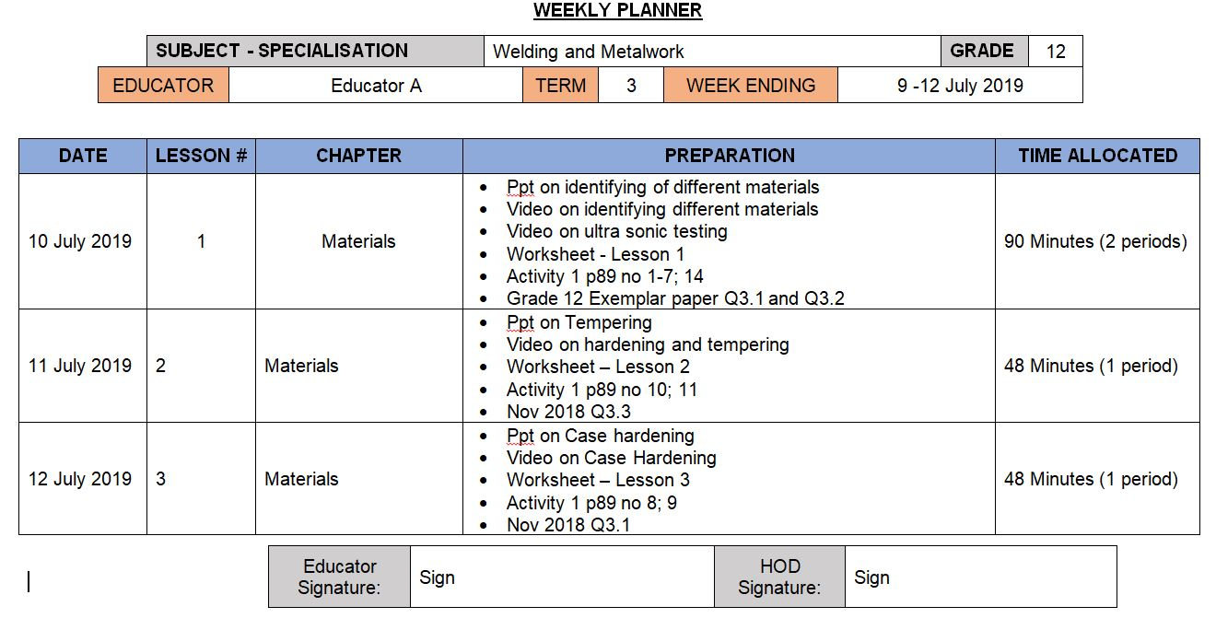
Complete Weekly Planner

Slide 31
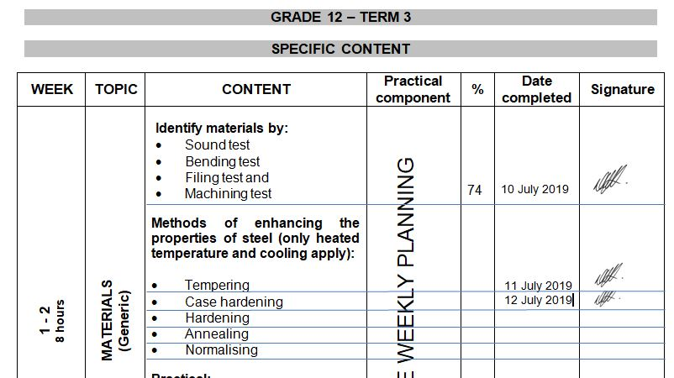
Complete ATP

Slide 32
Grade 12 Roadshows
Will be held on MS Teams from 3 – 5 February 2026
CONCERN – Absence from educators in 2025 …..
PAT MEDIATION – ALL SPECIALISATIONS
Poor attendance – Late log in.
Teams platform
Time: 14:30 – 16:30
Grade 10 – 12 PAT was discussed.
Automotive – 10 February
Fitting and Machining – 12 February
Welding and Metalwork – 13 February

Slide 33
Mark sheets
Composite Mark sheet:
Mark sheet is available on the website for download.
New weightings for Grade 10/11 on PAT in Term 2 and 3.
Use Phase 4 for Phase 2 and Phase 2 for Phase 4 on SASAMS.
PAT mark sheets in PAT documents.

Slide 34
Baseline assessments
Develop OWN Baseline assessments
GDE to monitor
D.H. to MONITOR!!
To establish WHAT previous content knowledge learner brings to your class.
Baseline assessment to be conducted for Grade 11 and 12 BEFORE EACH TOPIC!
“Conduct and record baseline assessments at the beginning of each topic to inform teaching and learner support.”
POLICY REFERENCE: CAPS Section 4 (Assessment to inform teaching); NPA – Continuous assessment principles.

Slide 35
Term 1 Formal Assessments – GradeS 10 – 12
Grades 10 – 12: TEST – 60 minutes.
Grades 10 – 12 Guideline in pre-moderation tool. USE IT.
NO 2 or 3 different tests and then add to make 50!
Set own tests.
D.H. To pre- and post MODERATE!!
Term 1 SBA mark
ONLY work done in Term 1 to be assessed.
DO NOT accept average of below 50%!
MUST be SEND to DSA for APPROVAL!!
PLC welcome!

Slide 36
Informal assessments
Informal assessment MUST be done.
Grade 10/11 can previous exam/test papers be used as extra assessments/homework. Must be recorded
Grade 12 – NB!!! – Use last 5 NSC papers as top-up to informal assessments given to candidates.
Informal assessments/homework to be done in learners books.
D.H. to monitor informal assessments
GDE will monitor informal assessments and must report back to DBE on amount and progress of informal assessments.
When learners are at home – assignments / research tasks to be given and must be monitored / checked by educators on return.
Schools with poor 2025 SBA marks – shows CLEARLY lack of informal assessments!

Slide 37
Progress / High Risk / Retained learners
SEPARATE name list for progressed learners – Grades 10 – 12
MUST be evident in Educator file AND D.H file.
Progressed learners' names to be submitted to DSA by 20 February 2026
Weekly extra classes for Progress / High Risk / Retained learners. – NON NEGIOTIABLE (S.I.P.)
Registers evident where learners sign for attendance each week.
Remedial work – NO HOMEWORK – Learners work in class
Separate book – Cover Page – Subject Intervention and Learner name.
Record communication to parents of absence.

Slide 38
PAT Tasks
PAT tasks on website for download.
DBE PAT Mediation on ALL PAT will be conducted on MS Teams 19 February 2026 14:00 -16:00 – COMPULSARY!
Guidelines and requirements will be clearly indicated in mediation.
DH’s to monitor PAT progress.
Phase 1 to be completed by end of Term 1.
Do not wait to continue – Grade 12 WM can quickly finish Phase 1 and already start preparations for Phase 4.
Grade 12 FM and WM – minor changes to Phase 3 – will inform on re-upload.

Slide 39
IMPORTANT MATTERS RE PAT
OWN PAT tasks COMPULSARY!
READ instructions in the documents.
WHOLE document must be in EACH learner PAT file
Follow instructions for assessment in PAT document
Learners to conduct self assessment FIRST BEFORE educator assess!
USE rubrics and do not thumb-suck marks!
Auto – Procedures – NO learner complete it – Educator do
SIGNATURES!!!! Learners AND Educators NB!!!!

Slide 40
Registers
Daily class attendance registers MUST be kept! – It is policy! Please have on hand during visits to verify.
Record must be kept of Grade 12 learners being absent.
D.H. and parents to be kept up to date with learners being absent if no valid reason has been provided to the school.
Catch-Up plan for leaners WHO was absent with valid reasons.
EXCEL Register available on website for use.
Stock/Asset registers MUST be updated – especially where new equipment, tool and material being delivered. Please have on hand during visits to verify.
GDE to monitor asset registers.

Slide 41
TRAINING
EPTD SETA Training nearing end. Congratulations on those who completed the program.
GDE Training Dates: 14 February / 28 February / 14 March
July is still to be confirmed
If any changes occur – educators will be informed in due time.

Slide 42
PLC
Imperative for professional development!
Need Agenda and register for Head Office.
All educators need to engage in PLC meetings – GDE requirement.
If needed – will arrange Teams meeting should educators want to.
Inform me in due time!

Slide 43
Website
www.mtechedusupport.co.za
For your support!

Slide 44


SOME THOUGHT

Slide 45
Questions
?

