Slide 1
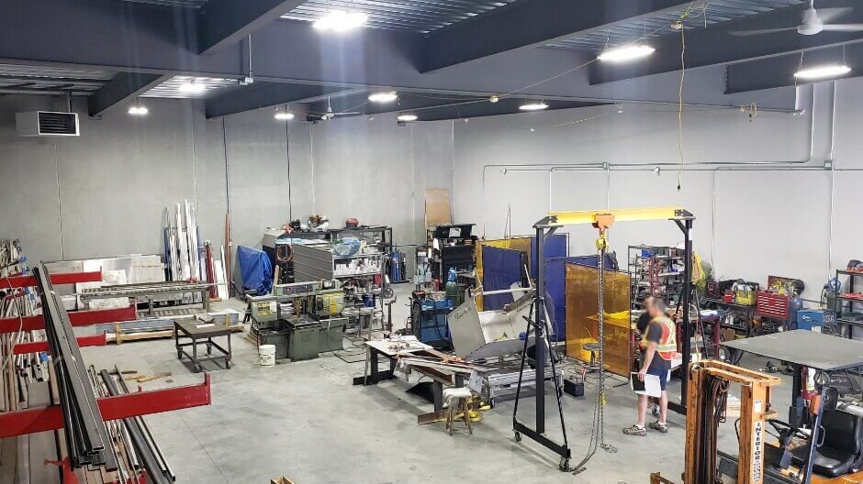
DEPARTMENT OF BASIC EDUCATION
MEDIATION OF THE 2026 GRADE 12 MECHANICAL TECHNOLOGY SPECIALISATIONS
PRACTICAL ASSESSMENT TASK
Date
Grade 12
10 FEBRUARY 2026

Slide 2
Navigation
PRESENTATION OUTLINE
01
Purpose
02
Introduction
Objectives of PAT mediation session
Assessment framework and PAT requirements
03
Components of the PAT
04
Challenges Regarding 2025 PAT
Structure and implementation timeline
Issues identified during moderation
05
Guidelines to Teachers
06
Delegation of Tasks
Best practices and implementation guidance
Roles and responsibilities matrix
07. Conclusion
Key success factors and summary

Slide 3
Section A
PURPOSE
1
Present the 2026 PAT
Present and mediate to the Grade 12 Teachers for Electrical Technology –the 2026 PAT
2
Establish Shared Understanding
To establish a shared understanding of the PAT assessment criteria and standards
3
Bring Clarity
Bring clarity to the assessment criteria and evaluation standards for all stakeholders
Key Focus
This mediation session aims to ensure all Grade 12 Electrical Technology teachers have a clear, unified understanding of the 2026 PAT requirements, assessment criteria, and implementation procedures.
4
Convey Challenges
Convey challenges experienced during PAT moderation in 2025 to prevent recurrence

Slide 4
Section B
INTRODUCTION
Assessment Framework
Assessment in the National Senior Certificate comprises multiple components designed to provide a comprehensive evaluation of learner performance:
School-Based
Assessment
Practical
Assessment Tasks
Language Oral
Assessment
External
Examinations
Continuous assessment conducted throughout the academic year by teachers
Hands-on practical tasks assessing skills not measurable in written format
Oral examinations for official languages to assess communication skills
Final written examinations administered and marked externally
25%
25%
Included
75%
Note: The PAT is a compulsory component for all subjects with a practical component, ensuring learners demonstrate applied skills and knowledge.

Slide 5
Section B
INTRODUCTION
PAT Requirements & Weighting
PAT Weighting
Grade 12 Moderation
25%
Teacher Assessment
(100 marks)
Practical tasks assessed by the subject teacher
A practical assessment task (PAT) mark is a compulsory component of the final promotion mark for all candidates offering subjects with a practical component.
External Moderation
Provincial subject specialists conduct moderation
DBE Oversight
Department of Basic Education team/panel involvement
Implementation Timeline
The PAT is implemented across the first three terms of the school year.
Critical Requirement
Terms 1, 2, and 3
Schools must ensure that all learners complete the practical assessment tasks within the stipulated period to ensure learners are resulted at the end of the school year.
Assessment Purpose
The PAT allows for learners to be assessed on a regular basis during the school year and assesses skills that cannot be evaluated in a written format.
Provincial Responsibility
Setting up moderation timetables

Slide 6
Section B
INTRODUCTION
PAT Design Principles & Requirements
Skill Integration & Problem Solving
Practical assessment tasks are designed to develop and demonstrate a learner's ability to integrate a variety of skills to solve a problem.
Technological Process
The PAT makes use of a technological process to inform the learner what steps need to be followed to derive a solution for the problem.
Timeline Compliance
The PAT should be completed during the FIRST THREE TERMS and must be ready at the start of PAT moderation.
Prohibitions
No Reuse
School Responsibility
Provincial departments or schools may NOT change or use the task of the previous year
Previous year tasks prohibited
Resources and funding
Resource Provision
Providing resources for the Practical Assessment Task is the responsibility of the school . Schools should ensure that adequate time and funding is allocated.

Slide 7
Section C
COMPONENTS OF THE PAT
Structure & Implementation Timeline
PAT Structure Overview
The PAT consists of four simulations and one practical project
1
TERM 1
2
TERM 2
3
TERM 3
Project Selection
Second Simulation
Project Finalization
Select practical project and procure material
Choose between Simulation 3 or Simulation 4
Finalize manufacturing of the project
Choose between Simulation 1 or Simulation 2
Complete simulation and record marks on SASAMS
Prepare for moderation
Complete simulation and record marks on SASAMS
Deadline: 31 August 2025
Continue project development
Teacher Choice: Select ONE project and TWO simulations
Compliance: Simulation 1 OR 2 + Simulation 3 OR 4 must be done
Critical: Projects must be ready for moderation start date
Simulation 1
Simulation 2
Simulation 3
Simulation 4

Slide 8
Section D
CHALLENGES REGARDING PAT 2025
Issues Identified During Moderation
Teacher Attendance
Groupwork Violations
Previous Year Reuse
Teachers not attending PAT mediation meetings
Groupwork is NOT allowed
School using the previous year's PAT
Plagiarism Issues
Moderation Timing
Timeline Violations
NO copying of any form is allowed
School moderation PAT plan in Term 2 and 3
PAT Timelines not followed
Non-Operational Projects
Equipment Shortage
Missing Model Answers
Projects not being operational
Shortage of equipment
Teachers not having model answers or working project
Evidence Gaps
Instruction Issues
Marks awarded for facets with no evidence
Reading instructions not followed properly
Unrecorded Marks
Simulation marks not recorded each term
Learner Availability
PCB-Related Issues
Learners not available during moderation
• Using premanufactured PCB without making their own
Inadequate Moderation
PAT not moderated on all levels (School and district)
• Alternative PCB not same replica of prescribed circuit
• Improper use of measuring instruments
• Circuit operation problems

Slide 9
Section E
GUIDELINES FOR TEACHERS
Part 1 - Implementation & Administration
1
Mediate PAT with Learners
5
Teacher's Working Model
Mediate the PAT with the learners and share the do's and don'ts governing the PAT as outlined in the PAT document.
The teacher must build his/her own working model as a reference standard.
2
Formal Administration
6
Individual Projects Only
PAT is to be administered under strict formal setting as other Assessment tasks e.g. Assignment and Examinations.
Each learner builds their own PAT project - no sharing of PAT projects or pieces thereof.
3
Adhere to Timeframes
7
Declaration Form Legality
Adherence to the set time frames per term is critical for successful implementation.
The legality of the declaration form must be properly mediated with the learners.
4
Workshop-Only Construction
8
Implementation Planning
PAT projects to be built in the workshop only (no taking it home).
Prepare an implementation process plan and align it to the PAT Programme of Assessment plan.
Key Principle: Share the implementation plan with learners and the departmental head to ensure transparency and accountability.

Slide 10
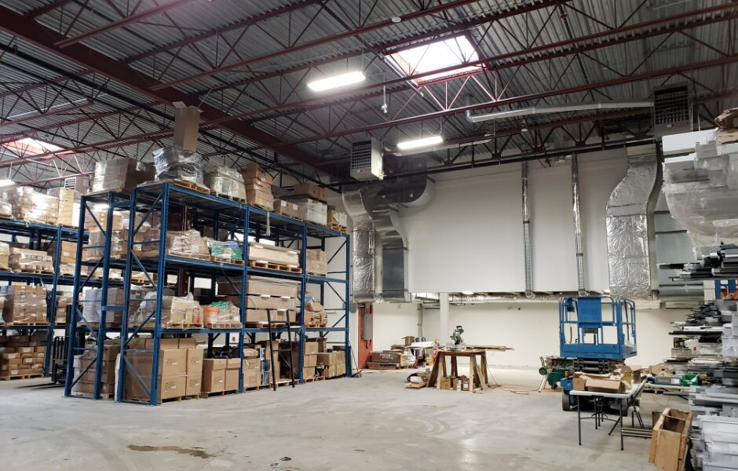
Section E
GUIDELINES FOR TEACHERS
Part 2 - Documentation & Assessment
9
Print PAT Documents
12
Use Model for Assessment
Print PAT documents for each learner to ensure everyone has access to requirements.
The teacher will use the model answers and project to assess the simulations and projects of the learners.
10
Display Rubric Copies
13
Identify Equipment Shortages
Make copies of the PAT Rubric and post it on the walls in the workshop for reference.
Identify shortages in tools, equipment and consumable items for simulations that must be procured.
11
Working Model & Model Answers
14
Share Procurement Document
Compulsory: Teacher must produce a working model and model answer file.
Share the developed procurement document with the School Management team.
This sets the baseline for assessment at a Highly Competent Level for every project choice.
Model Answer File Contents
All simulations with answers the teacher has done

Slide 11
Section E
NEW FACETS IN THE MARKSHEET
Updated Assessment Criteria for 2026
2026 Marksheet Updates
New marking criteria facets have been introduced
The 2026 PAT marksheet includes updated assessment criteria to better evaluate learner performance and ensure comprehensive assessment of practical skills in Power Systems.
Marksheet Facets Overview
Please refer to the official 2026 PAT document for complete marking criteria details
Planning & Design
Construction
Functionality
Documentation
Important: Teachers must familiarize themselves with all new facets and ensure learners understand the assessment criteria before commencing the PAT.

Slide 12
Section E
DESCRIPTION OF OPERATION
Documenting Circuit Functionality
Operational Documentation
Learners must provide a clear description of operation explaining how their circuit functions and operates under various conditions.
Required Elements
Circuit purpose and application
Component functions and interactions
Input/output relationships
Operating conditions and parameters
Safety considerations
Writing Guidelines
Use clear, technical language
Reference circuit diagrams
Explain step-by-step operation
Include expected outcomes
Assessment Note: The description of operation demonstrates the learner's understanding of circuit theory and practical application, forming a critical component of the overall PAT assessment.

Slide 13
Section F
DELEGATION OF TASKS AND RESPONSIBILITIES
Part 1 - Role Distribution Matrix
Clear delegation of responsibilities ensures successful PAT implementation across all stakeholder levels.
Departmental Head / SMT
Teacher
Learners
Subject Advisors / Coordinators
Facilitate procurement of PAT consumables, tools and equipment
Develop prototype of prescribed PAT project
Complete authenticity form declaring work is theirs
Set up moderation timetables per term
Assess learners continuously
Comply with Programme of Assessment
Ensure teacher is progressing with PAT from start of school year
Record marks on provided facet sheet
Monitor and support the PAT
Build individual projects (no groupwork)
Moderate the PAT per term
Monitor and support PAT implementation
Ensure SASAMS marks match marksheet
Provide guidance and training
Be available during moderation
Conduct internal moderation per term
Collaboration: Successful PAT implementation requires coordinated effort and clear communication among all stakeholders.

Slide 14
Section F
DELEGATION OF TASKS AND RESPONSIBILITIES
Part 2 - Assessment Finality & Moderation
Assessment Finality
SASAMS Verification
Once a facet sheet has been completed by the teacher, assessment will be deemed to be complete.
Teacher to ensure that the marks in the SASAMS correspond with the marks in the marksheet in the PAT file.
NO re-assessment will be done
Once facet sheets have been completed and captured by the teacher
SASAMS System
PAT Marksheet
Must Match
DH / SMT Responsibilities
Subject Advisors
Monitor and support PAT implementation
Setting up moderation timetables per term
Conduct internal in-school moderation per term
Monitor, support and moderate PAT per term
Quality Assurance: Multiple levels of moderation ensure fairness, consistency, and adherence to assessment standards across all schools.

Slide 15
Section G
CONCLUSION
Key Success Factors
1
Proper Planning
and Mediation
2
Adherence to
Programme
3
Monitoring &
Support
Proper planning and mediation of the PAT in schools will lead to learners performing well .
Adherence to the PAT Programme of Assessment ensures consistent implementation across all schools.
Monitoring and support by teachers, HODs and subject advisors will impact positively on learners achievement.
Foundation for success
Timelines and standards
Collaborative effort
Success Formula
Planning
+
Adherence
+
Support
=
Success
"Quality education requires quality assessment. The PAT is not just a task—it's an opportunity for learners to demonstrate their practical competence and readiness for the electrical technology industry."

Slide 16
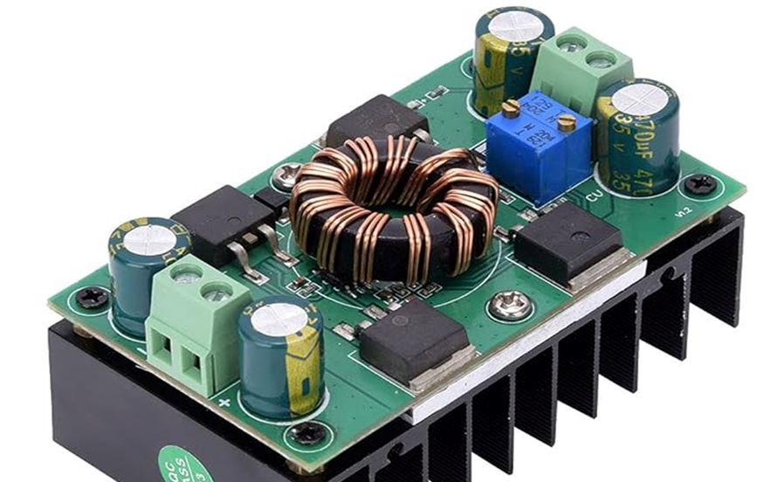
THANK YOU
Questions & Discussion
Electrical Technology PAT Mediation - Power Systems
Date
Subject
Grade
10 February 2026
Mechanical Technology
Grade 12
For Further Assistance
Contact your Provincial Subject Advisor or Department of Education Representative

