Slide 1
MECHANICAL TECHNOLOGY -
AUTOMOTIVE
PAT MEDIATION
Date: 19 FEBRUARY 2026

Slide 2

HOUSE RULES
Ensure that you are present and participate for the full duration.
Enter any meeting with your mic muted and camera off.
KEEP YOUR MIC MUTED. Most important: Keep your mic muted unless you need to speak.
Please raise your HAND if you have questions.

Slide 3
PRESENTATION OUTLINE
Purpose
Introduction
Components of the PAT
Challenges Experienced during 2025 PAT Moderation
Guidelines for educators
Points to note
Recommendations
Delegation of tasks and responsibilities

Slide 4
PURPOSE
To present and mediate to the Grade 12 Educators of Mechanical Technology – Automotive, the 2026 PAT.
To establish a shared understanding of the PAT assessment.
Bring clarity to the assessment criteria.
Convey challenges during PAT moderation 2025.

Slide 5
INTRODUCTION
Assessment of Mechanical Technology – Automotive in the National Senior Certificate comprises School-Based Assessment, Practical Assessment Tasks and external examinations.
A practical assessment task (PAT) mark is a compulsory component of the final promotion mark for all candidates and counts 25% (100 marks) of the end-of-the-year examination mark.

Slide 6
INTRODUCTION
The PAT is implemented across the first three terms of the school year.
The PAT allows for learners’ skills to be assessed on a regular basis during the school year.
It is therefore important that schools ensure that all learners complete the practical assessment tasks within the stipulated period to ensure that learners are resulted at the end of the school year.
Notes:
PATs must be completed by the end of August 2026 as is prescribed on page 7, bullet no. 5 in the 2026 Automotive Guidelines for Practical Assessment Tasks .

Slide 7
INTRODUCTION
Grade 12 PAT is assessed by …
  the educator,
  INTERNALLY MODERATED by the Departmental Head for Mechanical Technology at the school and
  will then be externally moderated by the PED and DBE.
The PAT should be completed during the FIRST THREE TERMS and all tasks must be completed by the start of PAT moderation.
PAT Tasks should be completed in time for External moderation.
Notes:
It is my experience that learners who have a good knowledge of the PAT tend to perform much better at the SBA.

Slide 8
INTRODUCTION
Practical assessment tasks are designed to develop and demonstrate a learner's ability to integrate a variety of skills to solve a problem.
The PAT also makes use of a technological process to inform the learner what steps need to be followed to derive a solution for the problem.
The provincial education departments or schools may not change the PAT nor use the PAT tasks of previous years.
Providing the resources for the Practical Assessment Task is the responsibility of the school and schools should ensure that adequate time and funding is allocated for the completion of the Practical Assessment Task.

Slide 9
COMPONENTS OF THE PAT
The PAT comprises of SEVEN practical tasks.
TASK 7 (Engine components measurement) is compulsory = 100 marks
The educator may choose any THREE of the remaining SIX tasks = 50 marks each
The total number of tasks to be completed = 4 (3 choices + 1 compulsory) for total = 250 marks

Slide 10
COMPONENTS OF THE PAT
CHOOSE ANY 3 TASKS FROM TASK 1 TO TASK 6:
TASK 1: Cooling system test
TASK 2: Cylinder leakage test
TASK 3: Exhaust gas analysis
TASK 4: Wheel balancing
TASK 5: Charging system
TASK 6: Computerised diagnostic scanner
+ COMPULSORY TASK:
TASK 7: Engine components measurement

Slide 11
Challenges Experienced during 2025 PAT Moderation
Inflated or Unjustified Marks:
  Learners cannot receive marks if they lack understanding of test components or are unable to interpret assessment results (for example, interpreting diagnostic scanner fault codes).
  Learners often skipped the setup process of tasks.
Group Work Irregularities: Practical procedures assessed in groups constitute a major irregularity and may lead to candidates not being resulted.
Off‑site Assessments: All assessments must take place under controlled conditions, with clear evidence of learner performance. Off‑site engine measurement tasks submitted without proof were rejected in 2025.
Notes:
Learners often skipped the setup process of tasks.

Slide 12
Technical Skill & Tool Requirements
Coaching During Assessment: Moderators noted instances of learners receiving assistance during assessments. This invalidates the results.
Low skill competency: Learners displayed low ability to complete some tasks. This reflected badly on the educator.
Multimeter Usage: Candidates did not know how to use a multimeter.
Micrometer vs. Vernier: Task 7 (bore measurement) cannot be done with a vernier caliper; educators must ensure outside/inside micrometers and dial bore/telescopic gauges are available and that learners are competent in using them.
Battery Maintenance: A simple but critical addition—ensure all engine batteries are charged before assessment begins, as flat batteries hindered moderation in 2025.

Slide 13
Prerequisite: Manufacturer Specification Sheets
The "No Spec, No Start" Rule: Educators must compile the Manufacturer Specification Sheets (using the example at the end of the PAT document) before any assessments take place.
Verification: Educators should record specific engine measurements in their own marking guidelines to gauge candidate accuracy.
Performance of tasks: Learners were given the worksheets while performing procedures. This is a major assessment irregularity.

Slide 14
Administrative Integrity
Asset Register Accountability: Many schools had incomplete or missing asset registers. This severely affects the educator's ability to identify tool shortages early in the year.
Meaningful Internal Moderation: We need to move beyond "Shadow Moderation." Reports found that some internal moderators simply copied marks from educators, whether correct or incorrect.
Signatures: Educators are reminded that both the candidate and educator must sign and date worksheets immediately upon completion of a task to validate the marks.

Slide 15
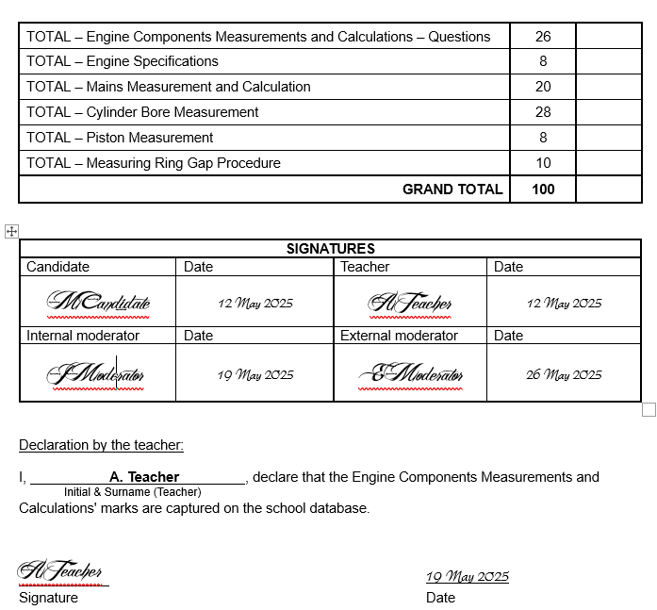

Slide 16
Other Challenges Experienced
Instructions for tasks were not followed, resulting in deviations from the prescribed guidelines.
No structured plan with clear timeframes was developed for completing the tasks.
Tools, equipment, and consumables were not procured timeously.
Evidence of completed Grade 10 and 11 tasks was not available when requested by moderators.
Workshops and equipment were poorly maintained.
Internal moderation was often not conducted.

Slide 17
GUIDELINES FOR EDUCATORS
The Automotive PAT consists of TWO documents:
  GUIDELINES FOR PRACTICAL ASSESSMENT TASKS
    This document must be made available to the learners
  EDUCATOR GUIDELINES FOR PRACTICAL ASSESSMENT TASKS
    Only EDUCATORS should have access to this document. DO NOT SHARE with learners.
The PAT contains TWO types of assessments:
  PROCEDURES: practical tasks which require tools & equipment
  QUESTIONS: written tests administered under strict formal settings

Slide 18
GUIDELINES FOR EDUCATORS
Mediate the PAT with the learners and share the dos and don’ts governing the PAT as outlined in the GUIDELINES FOR PRACTICAL ASSESSMENT TASKS which are amongst others:
  PAT assessment is to be administered under strict formal settings as with other Assessment tasks e.g. Assignment and Examinations
  Adherence to the set time frames per term
  The legality of the declaration form and the signing of each mark sheet must be properly mediated with the learners.

Slide 19
GUIDELINES FOR EDUCATORS
Prepare a PAT implementation process plan and align it to the PAT programme of Assessment plan and share it with the learners and the departmental head.
Educators MUST compile the manufacturer's specifications of the engines and vehicles available in their workshops before the tasks can commence.
Candidates must have access to these specification sheets during the tasks.

Slide 20
GUIDELINES FOR EDUCATORS
The candidate must complete the procedures practically (NOT a written task).
The educator records reasons, readings, specifications, etc. provided by the candidate onto the worksheet. Learners should not have any worksheets while performing procedures except for TASK 7.
TASK 7: The candidate must be provided with WORKSHEET 7 during the assessment, as the candidate has to record his/her own measurements and perform the necessary calculations.

Slide 21
GUIDELINES FOR EDUCATORS
On completion of each task in each term, the marks for the completed task need to be recorded on the mark sheet provided by PED.
Candidates must sign and date the worksheet on completion of every task.
At least one task must be completed each term.
The additional compulsory task must be completed during either
Term 1, Term 2 or Term 3.
Print PAT documents for each learner.

Slide 22
GUIDELINES FOR EDUCATORS
Compulsory: The educator is required to …
  complete all the assessments him/herself prior to assessing candidates to ensure that tools and equipment are in proper working condition.
  identify possible challenges.
  use the answers obtained, to gauge and assess the accuracy of the tasks of the learners.
  identify shortages in tools, equipment and consumable items for tasks that must be procured.
  share the developed procurement document with the School Management Team.

Slide 23
POINTS TO NOTE
TASK : Compression test and TASK : Wheel alignment are not included this year.
TASK 1: Cooling system test, which is a new task, has been added.
There are other changes that will be mediated later.
It is important that educators confine themselves to the GUIDELINES FOR PRACTICAL ASSESSMENT TASKS – GRADE 12 – 2026.

Slide 24
POINTS TO NOTE
The COOLING SYSTEM TEST is a new task that has been introduced.
  Note the method used to test the thermostat.
6.2.8 - Some OBD scanners automatically provide the vehicles details. Learners must confirm/verify if the details are correct.
TASK 7: ENGINE COMPONENTS MEASUREMENT – the bore cannot be measured with a vernier caliper.
  The suggested tools to be used for this task are Outside Micrometer, Inside Micrometer, Telescopic Gauge and/or a Dial Bore Gauge.
  Other tools include a feeler gauge, vernier caliper and a burette with a stand and a transparent sheet.

Slide 25
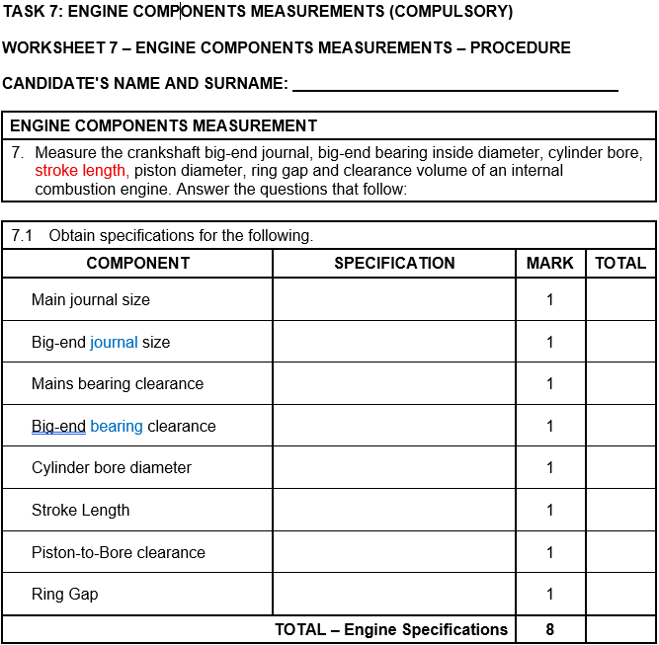
POINTS TO NOTE - CORRECTIONS

Slide 26
POINTS TO NOTE
The following tasks do NOT have a written component:
  Cooling System Test
  Cylinder Leakage Test
  Exhaust Gas Analysis
  Charging System
  Engine Components Measurement
All written tasks must be conducted under examination-controlled conditions.

Slide 27
POINTS TO NOTE
All PATs must be marked in RED by the educator.
PATs should then be moderated internally in GREEN.
  Internal moderation must be completed before it is moderated by Subject Adviser.
  Moderation will be done ever term where time allows.
District moderation is in ORANGE
Provincial moderation is in PINK.

Slide 28
RECOMMENDATIONS
Mark sheets must be signed by the Candidate, Educator and Internal Moderator on completion of tasks.
NO Group work by learners are allowed.
All FOUR PAT tasks MUST be completed by the learners individually.
Time frames for completion of tasks, as set out in the GUIDELINES FOR PRACTICAL ASSESSMENT TASKS, must be adhered to.

Slide 29
RECOMMENDATIONS
The PAT 2026 document MUST be used for all tasks.
Marks should be allocated fairly in accordance with the learners' performance during assessment.
Do not allocate undue or inflated marks.

Slide 30
RECOMMENDATIONS
Procure tools, equipment and consumables timeously.
Ensure tools, equipment and workshops are properly maintained to ensure safety and promote efficiency.
It is essential to have a plan of action to complete tasks on time.
Internal moderation must be performed.

Slide 31
DELEGATION OF TASKS AND RESPONSIBILITIES
DEPARTMENTAL HEAD/ SMT
Facilitate the procurement of PAT consumables, tools and equipment
DH/SMT has to ensure that the educator is progressing with the PAT from the start of the school year.
Monitor and support PAT Implementation.
Conduct Internal moderation per Term

Slide 32
DELEGATION OF TASKS AND RESPONSIBILITIES
EDUCATOR
Identify shortages in tools, equipment and consumables that must be procured for tasks.
Assess learners continuously and record marks on the provided facet sheets
Once a facet sheet has been completed by the educator, assessment will be deemed to be complete. No re-assessment will be done once the facet sheets have been completed and captured by the educator

Slide 33
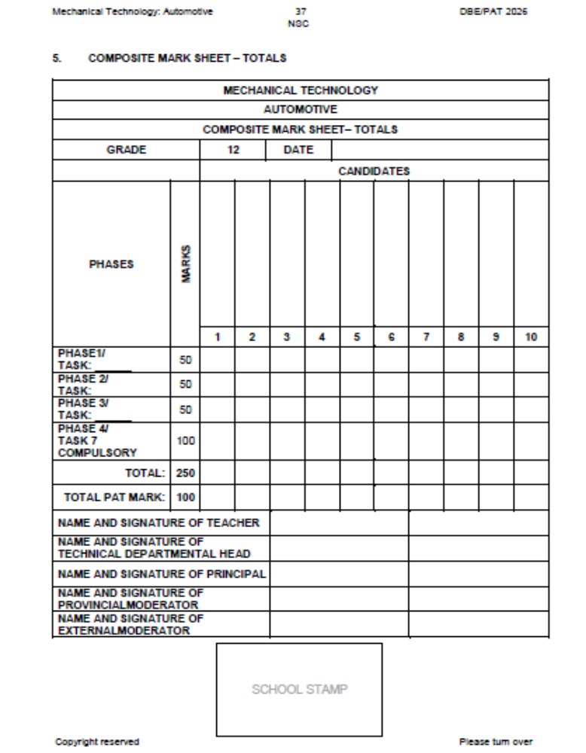

Slide 34
DELEGATION OF TASKS AND RESPONSIBILITIES
LEARNERS
Comply with programme of Assessment.
No Group work allowed.
Learners must complete the authenticity form declaring that the work are their own
Learners to sign all PAT tasks after completion of each task

Slide 35
DELEGATION OF TASKS AND RESPONSIBILITIES
SUBJECT ADVISORS/ CO-ORDINATORS
Setting up moderation timetables per term
Moderate the PAT per Term
Monitor the PAT and support the educator during school visits

Slide 36

Thank you!
Please raise your HAND if you have questions

