Slide 1
MECHANICAL TECHNOLOGY PAT MEDIATION
FITTING & MACHINING
Date: 19 February 2026

Slide 2
PRESENTATION OUTLINE
Purpose
Introduction
Components of the PAT
Guidelines for Teachers
E. Program of Assessment
F. Challenges during DBE PAT Moderation 2024
G. Delegation of Tasks and Responsibilities

Slide 3
A. PURPOSE
To present and mediate to the Grade 12 Teachers for Mechanical Technology – Fitting & Machining, the 2026 PAT
To establish a shared understanding of the PAT assessment,
Bring clarity to the assessment criteria and
Convey challenges experienced during PAT moderation in 2025.

Slide 4
B. INTRODUCTION
Assessment in the National Senior Certificate comprises School-Based Assessment, Practical Assessment Tasks, Language Oral Assessment for official languages and external examinations.
A practical assessment task (PAT) mark is a compulsory component of the final promotion mark for all candidates offering subjects that have a practical component and counts 25% (100 marks) of the end-of-the-year examination mark. The PAT is implemented across the first three terms of the school year.

Slide 5
INTRODUCTION
The PAT allows for learners to be assessed on a regular basis during the school year and it also allows for the assessment of skills that cannot be assessed in a written format, e.g. test or examination. It is therefore important that schools ensure that all learners complete the practical assessment tasks within the stipulated period to ensure that learners are resulted at the end of the school year.
Grade 12: The practical assessment tasks for Grade 12 will be assessed by the teacher, INTERNALLY MODERATED by Departmental Heads for Mechanical Technology at the school and will be externally moderated by the PROVINCIAL SUBJECT SPECIALISTS and the DBE team/panel.

Slide 6
INTRODUCTION
Provincial departments are responsible for setting up moderation timetables and consequently PATs should be completed in time for moderation. Refer to the PAT document for assessment time frame.
Practical assessment tasks are designed to develop and demonstrate a learner's ability to integrate a variety of skills to solve a problem. The PAT also makes use of a technological process to inform the learner what steps need to be followed to derive a solution for the problem.

Slide 7
INTRODUCTION
The PAT should be completed during the FIRST THREE TERMS and must be ready at the start of PAT moderation. PAT must be completed as per assessment program set in the PAT document.
The Provincial Education Departments or schools may not change the current PAT set for candidates or use the task of the previous year.
Providing the resources for the Practical Assessment Task is the responsibility of the school and schools should ensure that adequate time and funding is allocated for the completion of the Practical Assessment Task.

Slide 8
C. COMPONENTS OF THE PAT
The PAT consists of four phases .
TERM 1: Phase 1 (50 marks) must be completed by end of the term, and marks entered onto School Administration System (SA-SAMS). Phase 4 must be started.
TERM 2: Phase 2 (50 marks) must be completed, and marks entered onto School Administration System (SA-SAMS). Phase 4 must be continued.
TERM 3: Phase 3 (50 marks) AND 4 (100 marks) must be completed, PAT assembled, and marks entered onto School Administration System (SA-SAMS).

Slide 9
D. Guidelines for Teachers
Mediate the PAT with the learners and share the do’s and don'ts governing the PAT as outlined in the PAT document.
PAT is to administer under strict formal setting as other Assessment tasks e.g Assignment and Examinations
Adherence to the set time frames per term.
PAT projects to be built in the workshop under the supervision of the teacher. (learners are not allowed to take PAT home).
Each learner builds their own PAT project – (No sharing of PAT project or group work is allowed.)
The legality of the declaration form must be properly mediated with the learners
Prepare implementation process plan and align it to the PAT Programme of Assessment plan and share it with the learners and the departmental heads.

Slide 10
Print full PAT documents for each learner.
Make copies of the PAT Rubric and post it on the walls in the workshop.
Compulsory: The teacher is required to produce a working model that sets the baseline for assessment at a Highly Competent Level for the project exercised by the learners. This is stated on page 4, sub-section 2.1, paragraph 5 in the PAT Guidelines of 2026.
The teacher will use the rubrics on page 11 to assess the different phases of the learners.
Identify shortages in tools, equipment and consumable items for PAT that must be procured.
Share the developed procurement document with the School Management team.

Slide 11
Teachers must guide learners (Learners - Blue or Black pen) on how to conduct self-assessment and record their own marks on recording sheet.
Teacher to assess learners after learners has conducted self-assessment.
Record assessment onto recording sheet and provide feedback in comments column.
Internal moderation must be conducted by DH on same page as learner/teacher.
External moderators use same page as per learner to moderate.
Comments must be provided by teacher/moderators to provide continuous feedback.

Slide 12
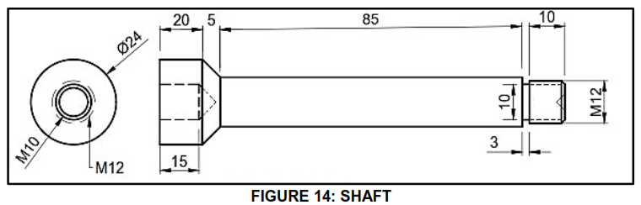
Note: PHASE 3
Shaft total comes to 123 mm

Slide 13
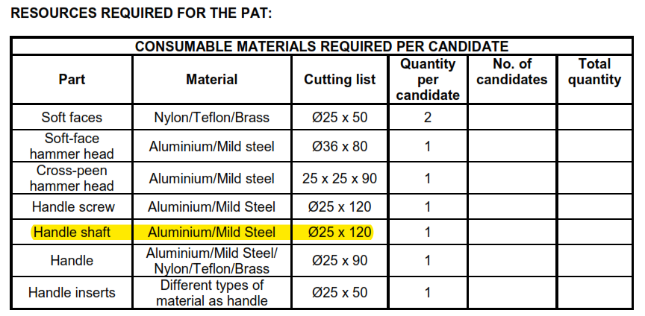
Material list indicated 120 mm – wise to always cut more as to clamp in the chuck.

Slide 14
Marking / Moderation
Correct colour pens must be used for marking / moderation.
Teacher – RED
DH – GREEN
District – ORANGE
Prov – PINK
DBE – TURQOISE
Umalusi – PURPLE
Marks of learners must be transferred to composite mark sheet (page 25)

Slide 15
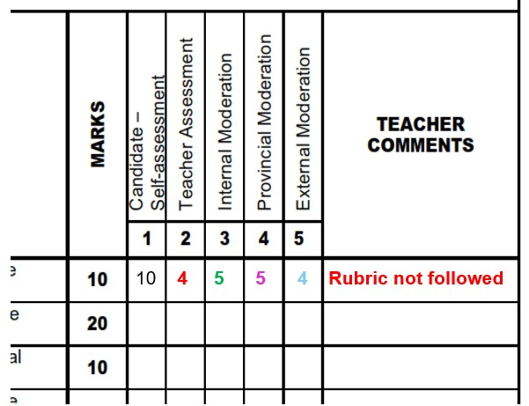
Example of assessment of PAT in document

Slide 16
E. Program of Assessment
All phases must be completed according to the program of assessment in these guidelines by the end of August 2026.
Provincial moderation must be conducted by the provincial education department (PED) in September 2026, to be ready for national external moderation in October 2026.

Slide 17
F. Challenges during DBE PAT Moderation 2025
The following challenges were experienced by the DBE moderation team in 2025:
Unsigned mark sheets – signature validate marks.
By learners
By educators
SASAMS not signed
Groupwork done by learners.
Incomplete PAT tasks.
Not adhering to time frames for completion set in PAT document.
Design instruction not followed – deviated from guidelines.
Extremely high marks for poor quality work done by learners.

Slide 18
Ghost marks – mark allocated for facets not done.
Very late procurement of material – as late as September 2025.
No Grade 10 and 11 PAT task was evident upon request by moderators.
Poor conditions of workshops and equipment, no general maintenance conducted by educators on machines and equipment.
No proper planning for completion of PAT drafted by educators.
No Internal moderation or monitoring of PAT by Departmental Heads of school evident.
No evidence of educator's own model to demonstrate to candidates the complete product.

Slide 19
G. DELEGATION OF TASKS AND RESPONSIBILITIES
Head od department/SMT | TEACHER | LEARNERS | Subject advisors/Coordinators
Facilitate the procurement of PAT Consumables ,tools and equipment | Teachers are supposed to draft consumable list and obtain quotations. Develop prototype of the Prescribed PAT project. | Learners must complete the authenticity form declaring that the work is their own (no groupwork was done). | Setting up moderation timetables per term. Monitor and support educators with the PAT. Moderate the PAT per Term for each phase .
DH to ensure that the teacher is progressing with the PAT from the start of the school year. | Assess learners continuously and record marks on the provided facet sheets. | Comply with programme of Assessment.
Monitor and support PAT Implementation |  |  | Support educator during school visits
Conduct Internal moderation per Term

Slide 20
Head od department/SMT | TEACHER | LEARNERS | Subject advisors/Coordinators
Monitor and support PAT Implementation | Once a facet sheet has been completed by the teacher, assessment will be deemed to be complete. No re-assessment will be done once the facet sheets have been completed and captured by the teacher | Learners must conduct self-assessment and record it on the recording sheet in their document. | Setting up moderation timetables per term. Monitor and support the PAT. Moderate the PAT per Term
Conduct internal school moderation per Term

