Slide 1

GAUTENG DEPARTMENT OF EDUCATION
SEDIBENG EAST/WEST
& GAUTENG EAST
Subject Meeting
Mechanical Technology Specialization
Automotive; Fitting & Machining; Welding & Metalwork
SE/SW – 16 March 2026 – 14:30
GE/EN – 17 March 2026 – 14:30

Slide 2
AGENDA
Welcome and Register.
Statistics for GDE.
Management Plan
School visits and Support
Curriculum delivery and ATP completion
Subject Improvement Plans
Administration and Planning
Mark sheets
Assignment and Baseline assessments.
Term 2 Formal Assessment.
SBA Moderation Phase 1
Informal assessments.

Slide 3
Progressed/High risk/Retained learners
PAT
PAT Moderation Phase 1
Registers.
Training.
Subject combination verification
SASAMS Marks verification
PLC
Important to remember
Website
Questions

Slide 4
Welcome and Register
Welcome to second subject meeting for 2025
Register via QR code – Google Forms
Please complete BEFORE 16:00 – register lock after 16:00

Slide 5
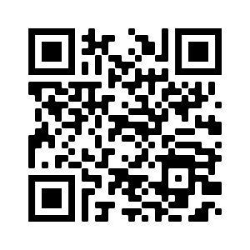
QR Code for register
https://forms.gle/qgBZYjy42v1P486N6

Slide 6
Statistics for GDE
14 January to 28 March
Curriculum coverage statistics for GDE
Update EVERY week.
CONCERN – not all school comply!
Monthly update due 17 March 2026
Link was emailed and send via WhatsApp.
Google forms – Teacher profiles needs to be updated yearly.

Slide 7
Management Plan
Management plan for school visits had been sent with email.
Term 2 will be sent in first week of Term 2.
GDE / DBE responsibilities – will inform in due time if any changes will occur in management plan for school visits.
Only available 8-10 April and then 20 April onwards due to DBE responsibilities.
Next SUBJECT MEETING – 20 April 2026 – SE/SW
– 21 April 2026 – GE
(SUBJECT TO CHANGE…..)
Second meeting in Term 2
– 18 May 2026 – SE/SW
– 19 May 2026 – GE

Slide 8
SCHOOL VISITS AND SUPPORT
Term 1 – a lot of new GDE and DBE responsibilities.
Changes to SV plans in this week …
Give support, but educators DO NOT implement support strategies and suggestions in order to make teaching and curriculum delivery more effective.
Email or WhatsApp if support is needed – concerning that only a few do this.
Upon visits – “I did not know” or “I did not understand” – Serious implication on quality teaching.
Support visits – monitor class teaching and teaching methods.
Reports – Not only reporting, but developmental tool as well.

Slide 9
Not ready for school visits …..
Focus on support and monitoring.
Support – Theory and PAT
Monitoring – Have the following ready:
Teacher files
Signed ATPs
Learner's books – Grades 10 – 12
DH file
List of progressed learners / High risk learners
Class registers

Slide 10
Curriculum delivery and ATP completion
Teach according to Revised ATP 2023/24/25/26 content for Grade 10 – 12.
Grade 12 – NO trimming of ATP! (FM – content movement)
ATP’s with % available on website for downloading.
Revised ATP’s – weekly coverage and % to assist planning – inform you on what to teach the particular week.
D.H.’s to monitor ATP’s EVERY two weeks.
Curriculum behind – need to show strategies for catching UP!
Registers to be kept on ANY type of extra class.

Slide 11
Subject Improvement Plan
Thank you for submissions of SIP.
Very few submitted – reported to HO of outstanding on 18 March
Some SIP very vague
Template provided.
Template available on website for download
SIP MUST be submitted EVERY Term after result analysis.
Document name:
Subject Improvement Plan (School + Subject) – Template
Example: Subject Improvement Plan (Phoenix HS – Fitting)

Slide 12
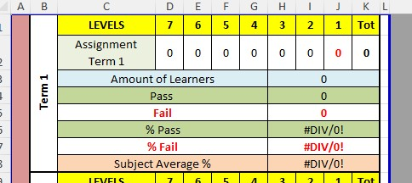

Slide 13
ADMINISTRATION and PLANNING
SBA and PAT files – separate
Teacher files – Table of content visible with content updated.
PAT files WITH mark sheets.
NO test/exam may leave the school premises.
NO PAT task or part of it to leave school premises.
Proper planning MUST be available for verification on school visit
Planning – WHAT / WHEN / HOW teaching is going to take place WITH ALL specified assessments included in planning
Going to revise WEEKLY planner to include what info is needed.
ATPs to be kept updated daily! – IT IS POLICY
Please complete Educator Profiles on Google Forms – Link will be send again via WA

Slide 14
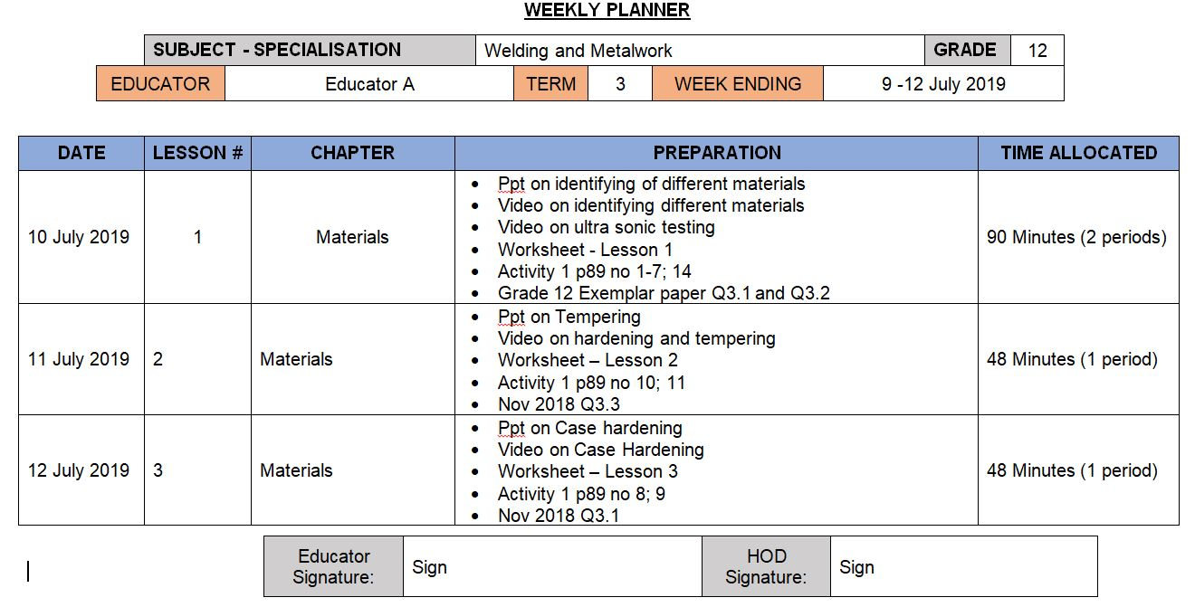
Complete Weekly Planner

Slide 15
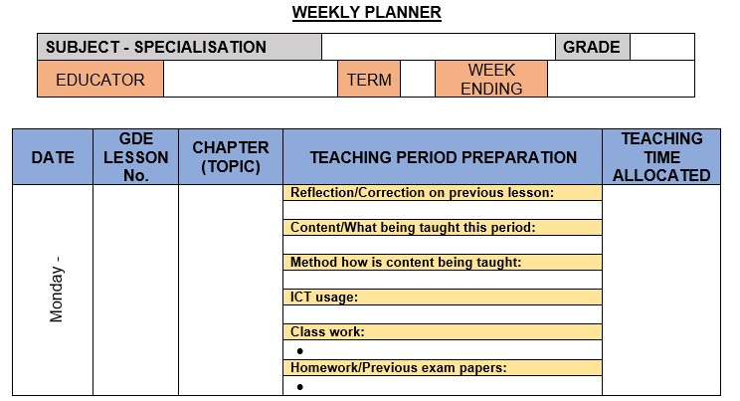
NEW WEEKLY PLANNER

Slide 16
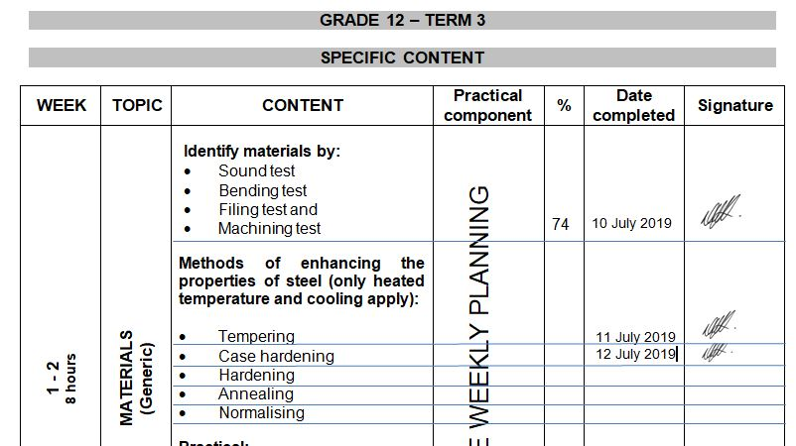
Complete ATP

Slide 17
Mark sheets
Composite Mark sheet is available on the website for download. – (Working mark sheet)
Copy of SASAMS mark sheet in file
Names and Surnames – exactly as SASAMS.
PAT mark sheets in PAT documents.
USE mark sheets in PAT documents for each learner – transfer to Composite and then SASAMS

Slide 18
Baseline assessments
Baseline assessment to be conducted for Grade 11 and 12 BEFORE EACH TOPIC!
Baseline assessment proof be available on school visits.
Requirement now from DBE Curriculum.
Determine content knowledge carried over from 2025.
Shortcomings in content knowledge to be addressed in teaching and lessons.

Slide 19
Baseline assessments
Develop OWN Baseline assessments
Do not re-invent the wheel – use questions from previous year text book – applicable to content going to be taught….
Learners can assess each other in class
GDE to monitor
D.H. to MONITOR!!
SEPARATE book/file to monitor baseline assessments.
Marks must be captured - Separate mark sheet for informal recording

Slide 20
Term 2 Formal Assessments – GradeS 10 – 11
Grades 10 – 11: Exam – 150 marks - 2½ hours(150 minutes)
Grades 10 – 11 Guideline in pre-moderation tool. USE IT.
Set own examination.
D.H. To pre- and post MODERATE!!
Term 2 – Only SBA mark
ONLY work done in Terms 1 and 2 to be assessed.
DO NOT accept average of below 50%!
MUST be SEND to DSA for APPROVAL!!
PLC welcome!

Slide 21
Term 2 Formal Assessments – GradeS 10 – 11
MUST BE SUBMITTED – 10 APRIL 2026
PLC welcome!
PLC – Inform on which schools participate
Schools who does not want to participate in PLC paper??
Question paper
Marking guideline (WITH TICK MARKS!)
Blooms
Pre-moderation tool
MUST be SEND to DSA for APPROVAL!!
New J1 and J2 Moderation tool was emailed

Slide 22
Term 2 Formal Assessments – Grade 12
Grades 12: Exam – 200 marks - 3 hours(180 minutes)
Provincial paper from GDE.
D.H. To post MODERATE!!
Term 2 – Only SBA mark
ONLY work done in Terms 1 and 2 to be assessed.
DO NOT accept average of below 50%! – practice previous papers

Slide 23
Moderation colour pens – Post moderation
School level – Green pen
District level – Orange pen
Provincial level – Pink pen

Slide 24
SBA MODERATION
Phase 1 moderation – NO e-marking will be conducted.
Compile Physical files.
Detailed Memo with required documents needed for upload will be send when schools re-open in Term 2.
BE READY FOR SUBMISSION IN TERM 2! – NO LATE SUBMISSIONS.
Waiting for moderation unit on appointment of TM’s.
Will keep schools updated om progress and information.

Slide 25
Informal assessments
Informal assessment MUST be done.
Grade 10/11 can previous exam/test papers be used as extra assessments/homework – USE Relab books! (on website)
Questions + answers in learners books.
Grade 12 – NB!!! – Use last 5 NSC papers as top-up to informal assessments given to candidates.
Informal assessments to be done in learners books.
D.H. to monitor informal assessments
GDE will monitor informal assessments and must report back to DBE on amount and progress of informal assessments.
When learners are at home – assignments / research tasks to be given and must be monitored / checked by educators on return.
Recent school visits showed CLEARLY lack of informal assessments!

Slide 26
Progress / High Risk / Retained learners
SEPARATE name list for progressed learners – Grades 10 – 12
MUST be evident in Educator file AND D.H file.
Weekly extra classes for Progress / High Risk / Retained learners. – NON NEGIOTIABLE (S.I.P.)
Registers evident where learners sign for attendance each week.
Remedial work – NO HOMEWORK – Learners work in class
Separate book – Cover Page – Subject Intervention and Learner name.
Record communication to parents of absence.
MUST be available for verification during school visits.

Slide 27
PAT Tasks
PAT tasks on website for download.
In GDE, Mediation on ALL PAT were conducted on MS Teams.
Guidelines and requirements were clearly indicated in mediation.
DH’s to monitor PAT progress.
Phase 1 to be completed by end of Term 1.
Do not wait to continue – Grade 12 WM can quickly finish Phase 1 and already start preparations for Phase 4.
Available on website for download
GDE moderation unit will monitor Grades 10 and 11 PAT completion!

Slide 28
IMPORTANT MATTERS RE PAT
OWN PAT tasks COMPULSARY! – Must be evident for verification
READ instructions in the documents.
WHOLE document must be in EACH learner PAT file
Follow instructions for assessment in PAT document
Learners to conduct self assessment FIRST BEFORE educator assess!
USE rubrics and do not thumb-suck marks!
Auto – Procedures – NO learner complete it – Educator do
SIGNATURES!!!! Learners AND Educators NB!!!!

Slide 29
Pat MODERATION – PHASE 1
School to be selected for Phase 1 moderation for Mechanical Technology.
School will be informed in time.
Subject Advisors are Provincial Moderators and will conduct Pat moderation for Phase 1 on selected schools.
Internal Moderation MUST be conducted on ALL PAT tasks as per policy.
Reports available when PM conduct visit.
Mark sheet MUST be signed by ALL stakeholders – Teacher / D.H / Principal.
Unsigned mark sheet will NOT be accepted.
Moderation will take place from 20nd of APRIL - 22nd of May 2026
PAT tasks to READY for moderation!!

Slide 30
Registers
Daily class attendance registers MUST be kept! – It is policy!
Record must be kept of Grade 12 learners being absent.
D.H. and parents to be kept up to date with learners being absent if no valid reason has been provided to the school.
Catch-Up plan for leaners WHO was absent with valid reasons.
EXCEL Register available on website for use.
Stock registers MUST be updated – especially where new equipment, tool and material being delivered.
GDE to monitor asset registers.

Slide 31
TRAINING
EPTD SETA Training service providers has been completed.
Poor attendance in Term 1 training – complaints from HO on attendance.
July is still to be confirmed – (??29 June – 3 July??)
Final dates will be confirmed
If any changes occur – educators will be informed in due time.
ALL novice educator MUST attend.

Slide 32
Subject combination verification
DH and Principal accountable for subject combinations.
DSA must conduct verification at schools to ensure correct subject combinations.
DH / Teachers to keep track of learners during the year if they change subjects – DSA MUST BE INFORMED OF SUCH!
See policy regarding subject changes
Only allowed to changed with Technical stream band

Slide 33
SASAMS Mark verification
DH to verify marks from working mark sheets to SASAMS
Sign and school stamp both sheets
Scan composite and SASAMS
Send via email to DSA for final verification
MUST be done EVERY term and final exam.

Slide 34
PLC
Imperative for professional development!
Need Agenda and register for Head Office.
All educators need to engage in PLC meetings – GDE requirement.
If needed – will arrange Teams meeting should educators want to.
Inform me in due time!
THANK YOU for those who participated – thank you for the PLC registers and agendas received.

Slide 35
IMPORTANT TO REMEMBER
Previous examination papers NB!!!!!
Relab books for Grades 10/11
PLANNING!
Proper PAT tasks!
OWN PAT tasks!
Quality Assessments – March / June assessments
Informal assessments.
Support programs and content for highflyers to enhance number of distinctions
Grades 10 and 11 Exam papers submissions …… ON TIME!
RESULT IN EXCELLENT PASS RATES!

Slide 36
IMPORTANT TO REMEMBER
GRADE 12 FINAL EXAMINATION – 16 OCTOBER 2026
NOT A LOT OF TIME FOR REVISION
PREVIOUS PAPERS
REVISION, REVISION, REVISION …….

Slide 37
Website
www.mtechedusupport.co.za
For your support!

Slide 38


SOME THOUGHT

Slide 39
Questions
?

