Slide 1

GAUTENG DEPARTMENT OF EDUCATION
SEDIBENG EAST/WEST
& GAUTENG EAST
Subject Meeting
Mechanical Technology Specialization
Automotive; Fitting & Machining; Welding & Metalwork
20-21 April 2026 – 14:30

Slide 2
AGENDA
Welcome and Register.
Statistics for GDE.
Management Plan
Curriculum delivery and ATP completion
School visits and Support
Mark sheets and Pat mark sheets.
Baseline assessments.
Term 2 Formal Assessment.
Informal assessments.
PAT
SBA District Moderation
PAT Phase 1 Moderation
Registers.
Training.
PLC
Website
Questions

Slide 3
Welcome and Register
Welcome to the Term 2 of 2026
Register via QR code – Google Forms
Please complete BEFORE 16:00 – register lock after 16:00

Slide 4
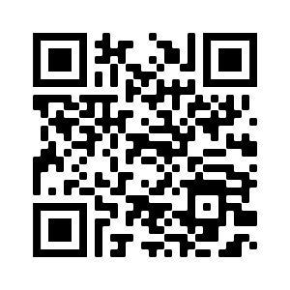
QR Code for register
https://forms.gle/qgBZYjy42v1P486N6

Slide 5
Statistics for GDE
8 April to 26 June (54 Days)
Curriculum coverage statistics for GDE
Update EVERY Week.
Link was emailed and send via WhatsApp (Pinned).
Next update due 24th of April 2026
ONCE a month – comprehensive update – link will be send via email and WhatsApp
Result submission a CHALLENGE!!!!!
Link has been sent via WhatsApp.

Slide 6
Management Plan
Management plan for Term 2 school visits had been sent with email.
School visits – educators not ready or do not inform when not available!
Term 2 has been emailed on 8 April 2026 to all – FILE and note on calendar the dates!
NB! CHANGES TO MAY SCHEDULE due to DBE responsibilities. Will inform as soon as DBE dates was sent.
GDE / DBE responsibilities – will inform in due time if any changes will occur in management plan for school visits.
CHANGES:
TERM 2 SUBJECT MEETINGS – 11 May 2026 – SE/SW
– 12 May 2026 – GE

Slide 7
Term Planning NB!
NOTE: 8 April to 26 June (52 Days) Now ….. June exams start 25 May.
Minus 20 Exam days ….
31 Effective Teaching Days for Term 2!!
As of today – 22(21) days left!
PLAN AHEAD!!

Slide 8
Curriculum delivery and ATP completion
Educators to teach all content in ATP / R-ATPs
Grade 12 – NO trimming of ATP!
ATP’s with % available on website for downloading.
D.H.’s to monitor ATP’s EVERY two weeks – NOT HAPPENING!
On visits in Term 1 DH neglected this! Term 2 Moderation also shows not happening.
School visits indicated some educators are behind with curriculum – need to show strategies for catching UP! DH TO MANAGE!
MUST be emailed by DH in writing strategies to catch up curriculum behind.
Registers to be kept on ANY type of extra class.

Slide 9
SCHOOL VISITS AND SUPPORT
Give support, but educators DO NOT implement support strategies and suggestions in order to make teaching and curriculum delivery more effective.
Email or WhatsApp if support is needed – concerning that only a few do this.
Learners' books and ATPs to be ready for monitoring – excuses learners are not at school today – please collect in advance! Need to verify ATP and curriculum completion.
Upon visits – “I did not know” or “I did not understand” – Serious implication on quality teaching.

Slide 10
Mark sheets
VERIFICATION:
Educators do not comply to request for CORRECT submissions:
SIGNED working mark sheet
SIGNED SASAMS mark sheet
MUST verify two mark sheets are correct!
Could not verify most as only some mark sheets were submitted or all outstanding.
Report to Head Office outstanding – principal of school will answer to Head Office on outstanding verification.
Outstanding to be submitted THIS week before 22 April 2026

Slide 11
Mark sheets
Outstanding schools:
 |  |  | GRADE 10 |  |  | GRADE 11 |  |  | GRADE 12
 | District |  | FM | Auto | WM | FM | Auto | WM | FM | Auto | WM
HS Die Anker | GE | D5
HS John Vorster |  | D5
Laban Mothlabi Comp School |  | D5
Protea Skool |  | D5
Spring THS |  | D5
Mamellong Comprehensive School |  | D5
Springs Boys High School |  | D5
HS Hans Moore | EN | D6

Slide 12
Mark sheets
Outstanding schools:
 |  |  | GRADE 10 |  |  | GRADE 11 |  |  | GRADE 12
 | District |  | FM | Auto | WM | FM | Auto | WM | FM | Auto | WM
HS Fochville | GW | D2
Phoenix HS | SE | D7
Thuto Lore Comp School |  | D7
HS Transvalia | SW | D8
HS Vanderbijlpark |  | D8
HTS Carel de Wet THS |  | D8
Sizanani-Thusanang Comp School |  | D8
Thuto-Tiro Comp School |  | D8

Slide 13
PAT Mark Sheets
Educators must adhere to GDE and DBE guidelines!
EACH learner MUST have a portfolio of evidence (PAT file) for each grade and specialisation.
Automotive Grade 10, Fitting Grade 10 – 12 and Welding Grade 10 – 12:
New strategy of assessment – Has been discussed in the previous subject meetings AND PAT mediation!
PAT moderation – Need the learners files where recording of assessment has been done.
INTERNAL MODERATION!!!!

Slide 14
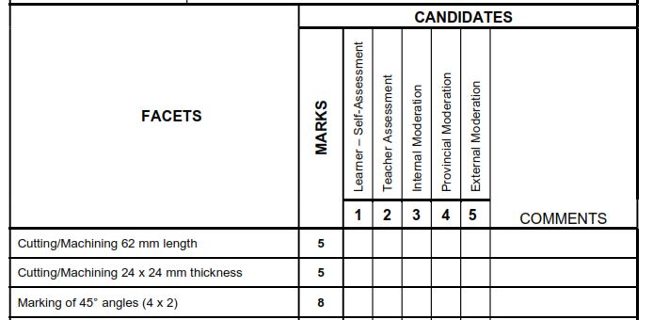
Grade 12 Fitting and Welding

Slide 15
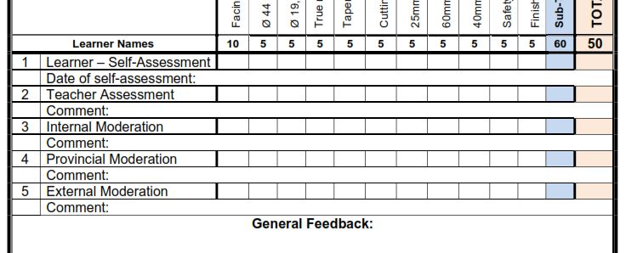
Gr10 Automotive, Gr10-12 Fitting and Welding

Slide 16
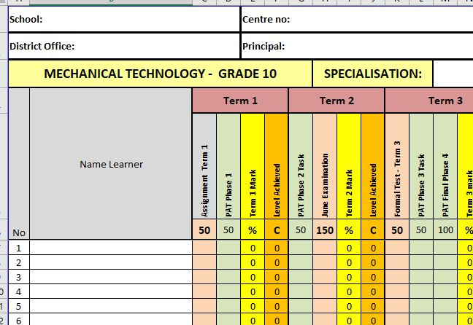
Composite Mark Sheet (Working Mark Sheet)
Complete composite mark sheet

Slide 17
Baseline assessments
Baseline assessment to be conducted for Grade 11 and 12 BEFORE EACH TOPIC!
Baseline assessment proof be available on school visits.
Educator still do not conduct baseline assessments!
Requirement now from DBE Curriculum.
Determine content knowledge carried over from 2023.
Shortcomings in content knowledge to be addressed in teaching and lessons.

Slide 18
Term 2 Formal Assessments – Grade 12
Grade 12 – EXAMINATION – 3 hours (180 minutes.)
COMMON paper from GDE – 3 JUNE 2026, morning session.
Topics same as in Guidelines tool on web.
NB!! To be on par with curriculum delivery!
DO NOT RUSH!!!!!!!
D.H. To MODERATE!!
ONLY work done in Term 1 and 2 to be assessed.

Slide 19
Term 2 Formal Assessments – Grade 10 – 11
ONLY Weightings in pre-moderation tool to be used.
150 marks – 2½ hours (150 minutes).
USE GUIDELINES tool weighting!! NOTHING ELSE…..
Set own examinations. (PLC welcome – MUST inform DSA of PLC)
D.H. To PRE-MODERATE!!
PLC leaders to send me email on schools participating.
ONLY work done in Term 1 and 2 to be assessed.
MUST be approved by district as per policy!!
FINAL submission date: 10 APRIL 2026.
MUST be submitted WITH pre-moderation report AND Blooms!

Slide 20
Term 2 Formal Assessments – Grade 10 – 11
CHALLENGES:
Schools still outstanding
Approval low
Reports send about Blooms
Schools submit WITHOUT Blooms or J1 report
WILL NOT APPROVE if all required documents not attached.
If I do not have the names of schools in PLC papers or outstanding submissions by 24 April 2026 – will not ask again. Verification will be done during examination time.
If found papers were not approved – learners WILL rewrite a fair and valid approved paper as per policy.

Slide 21
Informal assessments
Informal assessment MUST be done! School visits shows lack of informal assessments in learners' books!
Grade 10/11 can previous exam/test papers be used as extra assessments/homework
Grade 12 – NB!!! – Use last 5 NSC papers as top-up to informal assessments given to candidates – currently not happening!
Informal assessments to be done in learners' books. QUESTIONS + Answers!
D.H. To monitor informal assessments
GDE will monitor informal assessments and must report back to DBE on amount and progress of informal assessments.
Poor 2025 SBA marks – shows CLEARLY lack of informal assessments!

Slide 22
PAT Tasks
PAT tasks on website for download.
Mediation on ALL PAT was conducted on 2-5 February 2026 by GDE and on 18 March by DBE.
Guidelines and requirements was clearly indicated in the mediation.
DH’s to monitor PAT progress – not happening…..
Lack of proper planning still a challenge!
No planning – educator + DH + principal mediation session to resolve challenge….
PAT mediation videos available on website.

Slide 23
SBA MODERATION
Phase 1 moderation – physical marking conducted.
Schools to collect from TM where files were submitted.
Phase 2 district moderation and Phase 1 provincial moderation will be conducted in same manner.
Memo will be send as to inform of submission and documents needed.
Thank to all for complying on short notice

Slide 24
Pat MODERATION – PHASE 1
Schools was informed for Phase 1 moderation from SES for Mechanical Technology.
Schools were informed in management plan sent to all.
Subject Advisors are Provincial Moderators and will conduct Pat moderation for Phase 1 on selected schools.
Internal Moderation MUST be conducted on ALL PAT tasks as per policy.
Reports available when PM conduct visit.
LEARNERS files to be present with completed marks and self-assessment evident.
Mark sheet MUST be signed by ALL stakeholders – Teacher /D.H. / Principal.
Unsigned mark sheet will NOT be accepted.
Moderation will take place from 20th of APRIL - 25th of MAY as per GDE Assessment Guideline 04 for 2026.
PAT tasks to READY for moderation!!

Slide 25
Registers
Daily class attendance registers MUST be kept! – It is POLICY.
Record must be kept of Grade 12 learners being absent.
D.H. and parents to be kept up to date with learners being absent if no valid reason has been provided to the school.
Catch-Up plan for leaners WHO was absent with valid reasons.
EXCEL Register available on website for use.
Asset registers MUST be updated – especially where new equipment, tool and material being delivered.
GDE to monitor asset registers.

Slide 26
TRAINING
Training was conducted on selected Saturdays in Term 1.
Focus on PAT tasks.
POOR attendance by educators.
THANK YOU to those who attended.
NEXT TRAINING – 29 JUNE – 3 JULY 2026.
If any changes occur – educators will be informed in due time.
Venues:
Pretoria THS
Phoenix HS
John Orr THS

Slide 27
PLC
Received very little PLC information…..
PLC leaders??????
STRATEGY – Need a plan for Term with dates from PLC leaders.
Need Agenda and register for Head Office.
All educators need to engage in PLC meetings – DBE requirement.
If needed – will arrange Teams meeting should educators want to.
Inform me in due time!

Slide 28
Website
www.mtechedusupport.co.za
For your support!

Slide 29


SOME THOUGHT

Slide 30

Questions

