Slide 1

NORTHERN CAPE PROVINCE
SUBJECT MEETING
29 JULY 2026 – 14:30
SUBJECT: Mechanical Technology
PRESENTED BY: Mr D van der Westhuizen

Slide 2
TEAMS PROTOCOL
Please mute and switch video off
Please be aware the meeting is being recorded
Ask questions at end of meeting – please plot them down

Slide 3

CONTENT
Opening and Welcoming
2026 – Term 2 Results Analysis GR 10 - 12 Results Analysis
Administrative matters
Focussed support for progressed/repeating learners and learners at risk
2026 ATP
Formal tasks
PAT 2026 Moderation

Slide 4
2026 – Term 2 Results Analysis GR 10 - 12
Overview of the Term 2 results
Results missing
Province need the statistics
Cooperation needed from educators to comply with requests
Not a true reflection of result analysis
RESULTS MUST BE SUBMITTED BY 30 JULY 2026
Thank you to all who submitted

Slide 5
Missing results – did not submit
District | School | Specialisation Missing
ZF Mgcawu | H/SKOOL DANIELSKUIL | Mechanical Technology (Welding & Metalwork)
Pixley Ka Seme | VERITAS HIGH SCHOOL | Mechanical Technology (Fitting & Machining)
Pixley Ka Seme | VERITAS HIGH SCHOOL | Mechanical Technology (Welding & Metalwork)
John Taolo Gaetsewe | KATHU HOERSKOOL | Mechanical Technology (Fitting & Machining)
Frances Baard | EMANG MMOGO COMPREHENSIVE SCHOOL | Mechanical Technology (Automotive)
John Taolo Gaetsewe | BAITIREDI TECHNICAL AND COMMERCIAL SECONDARY SCHOOL | Mechanical Technology (Welding & Metalwork)
ZF Mgcawu | H/SKOOL SAUL DAMON | Mechanical Technology (Automotive)
ZF Mgcawu | H/SKOOL SAUL DAMON | Mechanical Technology (Fitting & Machining)
ZF Mgcawu | H/SKOOL SAUL DAMON | Mechanical Technology (Welding & Metalwork)

Slide 6
Analysis of Mechanical Technology Term Results Submission
Grade | Provincial Average
Grade 10 | 36.2%
Grade 11 | 38.3%
Grade 12 | 35.6%

Slide 7
Key Findings
Grade 11 achieved the highest average performance (38.3%), although overall achievement remains below the desired standard.
Grade 12 recorded a provincial average of only 35.6%, indicating the need for intensified intervention ahead of the Preliminary Examinations.
Nine expected school/specialisation submissions were not received, limiting the accuracy of the provincial analysis.
Two schools (Emang Mmogo Comprehensive School and H/Skool Saul Damon) submitted no results at all.

Slide 8
Automotive Technology – Performance Analysis
Grade | Analysis
Grade 10 | Performance is below the desired provincial benchmark. Several schools achieved below 40%, indicating gaps in foundational theoretical knowledge.
Grade 11 | Slight improvement compared to Grade 10, but learner achievement remains inconsistent across districts.
Grade 12 | Performance remains a concern ahead of the Preliminary Examination. Immediate intervention is required to strengthen examination readiness.

Slide 9
Key Findings
Automotive recorded the largest number of participating schools.
Significant performance variation exists between districts.
Practical competencies appear stronger than theoretical application.
Some schools failed to submit results, affecting provincial averages.

Slide 10
Recommendations
Strengthen weekly theory revision.
Increase examination-style assessments.
Conduct district moderation of common tests.
Prioritise support for schools below 40%.

Slide 11
Fitting & Machining – Performance Analysis
Grade | Analysis
Grade 10 | Learners experienced challenges with calculations and engineering drawing concepts.
Grade 11 | Moderate improvement observed, although averages remain below target.
Grade 12 | Results indicate insufficient mastery of higher-order questions and application of machining principles.

Slide 12
Key Findings
Fewer schools offer this specialisation.
Greater consistency between schools than in Automotive.
Technical calculations continue to be the weakest area.
Several schools have not submitted results.

Slide 13
Recommendations
Intensify practical demonstrations linked to theory.
Increase learner exposure to calculation-based questions.
Conduct common revision sessions before Preliminary Examinations.
Monitor curriculum coverage weekly.

Slide 14
Welding & Metalwork – Performance Analysis
Grade | Analysis
Grade 10 | Lowest learner achievement across most participating schools, particularly in theory.
Grade 11 | Improvement evident, but learner performance remains below provincial expectations.
Grade 12 | Performance suggests learners require additional support in welding processes, materials and forces.

Slide 15
Key Findings
Welding & Metalwork had the highest number of outstanding submissions.
Considerable variation between schools.
Theory performance remains weaker than practical performance.
Missing submissions reduce the reliability of provincial analysis.

Slide 16
Recommendations
Ensure all schools submit outstanding results immediately.
Strengthen classroom teaching of theoretical concepts.
Increase formal revision activities using previous examination papers.
Districts should monitor underperforming schools more frequently.

Slide 17
ADMINISTRATIVE MATTERS
Files
Asset registers and assets
Subject policy and compliance to minimum standards
Informal activities (daily)
Curriculum coverage monitoring (subject teachers & DH)
Excel mark sheets

Slide 18
Teacher files 2026
For Mechanical Technology every teacher should have the following files:
Subject file (Personal file)
Assessment file (To be submitted for moderation purposes)
Lesson preparation file

Slide 19
Subject/Personal files 2026
Table of contents
Personal information of educator.
QMS (PERSONAL DEVELOPMENT PLAN)
Timetable
School Subject policy (Technical department)
NCS policy document (CAPS)
Minutes of subject meetings, school, cluster or provincial
Control sheet for visits/moderation from Dept. Head/cluster or department
Other relevant information

Slide 20
Assessment file 2026
Table of contents (ONLY current year information)
Annual program of assessment
Framework for question papers
All formal assessment tasks/assignments with rubrics and
Memoranda including PAT all grades (ONE COPY ONLY Divided
per grade)
History of each task if it was set at school level
Proof of moderation (Pre and post moderation) by DH and/or subject advisor in the form of a report.
Mark sheets (Excel and SASAMS).

Slide 21
Lesson preparation file 2026
Table of contents
Term, weekly / cycle planning (ATP)
Lesson preparation for all grades taught per subject (showing evidence of EACH lesson and including additional activities and informal tests per topic)
Lesson preparation must be neatly filed in chronological order. Loose sheets not properly organised is not acceptable.
A maximum of TWO pages back to back may be inserted into plastic satchels
Lesson preparation MUST be done for every period for every week (Including practical work). A lesson plan for several weeks in one document is not acceptable.

Slide 22
Asset/Inventory registers
Use the provided Excel template for the capturing and control of all assets/inventory
All newly delivered assets MUST be captured on the asset register within SEVEN days of delivery
It is the responsibility of the SMT to plan and determine the dates for stock taking (At least TWO times a year).
All asset registers must be signed by the teacher, DH & Principal and must be stamped when assets were controlled
Copies of the most recent asset register must be available in each workshop at all times (Teacher and DH files)
Handover must be done when new teacher start or when a teacher leave the school.

Slide 23
EXCEL spread sheet sent out via WA
MUST be submitted by 31 JULY 2026
ALL schools offering Mechanical Technology to complete and submit
Requirement by Head Office – Office of the Director

Slide 24
Maintenance and repair of equipment
Every school must compile a list of equipment that is not functional with a description of the nature of the defect.
The list of defective tools must be available in the workshop at all times
The teacher and Dept. Head will be accountable for all damaged to equipment that was not caused due to normal wear and tear
It is the responsibility of the school to ensure that equipment is serviced and repaired when required.
Schools must budget for maintenance and repair of equipment

Slide 25
CURRICULUM COVERAGE
Teachers must ensure that they plan properly and that they are well prepared for every period
Every minute is important so be on time and use time wisely
Make copies of activities and give it to learners rather than writing it on the chalk board and having learners writing it down
Ensure that there is a recovery plan to catch up or revise topics that was not mastered by learners
Teachers must ensure that they stay on track with the ATP
Dept. Heads must regularly monitor adherence to the prescribed curriculum coverage and should not leave this task to the end of the term when it is too late to intervene

Slide 26
INFORMAL ACTIVITIES
A short baseline test must be written at the start of each new topic and it must clearly indicate “Baseline test”
There must be evidence of activities in learner books for every period that they were in class
All activities must be dated and the topic must be indicated
All activities must be marked daily
Remedial work and corrections must be done for all activities by all learners
Learner books must be marked regularly and any errors MUST be indicated
All scale drawings (As required in CAPS) must be drawn on drawing paper and must be pasted in the learner books at the correct place to form a complete portfolio of evidence of all work done by each learner

Slide 27
INFORMAL ACTIVITIES
All learners MUST write a minimum of ONE informal class test per month
All informal tests MUST be written at the back of learners workbooks
All informal tests MUST be dated, marked and corrections must be done

Slide 28
EXCEL MARK SHEETS
Ensure that you use the correct mark sheet
Mark sheets should indicate the name of the school, subject, maximum marks of task, date of task, learner mark and average mark of the group and MUST be properly renamed. Use the following naming convention:
School name/Grade/specialisation/Term
e.g. HTS KIMBERLEY GR 10 Automotive
Mark sheets must be signed by the DH/Principal and they should ensure that totals and averages are correct before signing.
It is the responsibility of the Dept. Head to ensure that Excel mark sheets are correct and that all mark sheets are E-mailed to the relevant subject adviser within SEVEN days after a formal task was written.

Slide 29
EXCEL Mark Sheet Template
Can use template
User friendly
Provide result summary
Cells locked for protection of formulas

Slide 30
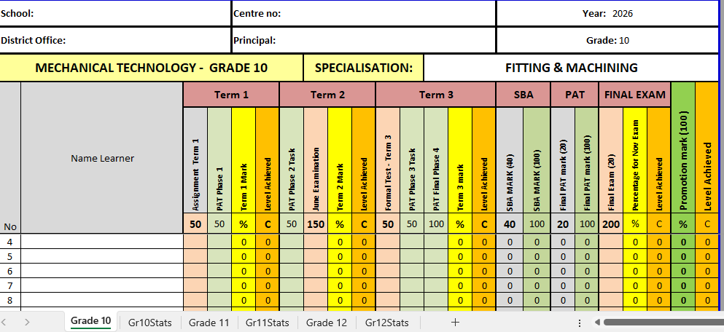

Slide 31
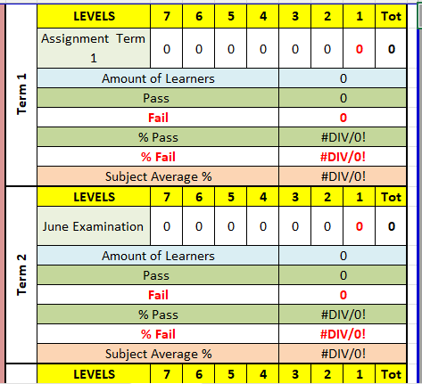

Slide 32
Focussed support for progressed/repeating learners and learners at risk
All teachers must conduct focussed extra classes for progressed learners, repeating learners and learners performing below 40% in the subject.
These extra classes must be conducted for a minimum of ONE hour per month per grade
An attendance register for all extra classes must be available as well as a list of topics taught during these extra classes (Lesson planning)
A list of all progressed learners, repeating learners and learners performing below 40% in the subject must be available in the assessment file (Use a copy of the Excel mark sheet to indicate these learners)

Slide 33
2026 ATP
The ATP must be read in conjunction with the CAPS and 2026 weekly dates
The ATP may in some instances not indicate all the sub topics as listed in CAPS so it is the responsibility of the teacher to ensure that ALL content as listed in the CAPS are taught (Nothing in CAPS may be excluded)

Slide 34
SC and ATP completion updates
Google form – sent via WA
Very view submissions
Does not take long
MUST be completed by 31 JULY 2026
Must be submitted to Head Office

Slide 35
Term 3 Formal Assessments – Grade 10 – 11
Weightings in pre-moderation tool available on website
50 marks – 1 hours (60 minutes).
Set own test.
D.H. to pre-moderate and post-moderate.
Term 3 SBA mark
ONLY work done in Term 3 to be assessed.
Imperative that the learners as late as possible to cover all work in Term 3.

Slide 36
Term 3 Formal Assessments – Grade 12
Weightings in pre-moderation tool available on website
200 marks – 3 hours (180 minutes).
Set own exam.
D.H. to pre-moderate and post-moderate.
Term 3 SBA mark
ALL work done in Term 1-3 to be assessed.
Papers can be made available?????

Slide 37
PAT 2026 - Moderation
31 August – 8 September
PAT MUST be ready with the following criteria:
• Departmental Heads to ensure that everything is ready on the day of moderation, if the teacher is the Departmental Head/Deputy then his/her superior must ensure readiness.
• All PAT working mark sheets must be available on day of moderation for all grades.
• Every Grade 12 learner in Mechanical Technology must have a PAT project.
• Verification of educator having their own models available as required by the PAT Guidelines 2026 set by Department of Basic Education, will be conducted by the PED moderators.

Slide 38
Post moderation reports by the Departmental Head / Internal moderator must be available for each moderation conducted by the PED.
ALL portfolio of evidence whereby each learner has a file with complete 2026 PAT Guidelines, must be evident and presented for moderation.
If (0) marks were allocated, there must be evidence of extended opportunities.
Grade 12 PAT projects to be displayed alphabetically with learner’s surname and initial clear on each project (These surnames must correspond with your mark sheets).
The EXCEL-composite mark sheet must be completed and evident together with a completed signed SASAMS mark sheet.

Slide 39
Have all documents clearly marked to speed up the moderation process.
ALL Grade 12 PAT portfolio files must evident and present on day of moderation.
Marks that must be evident in learner PAT file must be according to instructions from the PAT Guidelines 2026, Section 2 (Teacher Guidelines).
Please have a clean area with a plug point available for the moderator/s.

Slide 40
Grade 12 PAT AUTOMOTIVE task will be moderated on site. Make sure you have a running engine, petrol and a strong battery to start engine. All the necessary equipment and tools must be ready and available for the moderation. Learners will be called upon by the Provincial moderator to demonstrate their knowledge and skills acquired when task was completed.
ALL AUTOMOTIVE learners MUST be present for selection by the moderator.
If each learner did not complete this task practically, they will only receive marks for the theory questions answered on worksheets.
Educator memorandum for Worksheets must be available for the moderation.

Slide 41
Page 5 of PAT guidelines state the following:
“When required the moderator should be able to call on the learner to explain the function and principles of operation and request him/her to demonstrate the skills acquired through the capability tasks for moderation purposes.”

Slide 42
Schedule
EMANG MMOGO COMPREHENSIVE SCHOOL | Kimberley | 1 | 31 August 2026
FLOORS HIGH SCHOOL | Kimberley | 1 | 31 August 2026
TECHNICAL HIGH SCHOOL KIMBERLEY | Kimberley | 2 | 01 September 2026
H/SKOOL DANIELSKUIL | Danielskuil | 3 | 02 September 2026
BAITIREDI TECHNICAL AND COMMERCIAL SECONDARY SCHOOL | Kuruman | 4 | 03 September 2026
K P TOTO TECHNICAL AND COMMERCIAL SECONDARY SCHOOL | Kuruman | 4 | 03 September 2026
KATHU HOERSKOOL | Kathu | 5 | 04 September 2026
H/SKOOL DUINEVELD | Upington | 6 | 08 September 2026
H/SKOOL SAUL DAMON | Upington | 7 | 09 September 2026

Slide 43
Website
www.mtechedusupport.co.za
For your support

Slide 44


SOME THOUGHT

Slide 45


