Slide 1
AUTOMOTIVE Grade 12
Forces

Slide 2
DEFINITION OF WORK
Work:
Work is the moving of an object against an opposing force. The object can be moved by a push pull or lifting movement.
Force times distance will equal work.
Work will be force (N) x displacement/ distance (m)
W = Force x Distance
W = F x s
W = N x m
Work is measured in Joule (J)

Slide 3
DEFINITION OF POWER TORQUE
Power:
Work can be done slowly or rapidly. The rate at which work is done is measured in terms of power.
Power is the rate or speed at which work is done.
Power is work done per second
Power$=\frac{\text{Work} \text{done}}{\text{time}}$
Measured in Kilowatt kW

Slide 4
DEFINITION OF TORQUE
Torque:
Torque is the twisting effort transmitted by a rotating shaft or wheel.
Example when opening a screw cap bottle you apply torque to open it or the drive shafts of a vehicle apply torque to the wheels to turn them.
Torque = Force x radius.
Torque = N x m
Torque is measured in Newton metre (Nm)

Slide 5
CALCULATIONS BASICS
Identify the formula with the wanted data.
Ensure all the given data is in the correct SI units. (Do necessary conversions)
Manipulate the formula so that the wanted data is the subject of the formula
Substitute the given data into the formula
Calculate
Write answer in the correct SI unit

Slide 6
CONVERSION
Converting mm to cm divide by 10
Converting mm to m divide 1000
Converting cm to m divide by 100
Converting mass to a Force
Force is equal to Mass times gravitational acceleration
Force = mass x gravity
Force is measured in Newton.
Converting kPa to Pa multiply by 1000
Converting Watt to kiloWatt divide by 1000

Slide 7
EXAMPLE SHOWING CLEARANCE VOLUME AND SWEPT VOLUME

Slide 8
INDICATED POWER
This is the power developed by the pressure of the gas acting on the piston.
It is found by recording and plotting the pressure against volume inside the piston.
Such diagrams are called indicator diagrams and they are taken with engine indicators.

Slide 9
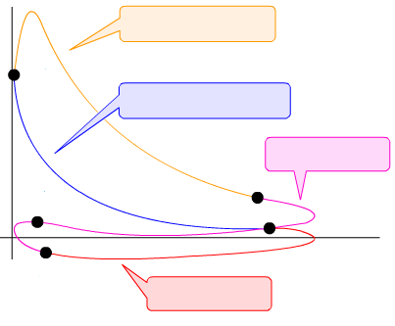
INDICATED POWER
INDICATOR DIAGRAM
C-D: Combustion
Pressure
C
B-C: Compression
D-E: Exhaust
D
A
B
Volume
E
A-B: Intake

Slide 10
INDICATED POWER
Indicated power is the theoretical power that an engine develops without taking mechanical or other losses into consideration
Formula used = PLANn
P = Mean effective pressure measured in N/m², 1 N/m² = 1 Pa
Mean effective pressure is derived from a planimeter
The mean effective pressure can be regarded as an average pressure in the cylinder for a complete engine cycle. By definition, mean effective pressure is the ratio between the work and engine displacement:
L = Stroke length in metres (m)
A = Area of piston crown measured in metres (m²)
N = Power strokes per second r/s
n = Number of cylinders

Slide 11
CALCULATING INDICATED POWER
DATA GIVEN:
Calculate the Indicated Power of a Four stroke 2 cylinder engine with the following information:
Mean effective pressure = 900 kPa
Length of stroke 86 mm
Cylinder diameter 84 mm
Revolutions per minute = 4000 rpm
Number of cylinders = 2

Slide 12
CALCULATING INDICATED POWER
FORMULA
IP = PLANn
DATA CONVERSION
Mean effective pressure = 900 kPa = 900 000 Pa………………..A
Length of stroke 86 mm $÷1000=0,086 m$ ………………..B
Cylinder diameter 84 mm $÷1000=0,084$m
Area of piston crown ? = $\frac{{πD}^{2}}{4}$ = $\frac{{πx0,084}^{2}}{4}$ = 0,00554 1769m² ………………..C
Revolutions per minute = 4000 rpm = $x=\frac{4000}{60}$ = 66, 67 r/s ……..D
Number of cylinders/ Firing strokes = $\frac{2}{2}$ = 1 ………………..E
CALCULATION
IP = PLANn
IP = 900000 x 0,086 x 0,00554 x 66,67 x 1
= 28 596,95 watt $÷1000$
= 28,6 kW

Slide 13
CALCULATING INDICATED POWER
Mean effective pressure = 900 kPa = 900000 pa
Length of stroke 86 mm $÷1000= ,086$
Cylinder diameter 84 mm $÷1000= ,084$
Area of piston crown ? = $\frac{{πD}^{2}}{4}$ = $\frac{π{,084}^{2}}{4}$= ,00554 m²
Revolutions per minute = 4000 = 33,3 r/s
Number of cylinders = 2
IP = 900000 x ,086 x ,00554 x 33,3 x 2
= 28557,8 watt $÷1000$
= 28,6 kW

Slide 14
EXAMPLE OF A PRONY BRAKE
Prop shaft connects
to flywheel of engine
Disc brake assembly used
to create resistance

Slide 15
DYNOMETER
Eddy current dynamometers use a magnetic field to provide counter restraining torque that increases with shaft speed.

Slide 16
PRONY BRAKE CONT.

Slide 17
BRAKE POWER
Brake power is the actual power developed by and engine and is measured at the flywheel or driving wheels
FORMULA - BP = 2$π$NT or F x 2x $π$ x R x N
N = Power strokes per second (revolutions per second)
T = Torque Newton metre(Nm.)
R = Length of brake arm Metre (m)
F = Reading of the scale kg convert to Newton x 9.8

Slide 18
CALCULATING BRAKE POWER
DATA GIVEN:
Revolutions = 2000rpm
Scale reading = 25 kg
Brake arm length = 420mm

Slide 19
CALCULATING BRAKE POWER
DATA GIVEN:
Revolutions = 2000 $÷$ 60 = 33,3 r/s
Scale reading = 25 kg x 9,8 = 245 N
Brake arm length = 420 $÷1000=0 ,420 m$
Torque = force x radius = 245 x 0,420 = 102,9 Nm.
BP = 2 x $π$ x 33,3 x 102,9
= 21529,77 watt
= 21,5 kW

Slide 20
MECHANICAL EFFICIENCY
Mechanical efficiency is defined as the ratio of indicated power to brake power (measured at the flywheel) or obtained from a dynamometer. This is expressed in an percentage.
FORMULA – ME = $\frac{BP X 100}{IP}$
Data given:
BP = 80 kW
IP = 90 kW
ME = $\frac{80 x 100}{90}$
= 88,8%

Slide 21
Clearance Volume
The easiest way to measure clearance volume is to use a coloured liquid and fill the cavity using a syringe.
When the combustion chamber is located in the piston, the same method can be applied.
1 ml of fluid = 1 cubic centimeter (CC)/ 1cm³
A typical combustion chamber volume is at around
30 ml/30 cc/30 cm³

Slide 22
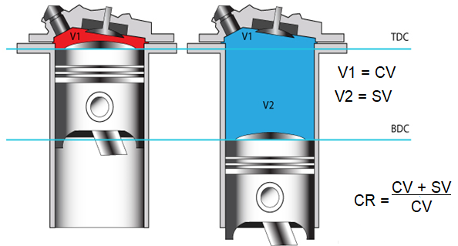
COMPRESSION RATIO
Definition:
Compression ratio is the ratio of the clearance volume above the cylinder at the end of the compression stroke to the total volume of the cylinder. Example below.

Slide 23
COMPRESSION RATIO CONT.
FORMULA:
CR = $\frac{CV+SV}{CV}$
Data given:
Calculate the compression ratio of an engine with clearance volume of 50 cm³. The stroke length is 80 mm and the bore size is 90 mm.
SV = $\frac{πD^{2}}{4}$ $×L$
SV = $\frac{π9^{2}}{4}$ $×8$
SV = 508,9 cm²
CR = $\frac{50+508,9}{50}$
CR = 11:1

Slide 24
COMPRESSION RATIO

Slide 25
END

