Slide 1
AUTOMOTIVE Grade 12
Steering Geometry

Slide 2
TOE IN AND TOE OUT
Toe in:
If the distance between front of the wheels measured at axle height is smaller than the distance measured at the rear then it is toe in.
Toe out:
If the distance between front of the wheels measured at axle height is larger than the distance measured at the rear then it is toe out.
Toe in or toe out is measured in millimeters

Slide 3
TOE IN and TOE OUT

Slide 4
`DEFINITION - CASTOR ANGLE
Castor angle is the forward or backward tilt of the kingpin as viewed from the top or side of the vehicle
Backward tilt will be negative castor. Imaginary line will meet the tarmac in front of the vertical line
Forward tilt will be positive castor. Imaginary line will meet the tarmac at the rear of the vertical line
King pin angle measured from the imaginary line through the kingpin, ball joints of upper and lower control arm or line through the suspension strut and the vertical line
Castor angle measured in degrees

Slide 5
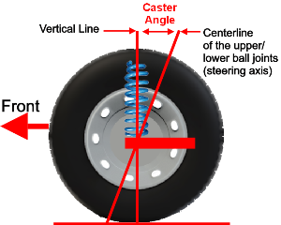
CASTOR ANGLE
POSITIVE CASTOR

Slide 6
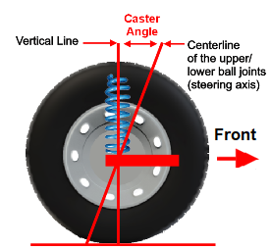
CASOR ANGLE
NEGATIVE CASTOR

Slide 7
DEFINITION CAMBER ANGLE
Camber angle is the angle the wheel is tilted inward or outwards from the vertical line as viewed from the front of a vehicle
The angle will be measured in degrees and minutes

Slide 8
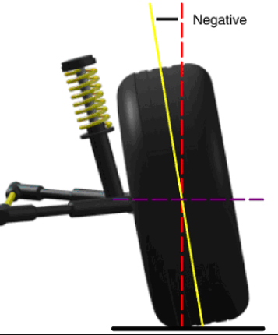
CAMBER ANGLE
NEGATIVE CAMBER

Slide 9
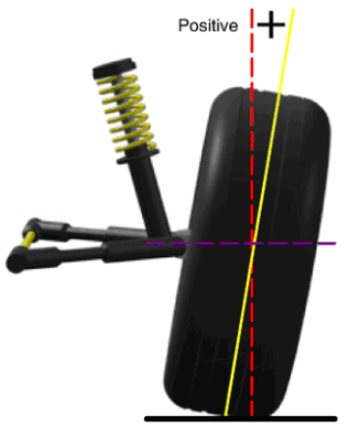
CAMBER ANGLE
POSITIVE CAMBER

Slide 10
ACKERMAN PRINCIPLE
Definition:
To achieve true rolling for a four wheeled vehicle moving on a curved track, the lines drawn through each of the four wheel axes must intersect at the instantaneous centre (Fig. 27.23). The actual position the instantaneous centre constantly changes due to the alternation of the front wheel angular positions to correct the steered vehicle’s path. Since both rear wheels are fixed on the same axis but the front wheel axles are independent of each other, the instantaneous centres lies somewhere along an imaginary extended line drawn through the axis of the rear axle.
http://what-when-how.com/automobile/the-ackermann-principle-as-applied-to-steering-automobile/

Slide 11
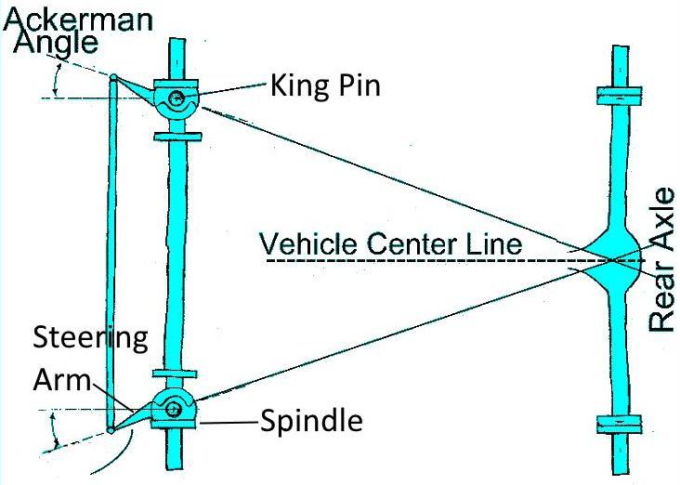
https://www.google.co.za/search?q=images+for+ackerman+principle&safe=active&tbm=isch&tbo=u&source=univ&sa=X&ved=0ahUKEwj5hf2RvOPXAhXGtRQKHeASBvUQsAQIJg&biw=1215&bih=566&dpr=1.13#imgrc=FDszbGcm2g2bfM:

Slide 12
TOE OUT ON TURNS
The principle of toe out on turns is directly related to the Ackerman principle.
During turning the inner wheel would turn sharper than the outer wheel
This would be due to the Ackerman lay of steering arms that is mounted at an angle inwards
When the wheels are returned to an straight ahead position the extended imaginary lines from the steering arms would again meet in the centre off the rear axle, on or close to the rear axle(Ackerman principle)
Toe out on turns would give true rolling to both wheels and prevent any one wheel from being dragged over the road surface
Toe out on turns measured in dgrees

Slide 13
ACKERMAN GEOMETRY
https://www.google.co.za/search?q=Images+toe+out+on+turns&safe=active&tbm=isch&tbo=u&source=univ&sa=X&ved=0ahUKEwic--LW9OPXAhXhJsAKHYsGDJkQsAQIJw&biw=1215&bih=566&dpr=1.13#imgrc=iuBcw0Ff1HZCCM:

Slide 14
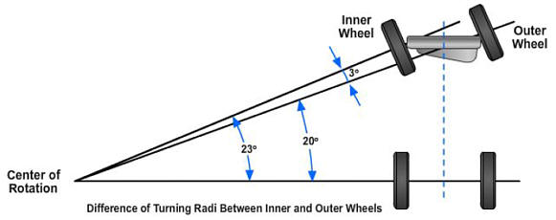
TOE OUT ON TURNS
http://freeed.net/sweethaven/mechtech/automotive01/AutomotiveSystems03_Files.asp?iNum=126

Slide 15
END

