Slide 1

SYSTEM OF FORCES
Danie van der Westhuizen
SES: Mechanical Technology

Slide 2
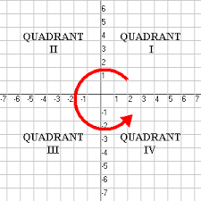
CARTESIAN PLANE
90°
180°
0°
270°

Slide 3
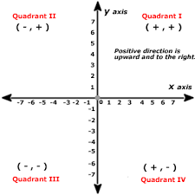
QUADRANTS

Slide 4
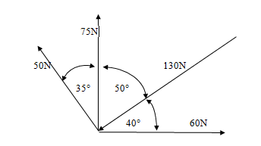
Example

Slide 5
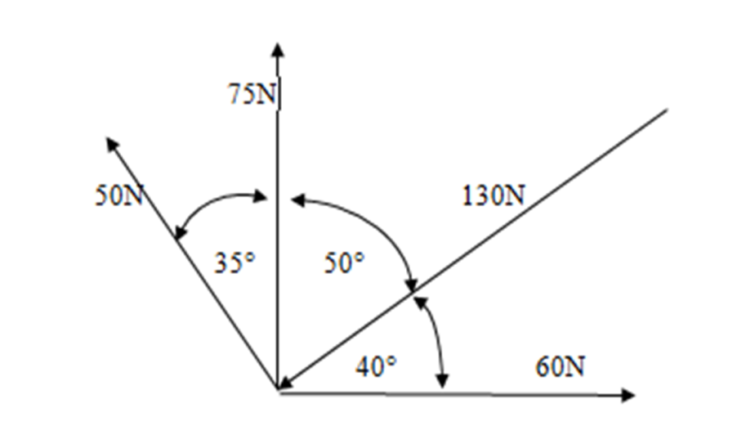
Note !!
ALL forces need to be PULLING forces.
First convert all pushing forces into PULLING forces, BEFORE calculating angles.
THUS:
Convert to pulling force

Slide 6
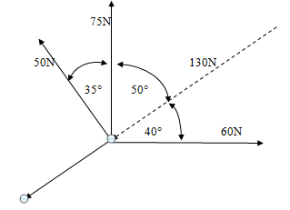

Slide 7
Calculating angles of forces

Slide 8
Calculate Arithmetic Sum
Force | Vertical component |  | Horizontal component
60N | Y = 60 sin 0° | 0N | X = 60 cos 0° | 60N
130N | Y = 130 sin 220° | -83,56N | X = 130 cos 220° | -99,59N
75N | Y = 75 sin 90° | 75N | X = 75 cos 90° | 0N
50N | Y = 50 sin 125° | 41,96N | X = 50 cos 125° | -28,68N
Total: |  | 32,40N | Total | -68,27N

Slide 9
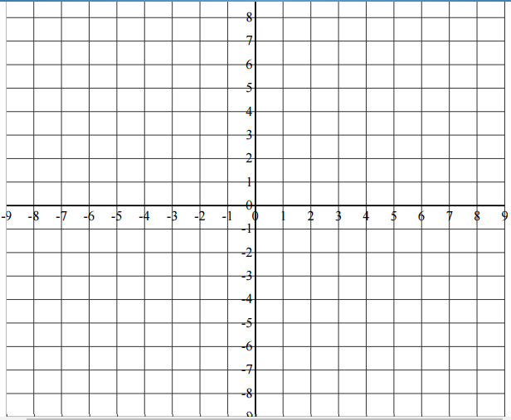

First plot on Cartesian plane
R
$$θ$$

Slide 10
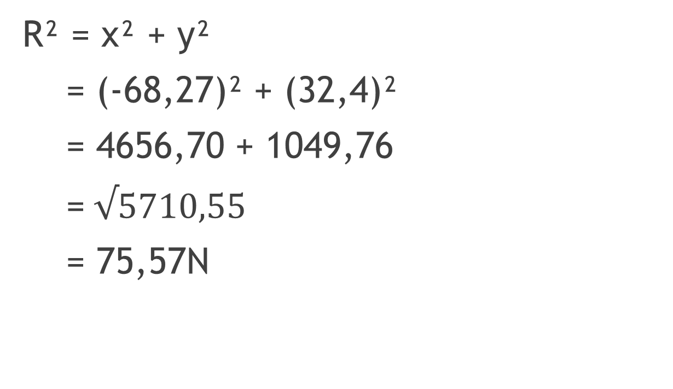
Resultant by using Phythagoras
R² = x² + y²
= (-68,27)² + (32,4)²
= 4656,70 + 1049,76
=$√5710,55$
= 75,57N

Slide 11
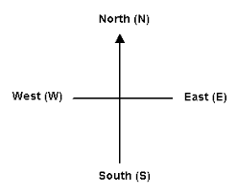
Direction of Resultant
Determining the direction, you must understand the compass

Slide 12
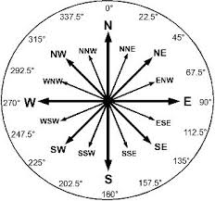
Bearings on a compass

Slide 13
Now apply compass to Cartesian plane

Slide 14
First plot on Cartesian plane
N
R
$$θ$$
W
E
S

Slide 15
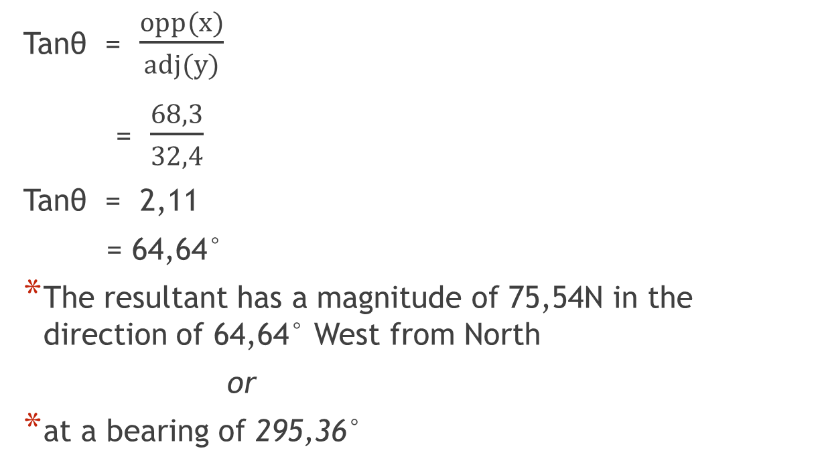
Calculate the direction of Resultant
Tanθ = $\frac{opp(x)}{adj(y)}$
= $\frac{68,3}{32,4}$
Tanθ = 2,11
= 64,64°
The resultant has a magnitude of 75,54N in the direction of 64,64° West from North
or
at a bearing of 295,36°

Slide 16
Questions ??

Slide 17
Thank You

